Slide 1
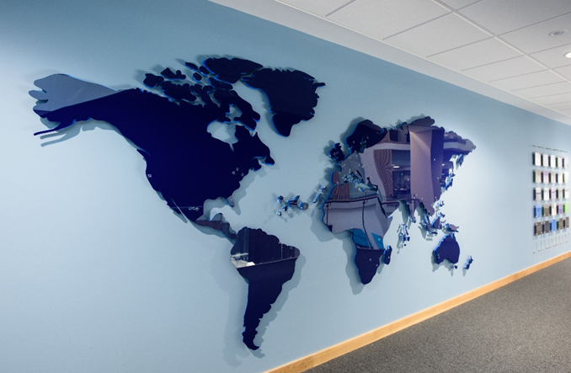
Presentation by
Externally Examining Partnership Provision
Fiona Jordan
Associate Dean – Strategic Partnerships (FBL)
Helen Dewar
Partnership Operations Manager
8th January 2020

Slide 2
Why we partner and how we choose who to partner with
Creating a global classroom to benefit students and staff
Choice based on strategic fit and academic quality
Extensive due diligence and approval process
Notes:
Internationalisation and external engagement strategies
International:
Students studying UWE programmes in-country
International students studying our programmes in Bristol
Creating a network to provide opportunities to learn with and from those from different cultures and backgrounds
Network gives opportunities for staff and student exchange and research collaboration
Global insight essential for today’s graduates
Local:
Partnering to provide innovative programmes to meet the needs of industry
Prior to approval full due diligence is completed to assess strategic fit and academic quality
For partnerships on a franchise basis (the majority of collaborative programmes) local staff, approved by UWE, deliver and assess modules
UWE provide partners with staff development, academic and administrative support and undertake quality assurance of modules and programmes

Slide 3
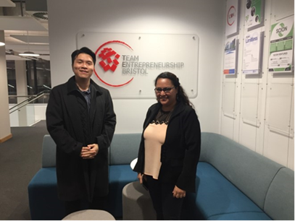
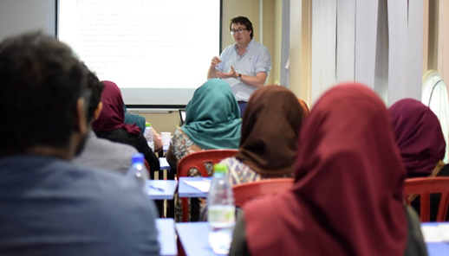
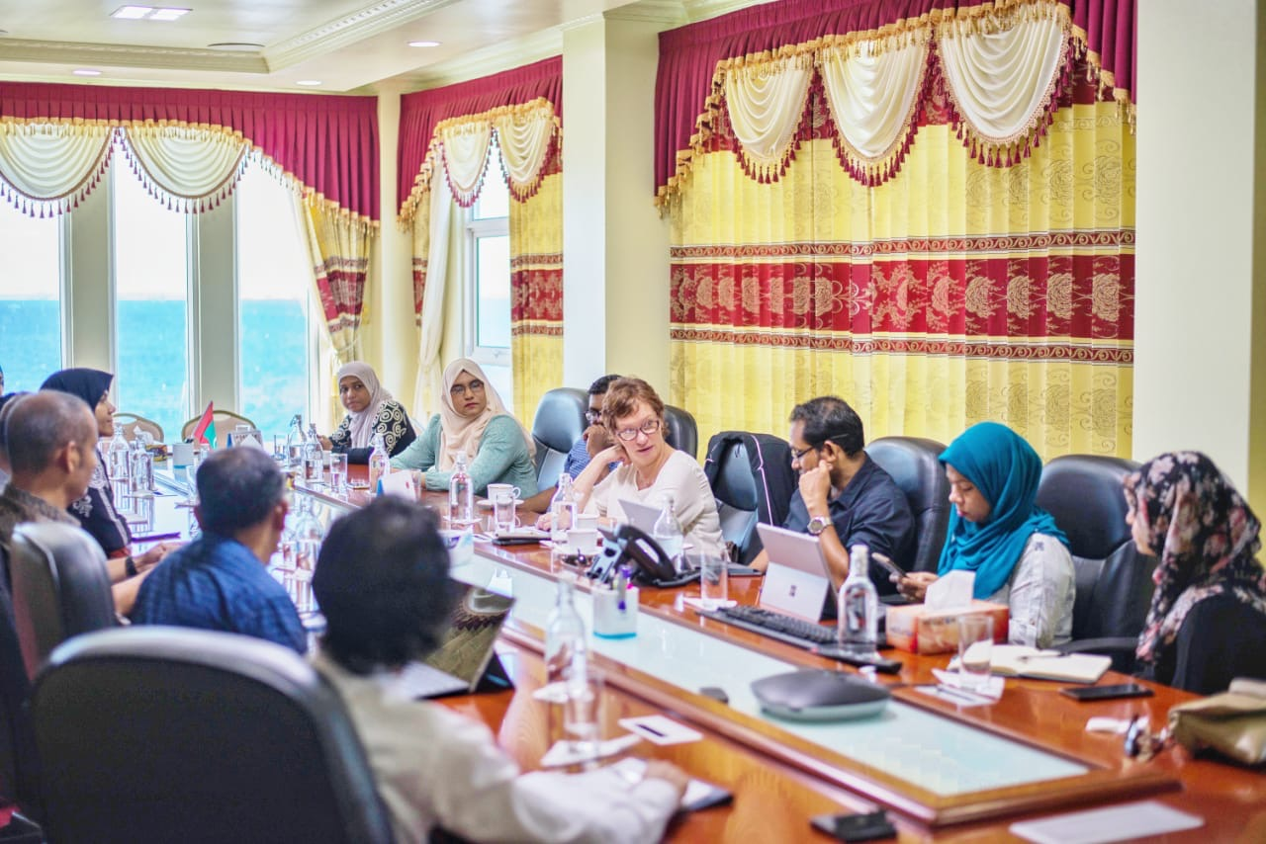
Support for partnership working
Link Tutors
Partnership Leads
Staff development
Annual monitoring
Notes:
UWE Link Tutor(s) act as relationship manager/s liaising with academic and administrative staff and carrying out staff development
UWE Partnership Lead oversees the strategic partnership relationship
Administration and regulatory oversight is undertaken by dedicated staff in the UWE Partnership Operations team - an annual operational calendar is produced for each partner
Annual monitoring
•Partner module reports and annual programme reports are produced and reviewed in the same way as for UWE.
•As part of the annual monitoring process, external examiner feedback is considered by UWE Partnership Leads and action plans drawn up
•UWE Link Tutors work with partner staff to respond to any moderator or external examiner issues through activities such as-face-to-face and virtual staff development, early moderation of small initial samples, sharing of more detailed indicative responses and ‘model’ answers
•There is funding available for teaching exchanges with all franchise partners to further enable sharing of practice
Key role of external examiners
- why EEs need to report on individual partners in EE reports. EEs report in same report template.
- what happens to their feedback - read by colleagues, included in partnership reports. Should be included in departmental reports and action plan. Included in annual report to academic board. Report stats relating to CP shared and discussed at CP sub committee
- partners see EE reports and their feedback, as well as the action plan

Slide 4
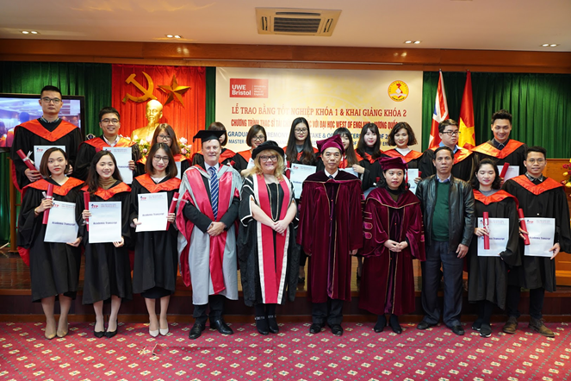
Delivery and quality assurance of partnership provision
Shared module materials
Moderated assessments
Joint examination boards
Notes:
Delivery
Partners deliver the same materials as at UWE, with in-country contextualisation where appropriate
Partner staff have access to all module materials on the relevant UWE module Blackboard sites
Module leaders at UWE are encouraged to engage in dialogue with their counterparts at the partner to support delivery
Assessment
Where possible, partner module delivery and assessment is aligned with that in Bristol
Where there are multiple intakes (eg. up to three per year) either additional assessments are set by UWE staff or are drafted by local staff and approved by UWE module leaders. Assessment briefs and exam papers for partners are usually the same as those for students in Bristol - contextualisation is subject to UWE module leader approval of any variation to the brief/paper
Assessments (including exams) are first and second marked at the partner and a sample moderated by the relevant UWE module leader. The moderation process is designed to assure that the standard of marking and quality of feedback is consistent with that of students studying the modules in Bristol
Exam boards
Partner Examination Boards generally take place separately from the Bristol-based provision (simply because of the limited time available to conduct boards)
Board Chairs are drawn from a limited number of experienced academic staff who are very familiar with the university’s regulations to ensure consistency
Relevant partner and UWE module leaders, programme leaders, link tutors and external examiners are invited to attend either in person or by Skype (though it is acknowledged that clashes with main UWE boards and the frequency of partner boards may limit attendance)
Boards are held by video conference to ensure that there is dialogue between partner and UWE staff and that any issues with individual students or with module/cohort performance are discussed.
UWE External Examiners are encouraged to attend Partnership Boards to gain understanding of how the quality assurance for partners is undertaken. Skype is frequently used to facilitate this
Consideration is given to quality assurance issues such as pass rates, good honours, trend data and consistency of performance with UWE provision

Slide 5
A dedicated team
Notes:
Each faculty has a student administration team – these look after UK partner provision, including degree apprenticeships.
Fifth student administration team with the expertise to support International partnership provision.
Work across differing national and organisational cultures.
Work with cross faculty partnerships.
Drive the quality monitoring processes, maintain the student record and assure academic regulations are consistently applied

Slide 6
Working with differing norms
Standard UK Academic Year
Non-Standard Academic Year
Notes:
Partners follow different academic calendars, not always UK norm approx. one third follows UK norm.
Different assessment papers –
Different field board meeting dates
Will contact EEs with a specific partnership comm – detailing partners they are involved with, dates of field board meetings, modules they are responsible for at each partner.
Not expected to attend all boards in person, video conference where possible, provide comments in writing in advance, be available by phone for the meeting if matters arise. Good for first hand experience of the quality assurance that is conducted.

Slide 7
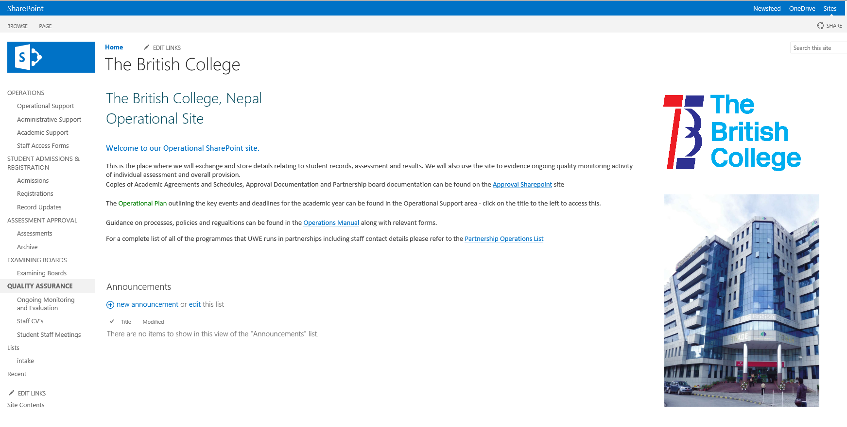
Tailored support
Notes:
Use Sharepoint for supply of partner assessment papers, assessment samples and managing shared record data. Secure site. Meets GDPR requirements.
Differs from the Blackboard system that is used for UWE provision and UK partners.
Provide links to areas where documents are stored
Ask you to complete comments on templates available on Sharepoint
Field board papers available through Sharepoint
If required partnership team are happy to provide further guidance on the Sharepoint system

Slide 8
Presentation by
Thank you for listening
Any questions?
Fiona Jordan
Associate Dean – Strategic Partnerships (FBL)
Helen Dewar
Partnership Operations Manager
8th January 2019

