Slide 1
Presentation by
Workshop
Using the
“Wisdom of the Crowd”
to Support Teaching and Learning in Higher Education
Janice
St. John-Matthews
Academic Director
Department of Allied Health Professions
07.06.2018
@jstjohnmatthews
Notes:
Coined by journalist Howe in 2006, crowdsourcing works through an institution outsourcing a function normally performed by an employee or group of individuals (Howe, 2006). However the notion of crowdsourcing continues to evolve. In the digital age crowdsourcing usually involves an open-call through participatory online activity, typically social media, providing a wider access to people internationally in less time and at a reduced cost than traditional methods (Schnek et al, 2005). Yet traditional outsourcing has been used for centuries and the practice of using the “wisdom of the crowd” can be traced back to Aristotle in the 4th century who explored the concept in his work titled “Politics” (Lord, 2013). The presenter for this session has a particular interest in crowdsourcing as through their doctoral studies, they are exploring the use of the tool in curriculum design processes. This seeks to capture the “expert by experience” voice in the development of a pre-registration healthcare curriculum through the development of an on-line community using crowdsourcing as the vehicle to achieve this. This session presents an opportunity to introduce the wider definition of crowdsourcing and how this fits with building community. The differences between crowdsourcing and concepts such as crowdlearning and crowdfunding will be highlighted. A standard conceptual framework for crowdsourcing and the challenges this presents when applied to the field of education will be shared. Examples of the use of the tool in medical and healthcare education will be presented. Finally the room will be crowdsourced on how individuals could harness “the wisdom of the crowd” via on-line learning communities to enhance the learning and teaching experiences in their respective disciplines.

Slide 2
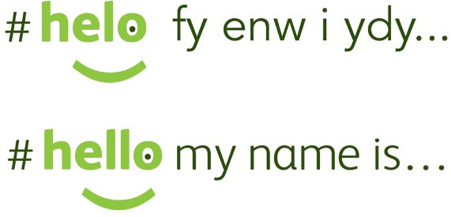
Introductions
Is crowdsourcing an effective method of gathering patient and pubic input in the design of an
undergraduate diagnostic radiography curriculum?

Slide 3
Workshop Roadmap
Using the “Wisdom of the Crowd” to support Teaching and Learning in Higher Education
Icebreaker
What is/ is not crowdsourcing?
Literature: Healthcare Education
Crowdsourcing applications
Crowdsourcing mechanics
Group Work
Students as co-creators
Acknowledgments
References

Slide 4
What is Crowdsourcing?
Works through an institution outsourcing a function normally performed by an employee/ group of individuals
Users, known as the crowd,
form a community who voluntarily undertake a task which typically involves the pooling of knowledge resources (Howe, 2006).
Creative, innovative, democratic providing a wider access to people internationally in less time and at a reduced cost compared to traditional methods (Schnek et al, 2009).

Slide 5
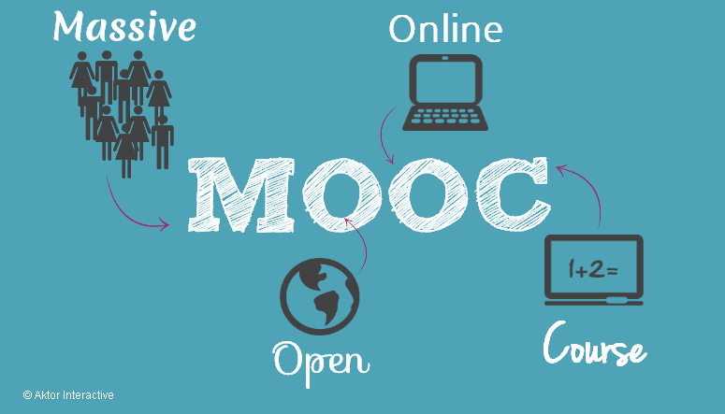
Crowdsourcing is NOT….
Crowdlearning
Crowdfunding
Notes:
With these changes, there is a shift in responsibilities from the course designer to motivated and self-directed learner-participants. Wikkis on M level module example.

Slide 6
Creative and innovative
Crowdsourcing the curriculum:
Public participation in redesigning a planning programme
(Evans-Cowley, 2011)

Slide 7
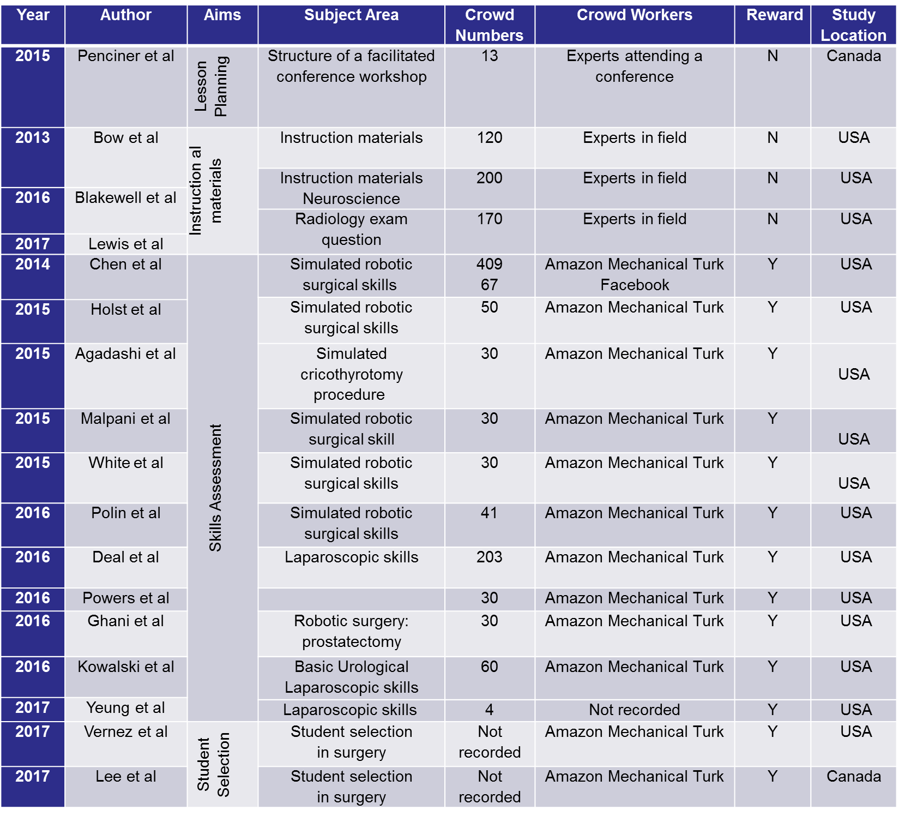
St. John-Matthews, Newton, Grant & Robinson, 2018
Notes:
Papers read and coded into subject areas and then into categories:
Lesson planning (n=1)
Instructional material design (n=3)
Skills assessment (n=11)
Recruitment/ selection of learners (n=2)
Further details obtained extracted: crowd numbers, crowd size and reward, study location
Papers US (n=15); Canada (n=2)
Study background information (authors, year, journal, and methodology) was collected for each article and data regarding crowdsource aims, sample numbers, crowd workers, crowd motivation and study location were documented

Slide 8
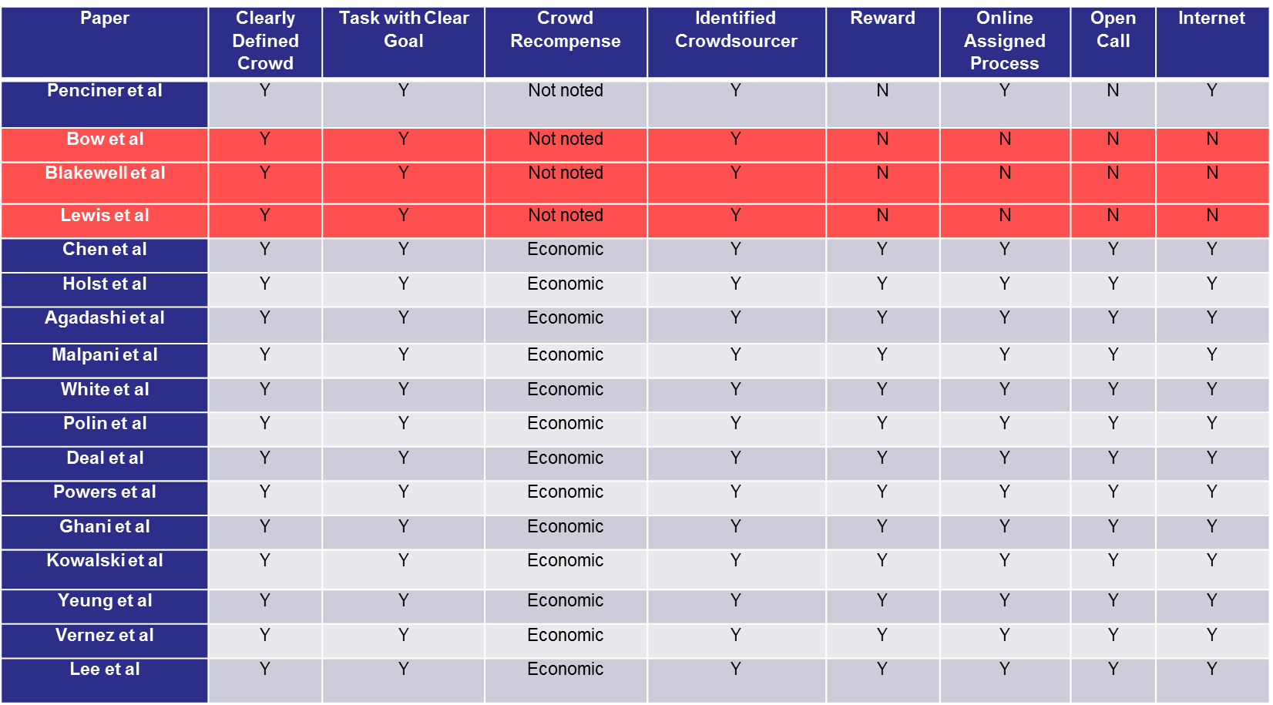
Applying a Verification Tool
Number list position 1
Number list position 2
Number list position 3
Estelles-Arolas & Gonzalez-Ladron-de-Guevara, 2015

Slide 9
Crowdsource Mechanics
Open versus pre-determined call
Type of community: spontaneous not usually sustained.
Tools used
Size of the crowd
Crowd motivations
Power dynamics
Of note papers discarded…

Slide 10
Group Work
How could you harness “the wisdom of the crowd” via spontaneous on-line communities to
enhance the learning and teaching
in your discipline?
Crowd n a large number of things or people gathered together
(Collins Concise Dictionary, 2018)

Slide 11
Addressing potential challenges in co-creating learning and teaching: overcoming resistance, navigating institutional norms and ensuring inclusivity in student–staff partnerships (Bovill et al, 2015)
Key Challenges:
Inclusion selection
Whose voices are heard?
Navigating institutional structures
How to manage large numbers?
Academic and/ or learners
Who are the experts?
? Enabler ?
Crowdsourcing
Notes:
At the
institutional level, challenges can be reduced by explaining that co-creation often leads to
more engaging and effective classroom practices and may shift the culture at departmental
level to a more collaborative one with a sense of shared responsibility for teaching and
learning. Similarly, providing institutional backing in the form of small-scale funding can
facilitate further co-creation and curriculum innovation.

Slide 12
Acknowledgements
Doctorate Supervisors
Professor Phil Newton, Director of Learning and Teaching Professor Andy Grant, Chair in Clinical Education
Swansea University Medical School
UWE Academic Directorate
Dr. Petia Petrova (Associate Director)

Slide 13
Questions & Answers
@jstjohnmatthews
https://janicestjohnmatthews.wordpress.com/about/

