Slide 1


Planning new neighbourhoods that are conducive to active travel CTS Symposium
Presented by
Dr Ben Clark, Dr Jonathan Flower,
Alex Painting, PJA
July 2025

Slide 2
Welcome
Overview of the Active Travel England Planning Advice Notes Project (~ 30 mins)
Planning active streets in new development that are suitable for adoption – Ben (UWE)
Planning new schools – Jonathan (UWE)
Providing cycle parking in new development – Alex (PJA)
Workshop carousel – 15 minute group activity on each topic area {~ 45 minutes)
Help us to identify
Barriers and enablers to good planning implementation
Evidence needs
Summary of workshop outcomes (~ 10 mins)

Slide 3
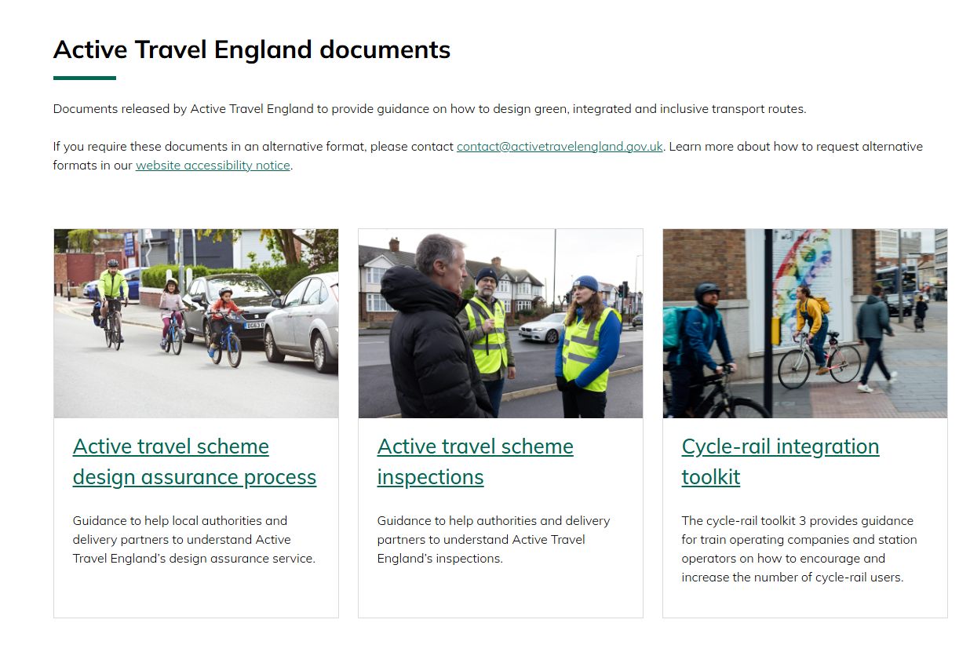
Active Travel England: New Planning Guidance
Active Travel England (ATE) are a statutory consultee on planning applications (>150 dwellings, >7,500sqm, >5 Ha)
ATE have identified a need to publish three new guidance notes (linked to development management) on:
cycle parking
planning new schools for active travel
managing the street adoption process
Intended audience includes professionals involved in planning, architecture, urban design, landscape architecture, transport planning and engineering; and local planning authority members

Slide 4

Development of the Guidance
Research and analysis
Case studies and good practice
Producing advice and standards
Complete
Due May 2025
Due Early July

Slide 5
Part 1: Active Streets and the Adoptions Process
Planning active streets in new development that are suitable for adoption

Slide 6
Local Authority Focus Group Insights
Successful outcomes for active travel in new development were found to be linked to:
Principles - agreeing and achieving consistent application of street design principles across teams working in different disciplines
Process – Effective management of planning process from pre-planning application to implementation
People – The right people, in the right roles, in the right teams, in the right organisational structures

Slide 7
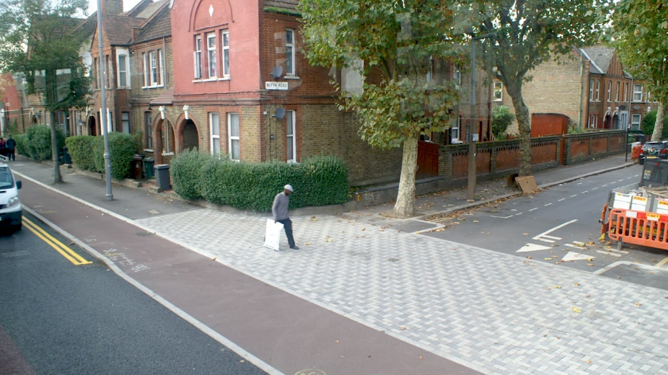
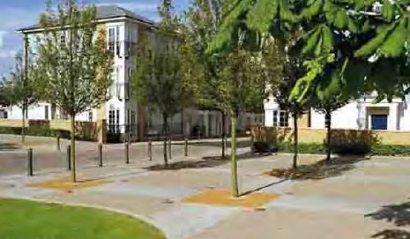
Principles: Competing or complementary objectives?
Tensions can arise between what appear to be competing objectives:
Competition for space for and investment in
active travel infrastructure
parking
dwellings (the bottom line)
Biodiversity Net Gain
SUDS
Different perceptions within planning authorities on whether AT design principles are appropriate / viable
Tight geometry / restricted visibility is not safe(?)
Tight geometry prevents access for bin lorries and emergency vehicles(?)
Surface treatments are too expensive to maintain (?)
The needs of people with visual impairments are not met (?)

Slide 8
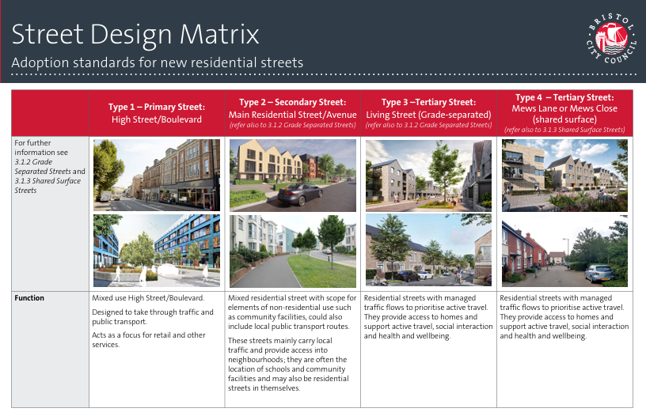
Principles: Achieving a consensus across teams
Spatial planning
Environment and urban design
Transport planning
Highway maintenance

Slide 9


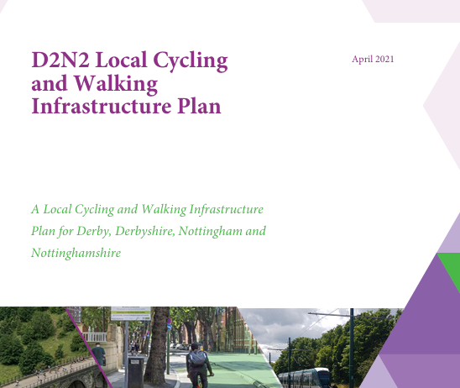

Principles: A coherent strategy for building out a network

Slide 10
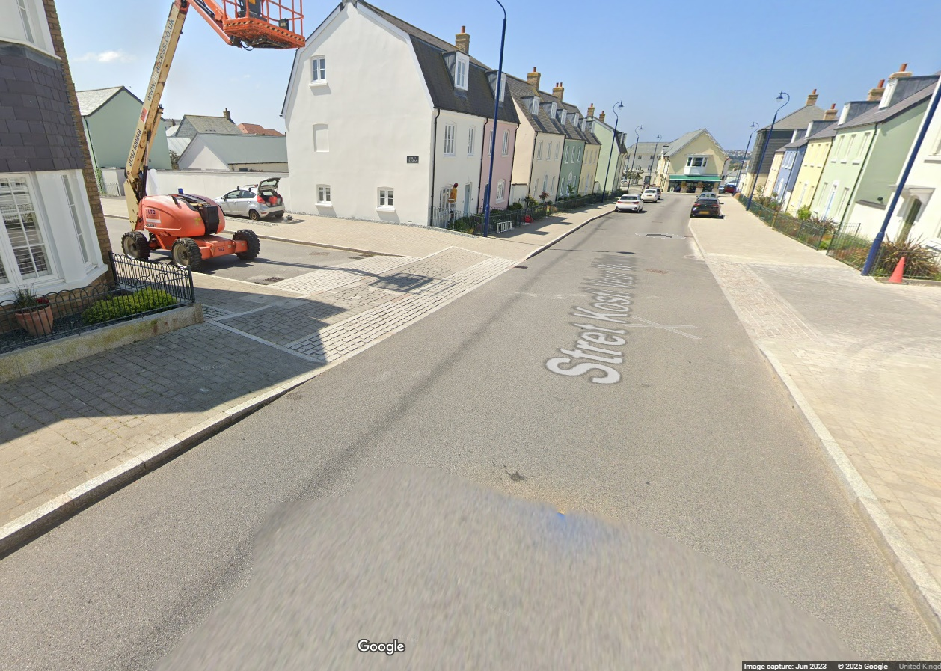
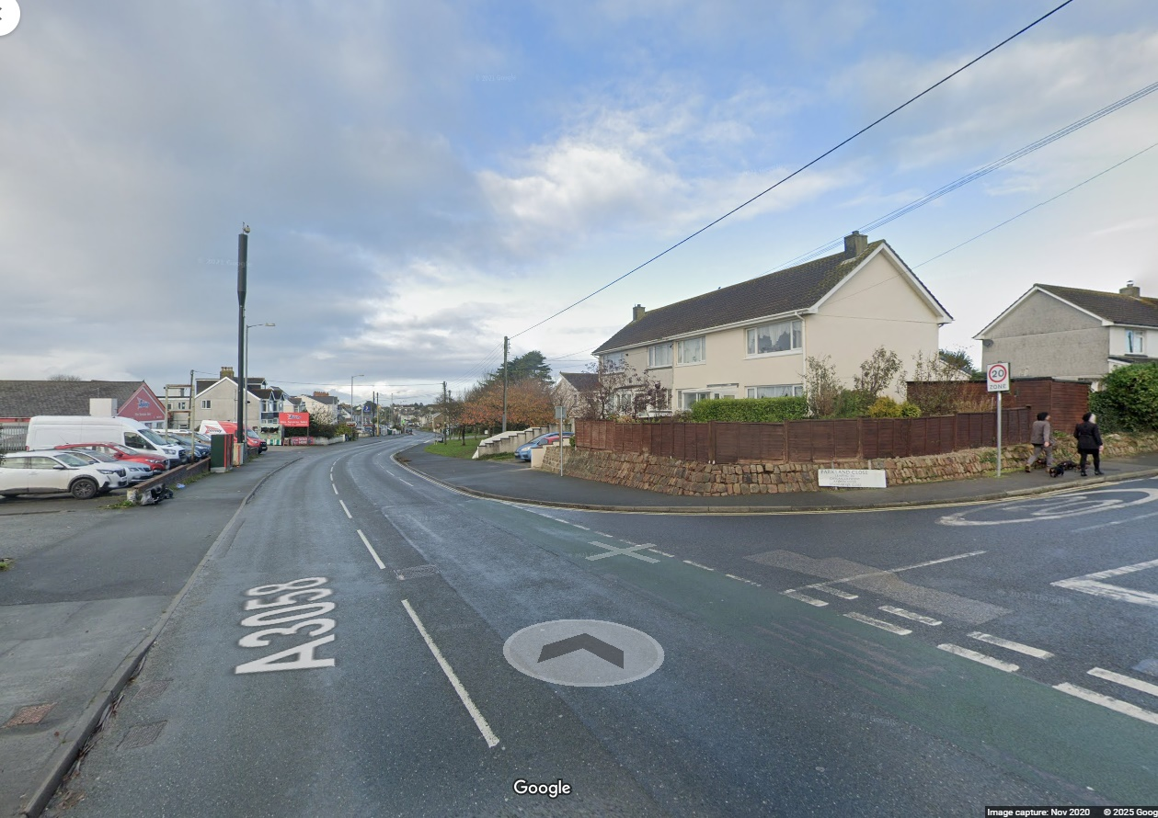
To avoid ‘islands of best practice’

Slide 11
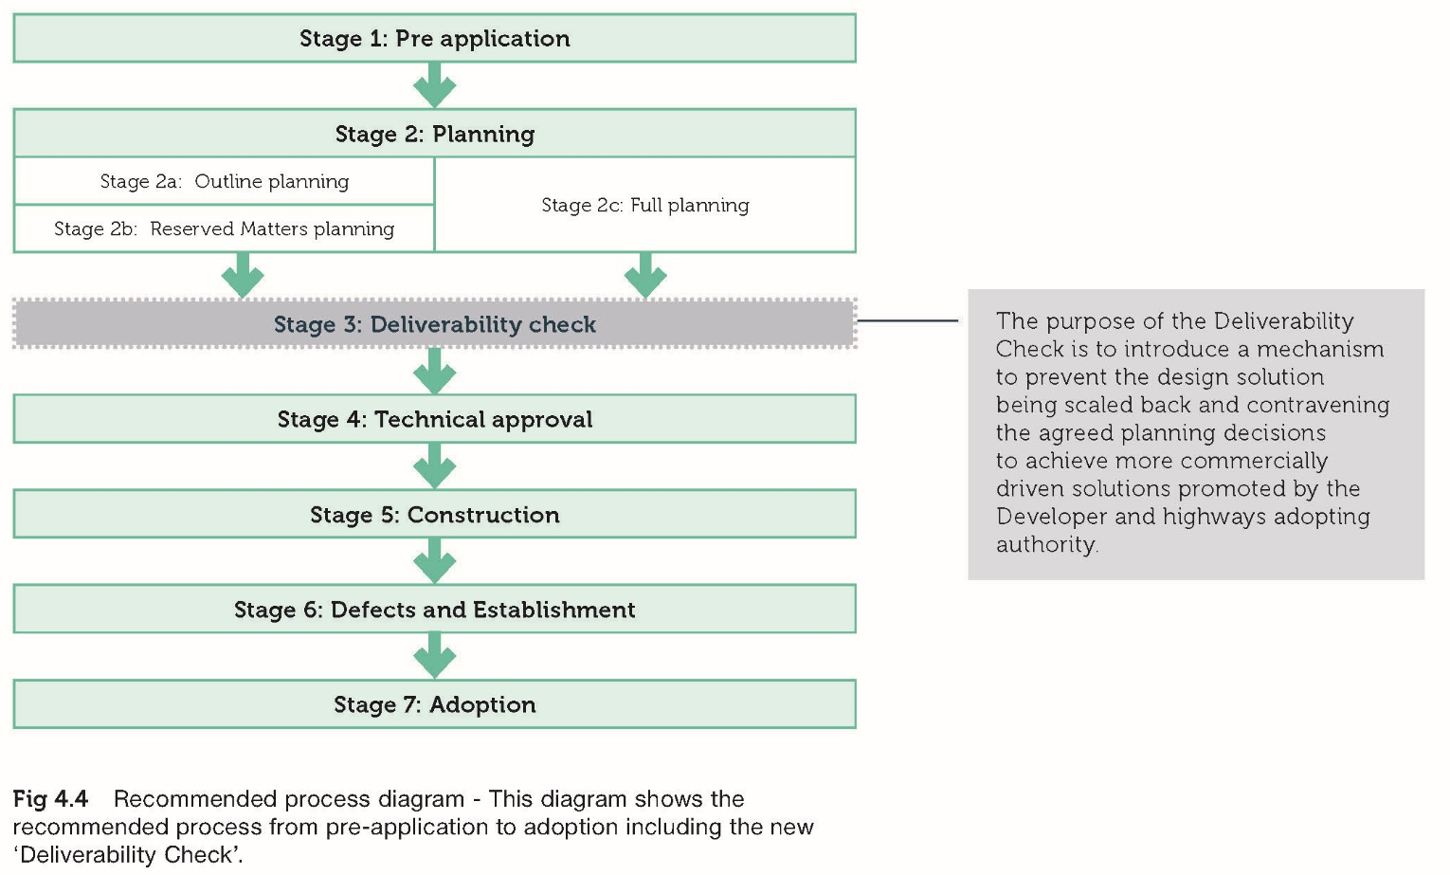
Process: The planning implementation timeline
Some necessary conditions for successful active travel outcomes:
Early engagement between developers and planning authorities
Early agreement of design principles between all stakeholders (at pre-application stage)
Consistent application of design principles through all stages from pre-app through planning consent to implementation
Time and cost-efficient management of the planning timeline

Slide 12
People: Organisational structures
Retain expertise and capacity within local planning and transport authorities.
Avoid outsourcing key functions (like technical approval of street designs)
Breakdown silos - Adopt organisational structures that bring together planning, urban design, environment, public health, transport planning and highway maintenance
Co-locate people in the same buildings to enable relationship building and facilitate day-to-day communication

Slide 13
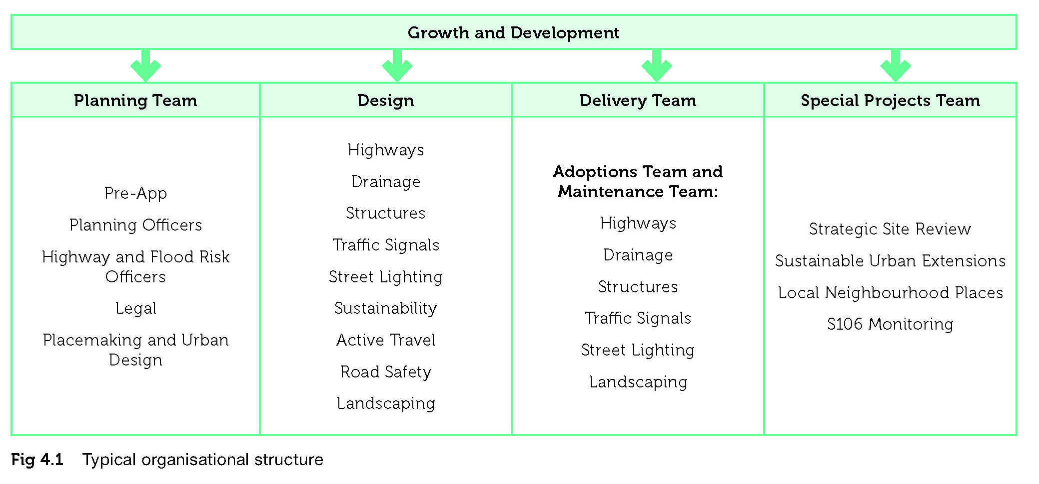
Organisational structure

Slide 14
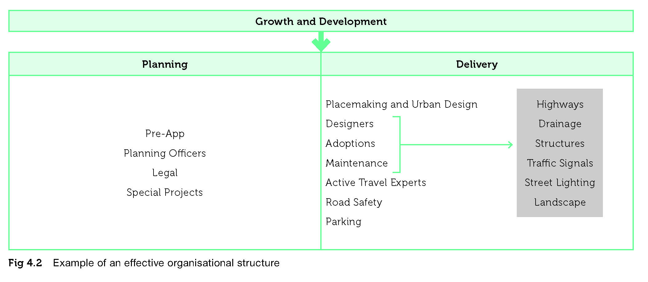
Recommended effective organisational structure

Slide 15
Part 2: Enabling Active Travel to Schools
Creating schools and their environments that prioritise the needs of children over vehicles.

Slide 16
Research
Evidence assessment of the impacts of active school travel (AST)
Carried out by Sheffield Hallam University’s Centre for Regional Economic and Social Research
A review of ATE consultation responses
ATE provided an initial long list of 250 planning applications that included schools
Any not reviewed by ATE or that did not require a review were remove
Created a short-list of 18 ATE consultation responses for review
Focus group discussions with stakeholders involved in the planning process of schools

Slide 17
Evidence assessment of the impacts of AST
The social determinants of AST
Socio-environmental factors and socioeconomic status
Attitudes and behaviours
Age and gender
The health impact of AST
Mental health
Physical health
Air pollution
Sleep quality
Cognitive development
AST interventions – cycle training
AST interventions – School Streets

Slide 18
Consultation Responses & Recurring Themes
Site no. | Type of School | Type of build | Themes mentioned
 |  |  | Cycle / scooter parking | Crossing | Access to Public Transport | Trip end facilities | Off-site active travel infrastructure | Route Audit | Site layout | Travel Plan | Active travel access | Drop off
1 | Primary | Extension | ü |  | ü | ü | ü | ü |  | ü | ü | ü
2 | Secondary | Rebuild | ü |  |  | ü |  |  | ü |  | ü
3 | Secondary | Extension | ü | ü | ü |  | ü |  |  | ü | ü
4 | Primary | Other |  |  |  |  |  |  |  | ü | ü
5 | Primary | New | ü | ü |  |  | ü |  |  | ü | ü
6 | Secondary | New |  | ü |  |  | ü | ü
7 | Primary / SEND | New | ü |  |  |  |  |  |  | ü
8 | Primary | New |  |  |  |  |  |  | ü | ü
9 | All through | New | ü |  |  |  |  |  | ü | ü
10 | Secondary | New | ü |  |  |  |  |  |  | ü
11 | Primary | New |  | ü |  |  |  |  |  |  |  | ü
12 | Primary | Rebuild | ü |  | ü | ü |  |  |  |  | ü
13 | SEND | New |  |  |  |  |  |  |  | ü
14 | Primary | New |  |  |  |  |  |  | ü |  | ü
15 | Primary | New |  |  |  |  |  |  | ü |  | ü
16 | Links between site and a secondary school | Other |  | ü |  |  |  |  |  |  | ü
17 | Further education college (19+) | Other | ü |  |  |  |  | ü |  | ü
18 | Site encircles a new school | Other |  | ü

Slide 19
Role holders & organisation types in the FGDs
ID no. | Role | Organisation type
FG1-1 | Principal Transport Planner | Local Highways Authority
FG1-2 | Senior Manager | Homes England
FG1-3 | CEO | Third Sector
FG1-4 | Planning Officer | Department for Education
FG1-5 | Development Officer | Police
FG1-6 | Head of Estates | Multi Academy Trust
FG2-1 | Highways Development Control Manager | Local Highways Authority
FG2-2 | Delivery Manger – Property Services (architect) | Local Planning Authority
FG2-3 | Strategic Applications Manager | Local Planning Authority
FG2-4 | Head of Design and Engineering | Third Sector
FG2-5 | Senior Planning Manager | Department for Education
FG2-6 | Principal Technical Planner | Local Highways Authority
FG2-7 | Technical Coordinator (ex-local planning authority) | Third Sector NB Developers took part in a separate research and analysis workshop

Slide 20
Comparison of emerging themes
Focus Group Discussion Theme | ATE Consultation Responses Theme
Travel Plans | Travel Plans
Cycle parking and facilities | Cycle/scooter parking
Location and access | Active travel access
Staff and pupil facilities | Trip end facilities
Public transport | Access to Public transport
Off-site active travel infrastructure | Off-site active travel infrastructure
Drop off and pick up spaces | Drop off
Park and stride and school streets | N/A, but referenced under off-site infrastructure
Car provision – access and parking | N/A
Funding | N/A not a focus, but referenced tangentially, e.g. to a Section 106 contribution
Early engagement | N/A, but a principle that ATE highlights from the National Planning Policy Framework (NPPF)
N/A, not raised specifically, but sometimes implied in off-site infrastructure | Crossings
N/A, not referenced | Route audit
N/A, not referenced | Site layout
Barriers to active travel | N/A not framed this way in the ATE consultation responses

Slide 21
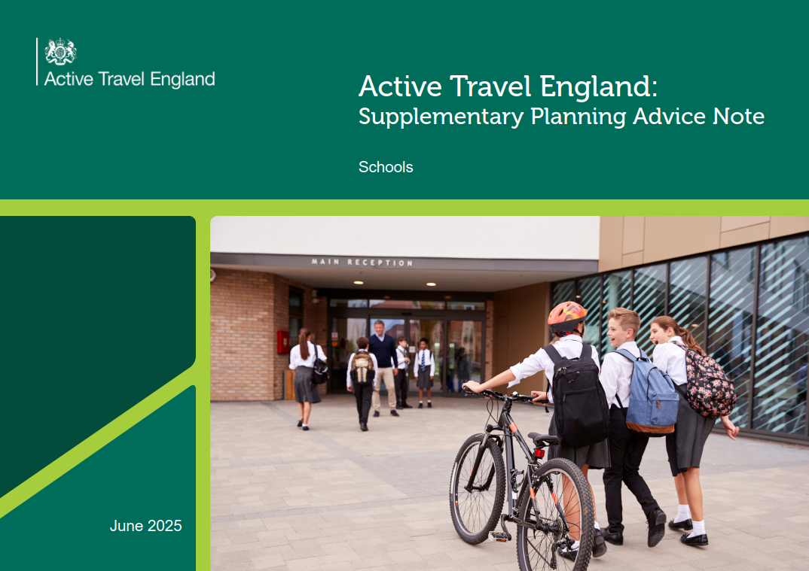
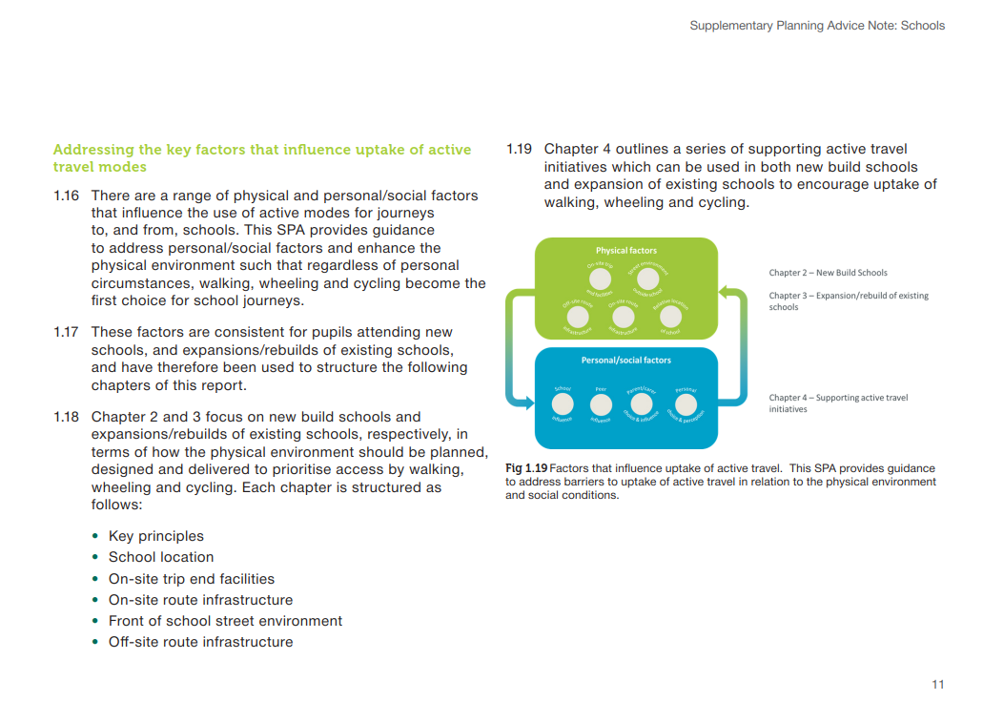
‘Look and Feel’

Slide 22
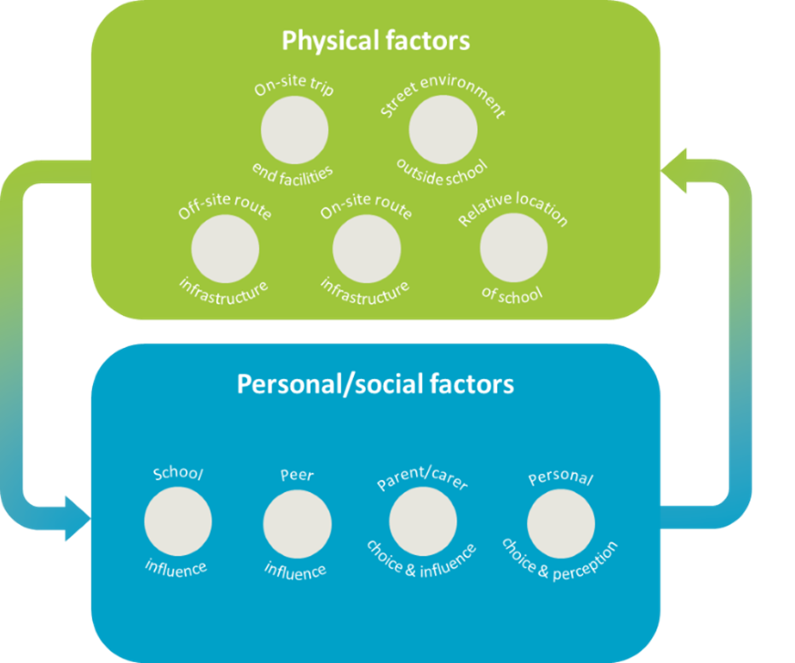
Structure/Content
1 Introduction
2 New Schools
Key principles
School Location
Front of school street environment
Off-site route infrastructure
On-site trip end facilities
On-site infrastructure
3 Existing Schools
Key principles
Assessing the potential for school expansion or rebuild.
Front of school street environment
Off-site route infrastructure
On-site trip end facilities
On-site infrastructure
4. Supporting Initiatives for Active Travel
Key Principles
Travel Plans
Walking/Cycling Buses
Park and Stride
Education
Bikeability Cycle Training
Cycle Playgrounds / Cycle Tracks
Other Initiatives

Slide 23
ATE’s Vision for New Schools
Places new schools as a central pillar within each well-connected, mixed-use development – co-located with essential services, transport interchanges and community spaces, and seamlessly integrated with active travel routes, public transport, and public spaces. The school will be a welcoming, car-free environment where all pupils are able to move, play and socialise safely, and parents/carers can gather with ease. The majority of homes served by the school will be a short walk or cycle from the main entrance, via a network of high quality, safe, accessible, direct and coherent active travel routes. These routes will spark curiosity and foster healthy trip making habits for pupils, parents/carers, and wider local community, alike. For those who must drive, well-located Park and Stride sites with designated walking buses will provide a fun, healthy and sustainable way of getting to school. The new school will provide a catalyst for use of active travel modes, and improved connectivity, health, and wellbeing within the local community.

Slide 24
Phasing
Initial Phase
Delivery of classroom capacity for initial on-site occupations and future proofed communal facilities e.g. sports facilities, assembly halls.
Land safeguarded for school’s expansion in later phases, as the wider development is built-out and occupied.
Later Phases
Phased delivery of additional classroom capacity to reflect the build-out and occupation of the wider development.
Initial Phase
Delivery of classroom capacity for initial on-site occupations and future proofed communal facilities e.g. sports facilities, assembly halls.
Land safeguarded for school’s expansion in later phases, as the wider development is built-out and occupied.
Later Phases
Phased delivery of additional classroom capacity to reflect the build-out and occupation of the wider development.
Temporary Expansions to existing schools should be avoided wherever possible. This will ensure that pupils residing within the development are not travelling long distances which could limit the uptake of active travel modes.

Slide 25


School Location
Primary Schools:
Majority of residential community served should be located within 800m and accessible by active modes.
Secondary Schools:
Majority of residential community served should be located within 2km and accessible by active modes.
SEND schools, standalone faith schools or schools in rural areas are likely to have wider catchments and therefore the above distances may not apply in these cases.

Slide 26
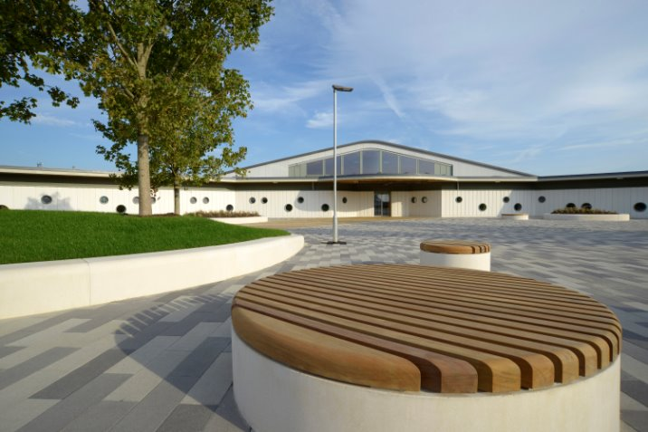
Front of School Street Environment
The frontage of new schools within wider mixed-use developments should be motor vehicle-free with vehicular access provided to the rear of the school for staff/visitor car parking, servicing and deliveries, and drop-off/pick-up for those with mobility impairments, if necessary.
Incorporate street trees and urban greening, alongside seating and play equipment
Provide an attractive area of public realm
Provide direct connections onto off-site routes to surrounding new and existing residential communities

Slide 27
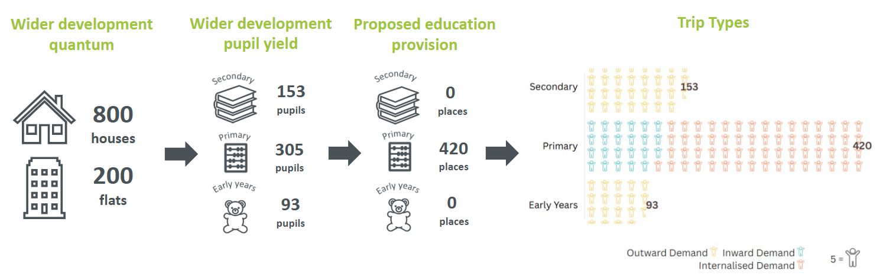
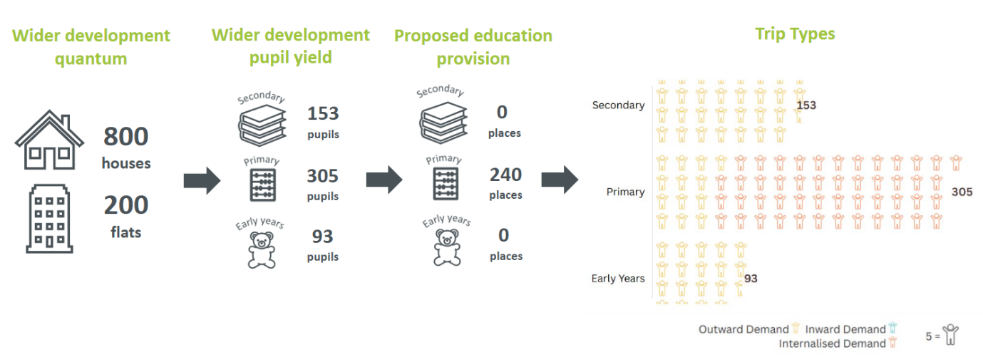
Off-site route infrastructure – Defining Routes
Example 1 – New school where proposed pupil capacity exceeds pupil yield from wider development
To define key desire lines to and from new schools, consideration should be given to the number of trips generated by each of these trip types, and the routes these pupils may take:
Standalone new schools:
Inward demand
New schools within wider development sites:
Internalised demand
Outward demand
Inward demand
The level of internalised, outward and inward demand for new schools within development sites should be ascertained using the DfE Pupil yields data, by housing type.
Example 2 – New school where proposed pupil capacity is less than the pupil yield from wider development

Slide 28




On-Site Trip End Facilities
Cycle Parking:
Advice on the number of cycle parking is provided within the ATE Cycle Parking SPAN
Showers/Changing Rooms:
Staff: minimum of 2 showers and 2 changing areas for separate genders. One locker/secure storage area per staff member.
Primary Pupils: one locker/secure storage facility per pupil
Secondary/Post-16 Pupils: a minimum of 2 showers and 2 changing areas for separate genders. One locker/secure storage facility per pupil.
Waiting Areas:
A sheltered waiting area with seating should be provided in the vicinity of the school entrance.
Waiting areas should include seating, be well lit and located with high levels of natural surveillance.
Waiting areas could be located with cycle and scooter parking provision.
Car drop-off and pick-up provision:
Car drop-off and pick-up areas should not be provided at new schools. Provision should be restricted only to those reliant on car travel such as those with disabilities.
SEND schools and schools with SEND provision should provide well-designed, secure on-site drop-off and pick-up areas aligned with the demand and needs of pupils.
The need for drop-off and pick-up areas for standalone rural, faith and independent schools should be considered on a case-by-case basis.

Slide 29


On-Site Infrastructure
Access Points:
All new schools should have segregated active travel and vehicular access points to minimise the potential for conflict between pedestrians, cyclists and motor vehicles.
The location of active travel access points should meet the desire lines of pupils, including those using off-site Park and Stride locations and walking/cycle bus routes.
While having multiple active travel access points can be beneficial, these should be clearly signposted, well-secured and monitored.
Vehicle access points should desirably be located to the rear of the school, segregated from the pedestrian and cycle access points.
Routes:
Dedicated routes for pedestrians and cyclists through the new school site should be provided.
These routes should be separate from any vehicular routes.
All routes through the site should be of sufficient width and located such that the cycle/scooter parking area is freely accessible from the street or cycle path beyond the school boundary without the need to dismount before reaching the cycle/scooter parking area.

Slide 30
Supporting Initiatives for Active Travel
Supporting initiatives should be implemented at all schools to encourage active travel. Multiple initiatives should be delivered that complement each other, with consideration given to the budget, expertise and time required to plan and implement each initiative.
Travel Plans
Bikeability Cycle Training
Walking/Cycling Buses
Other Initiatives i.e.
Walk to School Week
Cycle to School Week
Cycle Playgrounds/Cycle Track
Park & Stride

Slide 31
Part 3: Cycle Parking
Ensuring that good cycle parking is embedded in site plans and is not an afterthought

Slide 32
The Brief
Cycle parking is an area identified by ATE’s Planning Managers as one of the most common issues when responding to planning applications.
No approved guidance beyond LTN 1/20.
Getting cycle parking right is critical to ensuring more journeys are made by cycle.
Need for evidence-based set of design guidance and standards for cycle parking and supporting facilities in a range of settings that LPAs could adopt.
Research and Analysis
Case Studies
Advice and Standards
Stakeholder Engagement

Slide 33
Research and Analysis
Develop an evidence base for any new strategies in line with user demand.
Understand whether and to what extent existing research demonstrates a link between the role of cycle parking and supporting facilities and modal shift, and the extent to which poor quality cycle parking and supporting facilities are a barrier to cycling.
Identify key findings on what factors are important considerations when designing cycle parking facilities.
Design Guidance
Non-Academic Research
Academic Literature

Slide 34
What we know... and what we don't
Mode Shift
Design Considerations
Security Surveillance and Theft
Needs to be more secure for longer duration of stay
Cycle Parking Management
Positive correlation between residential parking and liklihood of cycling
Positive correlation between high quality parking and cycling to work/stations
Positive impacts of promoting good parking practices
Abandoned cycles are a deterrent
Need to maximise visibility in for public cycle parking
Actual risk of theft is less than percieved risk
Requirements best known at workplaces and rail stations
Maximise visibility, protection, accessibility, proximity, integration, and diversification
Types of cycle other than bicycles pose more issues than bicycles
Shower facilities at workplaces
Cycle parking is important indicator of Bicycle Level of Service
Lack of cycle parking

Slide 35
What we know... and what we don't
Mode Shift
Design Considerations
Security Surveillance and Theft
Cycle Parking Management
Availability of residential cycle parking and cycle ownership
Requirements and design considerations in different urban contexts
Relationship between cycle parking and bus ridership
Need for an empirical review of good practice and its influence on preferences and behaviour
Relationship between cycle parking and cycle levels at aggregates scales
No empirical evidence on quantifying how much cycle parking is needed
Unknown demand for the use of cycles that are not bicycles
No literature on electric cycles
Effect of ancillary facilities is assumed
Little is known about the issue of effectively dealing with abandoned cycles in residential settings
Need for research on public cycle parking in relation to required durations of stay and requirements
Design principles for residential settings less well understood
Research needed to understand what design issues may influence risk of cycle theft
Little is known about cycle parking at schools and requirements for children

Slide 36
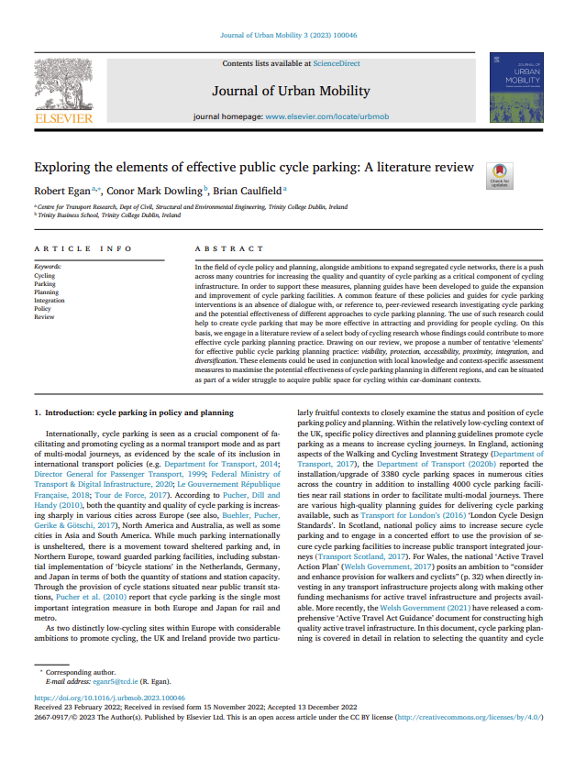
Egan, Dowling, and Caulfield (2023)
Proximity
Integration
Diversification
Visibility
Protection
Accessibility

Slide 37
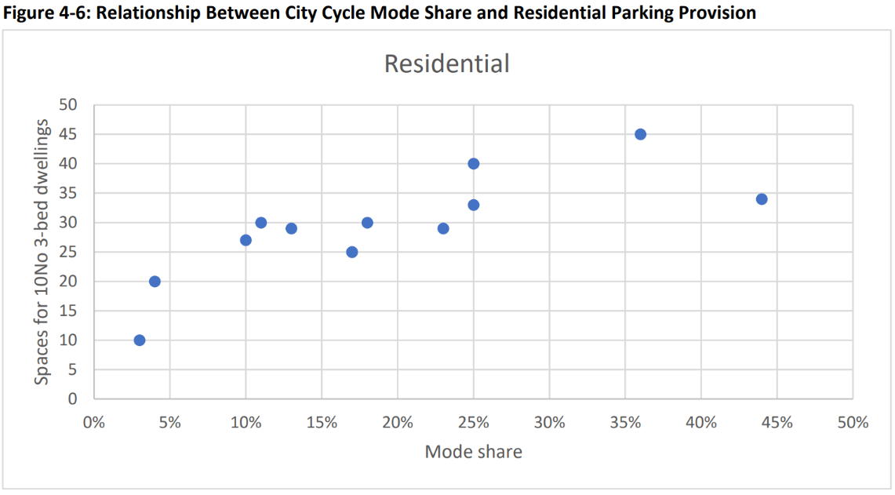
Kohlrautz and Kuhnimhof (2024)
Amsterdam
London

Slide 38
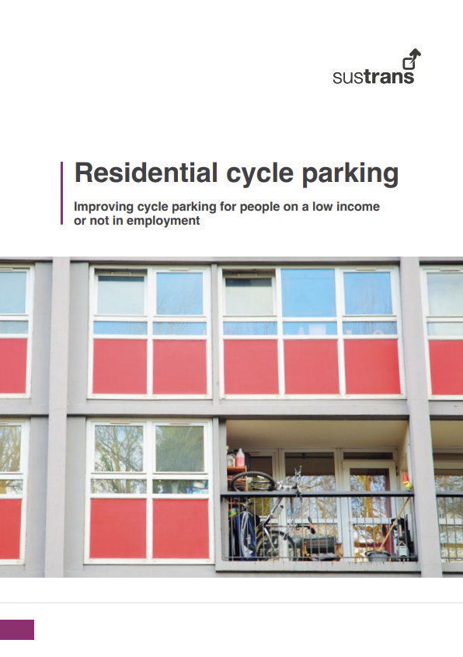
Sustrans (2024)
1.5 million people on a low income or not in employment have been put off buying a cycle due to accommodation restrictions, for example not having a secure, convenient place to park a cycle
32% of people on a low income or not in employment did not have a convenient and secure space to park their cycle at home (~3.7 million people)
39% of disabled people did not have convenient and secure space to park their cycle at home as well as 34% of women and 36% of people from an ethnic minority background
47% of people on a low income or not in employment said they would start cycling or cycle more if they had a place to park their cycle at home which was convenient, secure, safe, and accessible (~5.5 million people)
People who live in a flat are far less likely to have a secure (27%) or accessible (23%) place to store a cycle than people who live in a detached house (60% and 58% respectively).
15% of respondents had their own or knew someone who had had their cycle stolen from where they lived in the past 12 months

Slide 39
Case Studies
Residential
Commercial / Employment
Community Facilities
Education
Public Transport Interchange
Destination / Public Parking
A series of good practice case studies were compiled through collaboration with industry professionals.
Evident that while most cycle parking schemes incorporate good design elements, they often fall short in other areas.
Highlight specific design features, and the overarching goal is to illustrate the measures discussed through built examples and supports the content outlined in the framework documents.

Slide 40
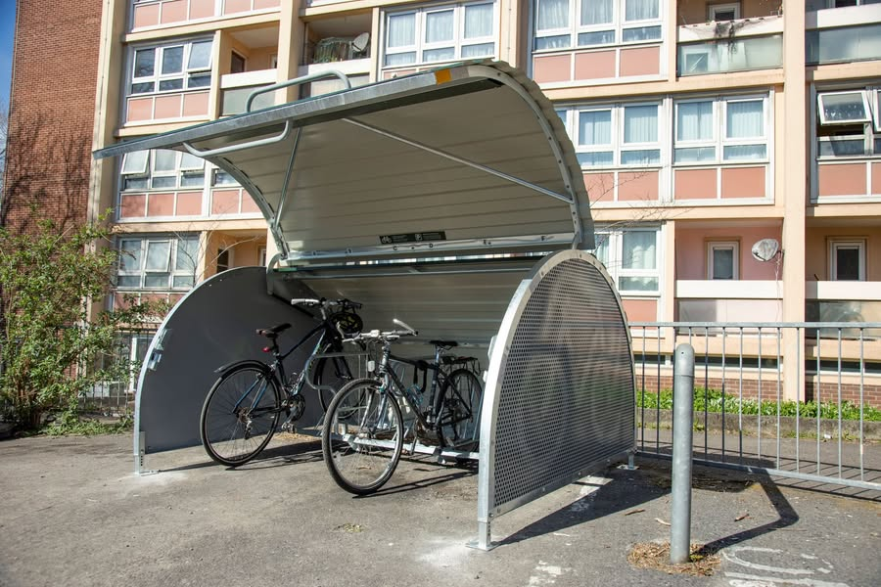
Case Studies: Residential
Dense Residential Accommodation, Bristol City Centre
31 cycle hangars installed at 16 council owned tower blocks sites in Bristol (186 cycles)
Sites with no formal cycle storage - cycles in hallway, flat, or balcony etc.
Transforming Cities Fund (£130,000)
Reallocation of hardstanding off the highway
Fewer barriers to delivery compared to installing on-street
Spaces and keys administered by Life Cycle UK

Slide 41
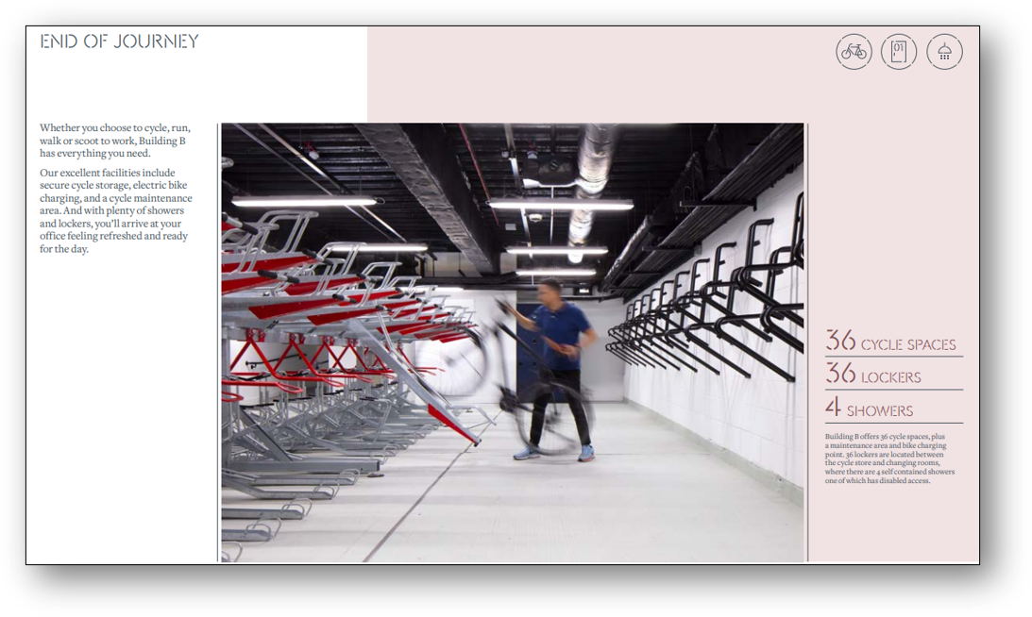
Case Studies: Commercial/Employment
Employment Location, Bristol City Centre
Separate bike entrance
Provision for e-bikes with charging capability
40 segregated visitor spaces

Slide 42
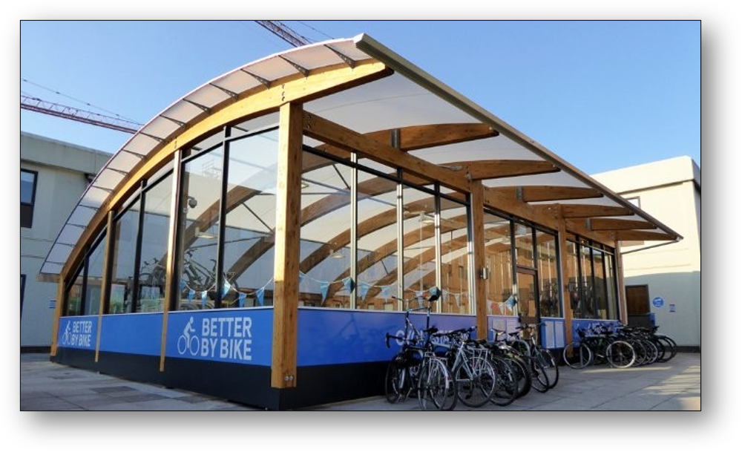
Case Studies: Education
Campus Facilities, UWE
See-through structure removes personal security risks. Completely enclosed structures may be intimidating for some users
Cycle hubs should be constructed using high quality and secure materials. Generally, they should avoid cheap timber, and metal rooves that can easily be removed, and non-secure door locking mechanisms

Slide 43
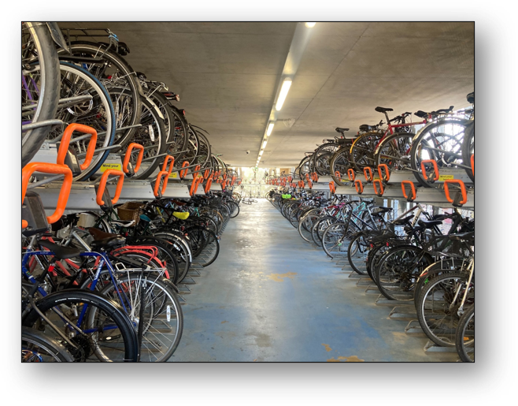
Case Studies: Public Transport Interchange
Cambridge Railway Station
3no. floors of cycle parking.
Currently in the process of retrofitting the cycle hub following a user survey issued by the station operators.
Ground floor safeguarded for dedicated cargo cycle spaces and accessible spaces for adapted cycles.
CamCycle have requested that classical music is played on ground floor to deter cycle thefts!

Slide 44
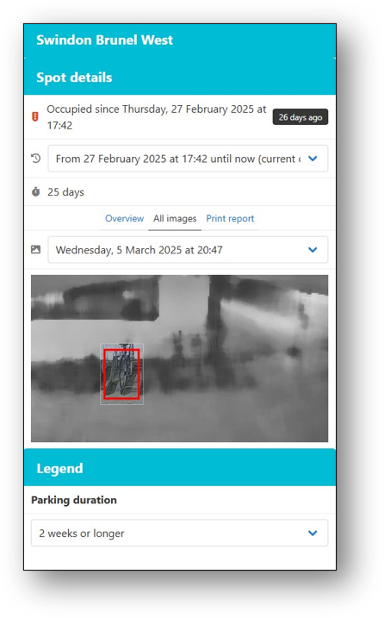
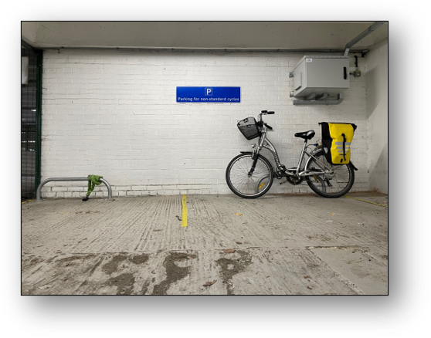
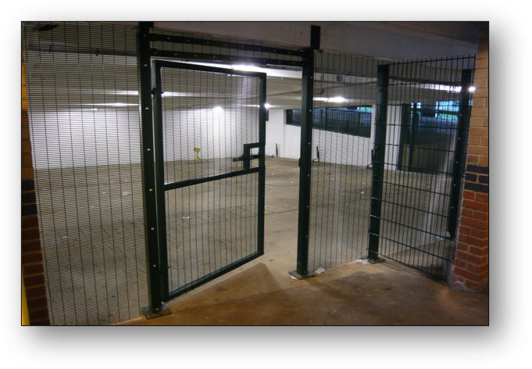
Case Studies: Destination/Public Parking
Swindon, Brunel Cycle Park (160 spaces)
24-hour access via an Access Card.
No daily charge but a one-off charge (£10) to obtain the Access Card. Proof of address required to assist with security.
Lessons learned – tailgating resulted in some theft. Introduced 'air-lock' door on second cycle park however some limitations with accessibility.
New technology used to identify abandoned bikes (left for more than 6 weeks).

Slide 45
Producing Advice and Standards
Recommendation for how cycle parking provision should be considered in the preparation of applications and how LPAs should assess an application in relation to cycle parking.
Theme of accessibility throughout – consideration to all types of cycles.
The quantity of cycle parking provision needs to relate to the future anticipated or targeted cycle parking demand.
Characterisitcs
Accessibility
Safety
Convenience
Type
Home
Destination
Transport Interchanges
Determining Demand
Design
Future Demand Estimation
Look-Up Table by Land Use

Slide 46
Processes
Vision-led approach
Specify the quantity of cycle parking required
Layout and design integral to overall design
Equivalent level of consideration to long and short-stay parking
Specify required standards
Designer knowledge and skill

