Slide 1
Local health impact of physical inactivity: a new JSNA toolkit
Jon Roberts, Chris Payne, Adrian Davis, Mark Dancox, Paul Brown, Phil Install
SW Public Health Training Scheme
Bristol City Council
NHS Bristol/NHS South Gloucestershire
Sustrans
South West Public Health Observatory

Slide 2
How much of a problem is physical inactivity in my area?
Question for the JSNA
How does the problem compare with smoking, road traffic injuries, pollution, alcohol?
No good source

Slide 5
Physical Inactivity PILL (Population Impact at a Local Level)
For each LA in England, shows local impact of physical inactivity on
All cause mortality
Coronary Heart Disease
Breast Cancer deaths
Colon cancer deaths

Slide 7
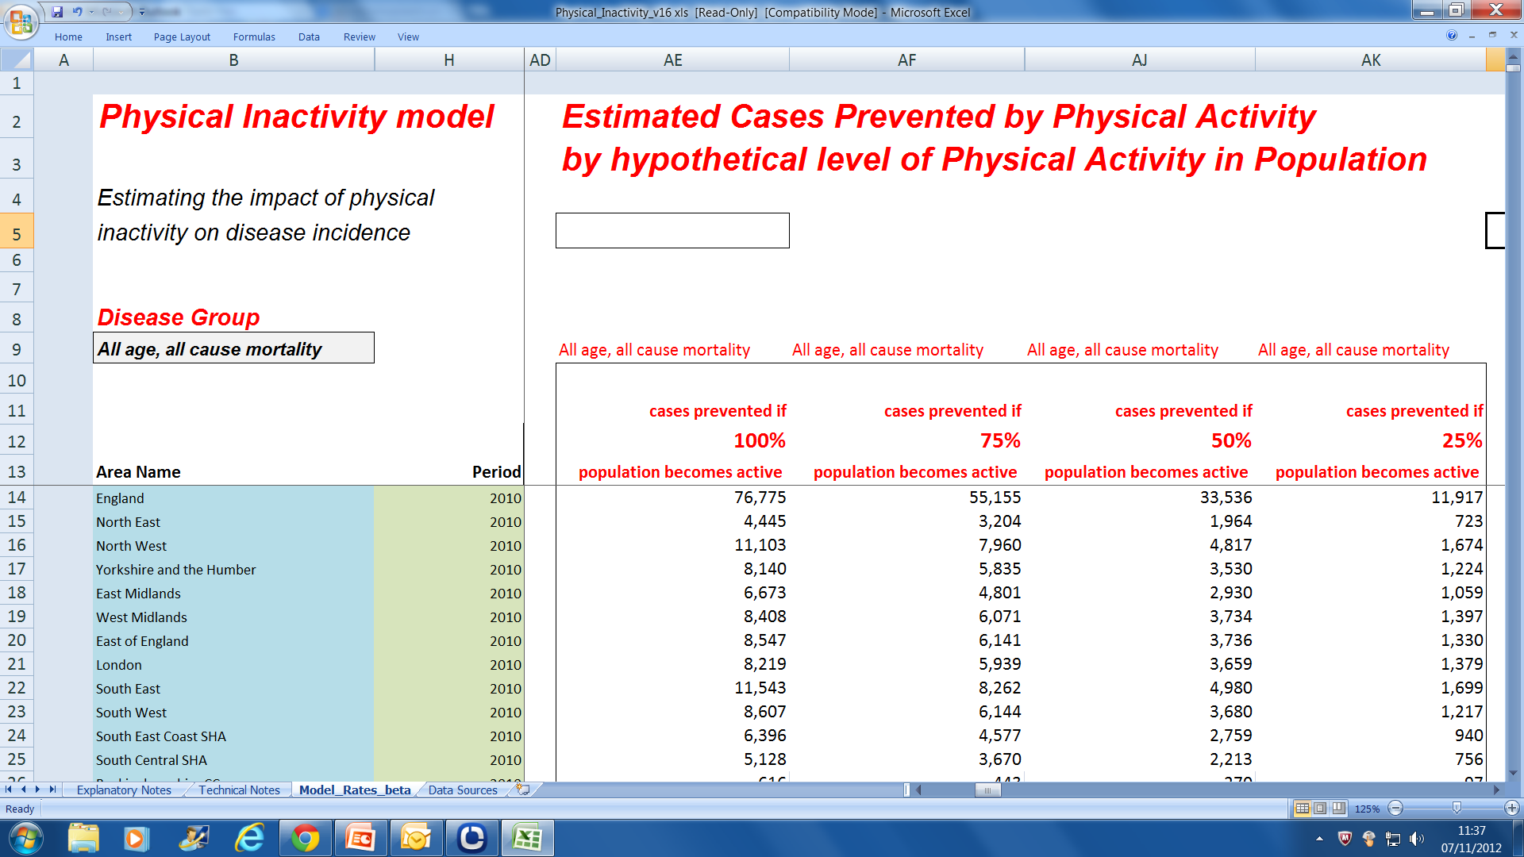
Physical Inactivity PILL

Slide 8
Questions
Will this tool help communicate health impact of physical inactivity?
How could it be best used at a local level?
What else needs to happen?
How to prioritise
a “user friendly” front end
health care cost data
other priorities?

Slide 9
Physical inactivity PILL
Will be published January 2013
http://www.apho.org.uk/

