Slide 1
University of the West of England, Bristol
Transferable model for academic workload management and TRAC reporting
Leadership Foundation Innovation & Transformation Project

Slide 2
Where is UWE now?
Initiated a project in 2009 to develop a UWE-wide Academic WLM
Implemented a common, university-wide academic workload management model – live from 2010/11, operational for 3 years
Spreadsheet-based, built in-house
Generate workload associated with teaching, research, management roles, other activities
Allocate that workload to academic staff
Record and communicate it

Slide 3
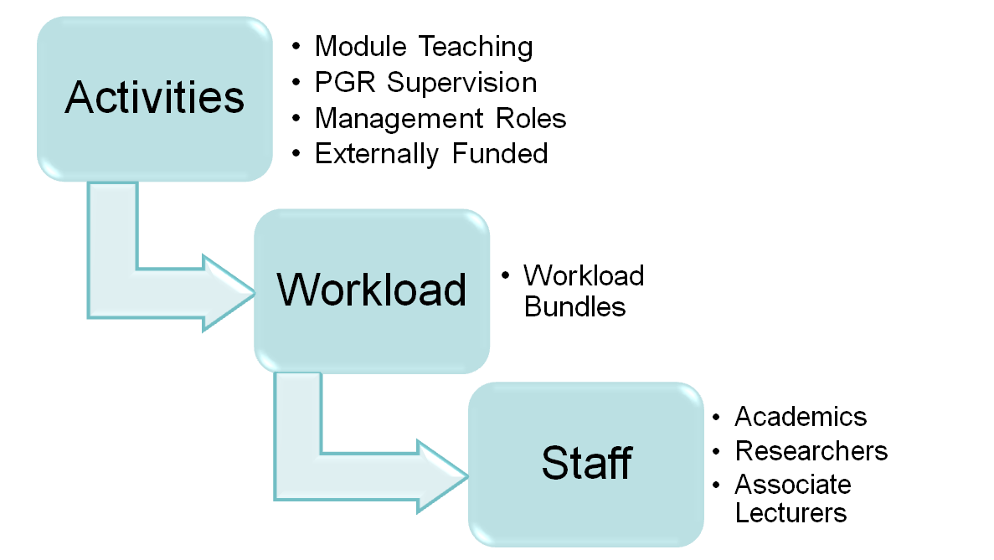
Generate, allocate, record workload
Generate
Allocate

Slide 4
Generating the resource-need ..
Teaching resource-need generated at module level by formula based on student numbers, credit, weeks. level. Split into delivery (lectures + small groups), assessment, management roles
Tariffs set for other management roles, PGR supervision, other - placements, field trips etc
External and internally funded research, KE etc converted from time into workload currency
Currency ‘bundles’ (550 = ‘full’ workload)

Slide 5
Workload Allocation Management System (WAMS)
Developed Web-based Academic Workload Management System over 2012/13 – ‘WAMS’, has replaced spreadsheet for 2013/14
Internal UWE project
Model the same - workload allocation and management plus TRAC data generation
Populated with 2013/14 data, initial workload allocated to staff, live from end of July

Slide 6
Benefits of a WLM?
Fairer, transparent, UWE-wide allocation & management of academic workload
Management of (human) resource allocation to different activities, the major resource cost: T, R (external/institutionally-funded), PGR, KE, assessment, management roles. Other
Alignment with objectives
Identifies individuals over/under-committed
Identifies departments, subject areas under/over-resourced – guides investment, disinvestment

Slide 7
And ...
Enabled institutional own-funded research (particularly PGR) to be contained and focused
Supported review of Academic Management Roles and containment of overall cost
Input to activity costing eg PGT
Activity analysis – professorial time, women’s research (Athena Swan)
Generates TRAC data – more reliable, ‘managed’ time, no need for TAS process

Slide 8
Generating TRAC time data
All activities mapped onto TRAC categories in WAMS system
Includes funded research, tagged by funder
Runs in background – invisible to staff, managers
Workload confirmation at start of year, discussed with manager (inc. PDR), signed off at year end
Completed audit – operational for 2012/13

Slide 9
Key points for implementation
Senior management commitment, sponsorship, follow through is crucial
Interdisciplinary, cross-university team
Good, professional project management
Staff consultation & communication including union consultation
Strong academic management: roles, training, communication – it is a tool for management
Professional support structure – business partners .....

Slide 10
Also ....
Single model – no variants for faculties, departments
Cases for different treatment at programme/module level – but close scrutiny and decision by Governance Group – also on tariffs, what included ..
Managing information/systems interface - freestanding versus integrated ....

Slide 11
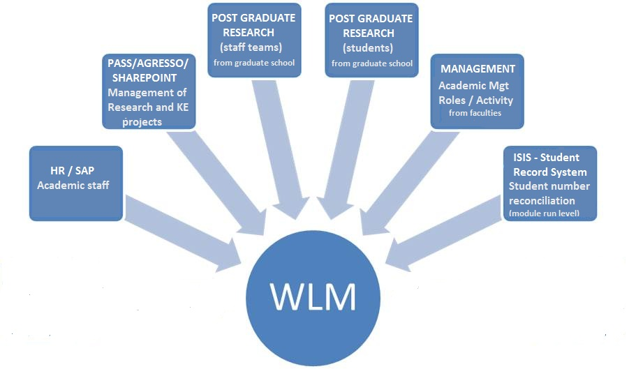
Links with other systems

Slide 12
Issues which remain ...
Still working on some aspects of the ‘human infrastructure’ – line management, particularly consistency of processes around discussing, recording, allocating workload
Not popular with some staff – feel micro-managed, lack of trust etc – cultural issues
At same time, some staff look for workload recognition for every last activity and variation of activity
Managing over/under allocation effectively

Slide 13
Also ...
Reinforced by staff union – ongoing issues:
Target v ceiling for overall workload
Activities not included
Activities under-accounted for
Danger of micro-management – catch-all buffer better
WLM becomes lightening rod for issues of management, overall workload, parity or lack of
WAMS itself on-track, well-used, popular

