Slide 1
Presentation by
Mapping the discourse of professional identity and values of journalism students, practicing journalists and industry.
Sally Reardon
University of the
West of England
Sally2.reardon@uwe.ac.uk
LearningForAll2017

Slide 2
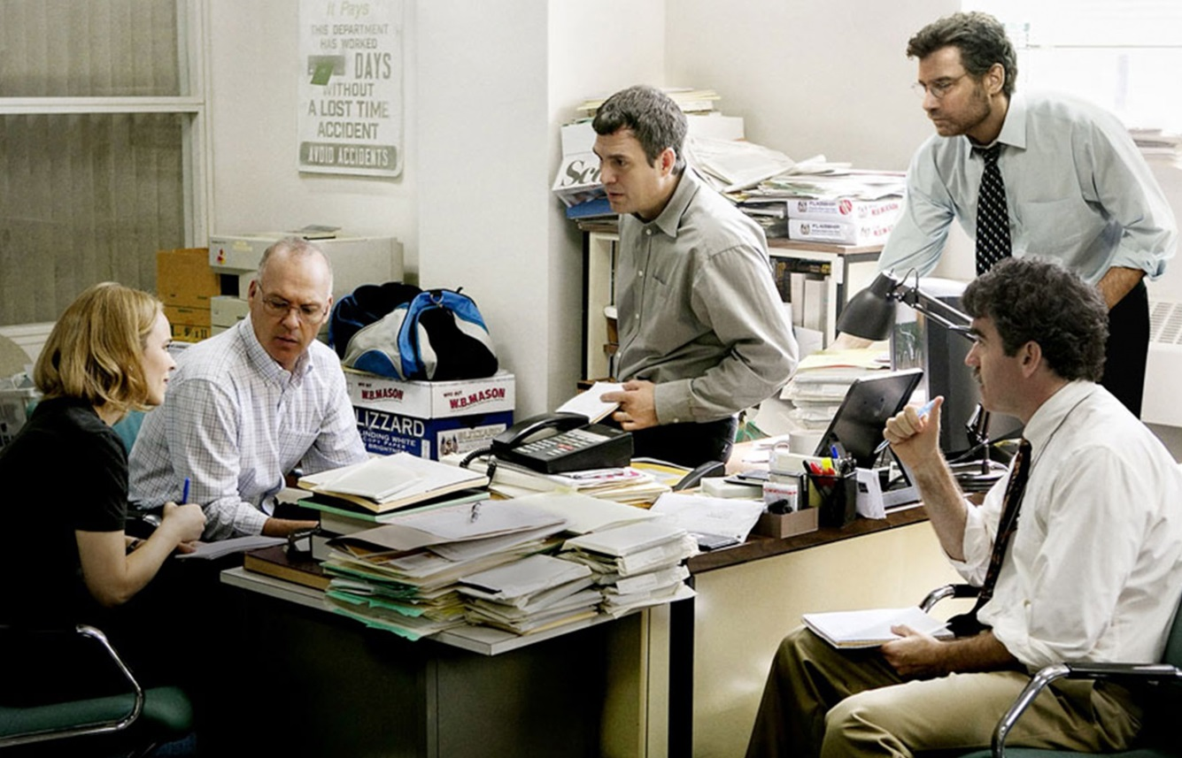
And a film quiz…
Presentation by
Sally Reardon
University of the
West of England
Sally2.reardon@uwe.ac.uk
LearningForAll2017

Slide 3
Output

Slide 4
Output

Slide 5
Production

Slide 6
What do they say?

Slide 7
Data
Education: The Broadcast Journalism Training Council (BJTC) website and the websites of 27 ‘Journalism’ degree courses accredited by the BJTC
Employers: Websites of 9 major broadcast journalism employers’ trainee and graduate schemes included.
Journalists: Interviews with broadcast journalists; and in the media and in conversation.
Students: Interviews with third year students at UWE.

Slide 8
Methodology
Discourse analysis looking at the ‘interpretive repertoires’
Interpretive repertoire:
‘a lexicon or register of terms and metaphors drawn upon to characterise and evaluate actions and events’ (Potter and Wetherell 1987:138).

Slide 9
The headlines: 3 major chords and one minor
Training
Vocation
Accident
Critical Reflection

Slide 10
1. Training

Slide 11
1. Training
A Broadcast Journalism Training Council (BJTC) accredited course that produced the Journalist of the Year and Best Documentary in its ﬁrst year of membership. Our course has been described as “cutting edge” and one which could “revolutionise the way the next generation of journalists gather and distribute news”. Taught by experts in their ﬁeld, supported by numerous industry professionals, the course is designed with the future profession as its focus; giving you the knowledge and expertise to be a 21st Century journalist and media professional.

Slide 12
2. Vocation

Slide 13
2. Vocation
“.... People should become doctors because they want to cure sick other people. People should want to be journalists because of anger. And when I see anger I give real encouragement. And guess what - they actually do pay you a bit, enough, to go out and expose wrongdoing, and that feeling is a hell of a lot better than money or drugs or anything else for that matter. So that's why you should do journalism and that ain't going away no matter how the different platforms of media delivery are being invented... That alone should motivate journalists of any age - the anger to damn well try and do something about it.” (Thompson, 2015)

Slide 14
2. Vocation
The Spectator editor Fraser Nelson (2014a, 2014b) [Those applying for jobs with the Spectator should not include educational information because].. “It’s just not a factor in journalism” (Nelson, 2014a).

Slide 15
3. Accident (or “the sexually transmitted job”)

Slide 16
3. Accident (or “the sexually transmitted job”)
And it was while I was working at um, er….. at the Barbican…. Theatre in London, with the Royal Shakespeare Company that I, um…met a girl… um, I met a girl who…er…who…er….knew people that were…um… …journalists. And it was called a sexually transmitted job, was the way, was the way it was referred to. (both laugh). I was sleeping with this girl and she had been sleeping with this bloke, or a friend of hers had been sleeping with this bloke and the job that they needed someone for was at [name of company]

Slide 17
Tensions – Nurture v. Nature
VOCATION
TRAINING
ACCIDENT

Slide 18
4. Critical thinking

Slide 19
4. Critical thinking
“[the course] combines practical training…with a solid academic base”
“The course is academically challenging and is underpinned by a wide range of practical skills.”

Slide 20
Tensions
TRAINING
CRITICAL THINKING
VOCATION
ACCIDENT

Slide 21
So…
Tension in public pronouncements
Journalistic discourse is lacking in terms of a reflective discourse
Is this the same for students who have been studying this for 3 years? How do they construct their professional identity?

Slide 22
Students professional identity
Training?
Vocation.
Accident.
Critical thinking.

Slide 23
Student Professional Identity
Category entitlement (Sacks 1992)
“Category entitlement is the means by which individuals justify their opinions and attitudes by recourse to being part of a specific social grouping which contains knowledge of specific issues.” (Reardon, 2013)
”Being a journalist does not in itself carry a ready-made and mechanical set of entitlements. Such entitlements can be built up or undermined in various ways” (Potter, 1996, p133).”

Slide 24
Accident
Q. Do you think of yourself as a journalist?
A1: I haven’t really thought about it, to be honest. No, I don’t think so, until I work in a journalist job.
A2: I’m coming to the end of being a student, but you still describe yourself as a student, I think, until you actually leave and get your first job.

Slide 25
Accident
Q: Did you want to be a journalist when you applied?
A1.: Kind of. I think I kind of looked at what the course did and thought it was really interesting, and not knowing what else I wanted to do, I thought, “Oh, let’s just do that.”
A2.: I don’t think I planned it for a long time; I think I was just looking at what I could do after college

Slide 26
Vocation

Slide 27
Vocation: Divergences: Creative v. Clever
“I think, with online you can be so creative, I do think it’s becoming more the younger generation with blogs and vlogs, I can’t imagine older people reading stuff like that, but I can imagine them watching the TV, watching all the normal news stories. Like hard-hitting news, and lighter news, and like what’s going on.”

Slide 28
Vocation: Divergences: Creative v. Clever
“I don't know. I feel like I'm quite creative, but I don't know if journalists are creative, do you know what I mean? I know that they are very good at what they do and they're intelligent, I mean, you have to be intelligent in order to put out news because you just do, don't you.”

Slide 29
Vocation: Divergences: Creative v. Clever
[a soft story] turned out to be a really nice story. We got to learn something new. I am not sure that you get to learn new things in hard stories. Obviously you learn what happened but you don’t expand your view of the world.

Slide 30
Training

Slide 31
Category entitlement:
Partly based on extrinsic circumstances:
Being paid.
Being employed by a recognised organisation.
Having kit.
Being employed in a job with ‘journalism’ in the title.
Partly based on intrinsic qualities of
Creativity
‘Natural’

Slide 32
Critical thinking: News values

Slide 33
Discussion
Students have taking on some of the ‘nature’ repertoire of journalism.
However, category entitlement is framed as being based on extrinsic factors.

Slide 34
Presentation by
Is this familiar?
Sally Reardon
Job Title
Date

Slide 35
References:
Billig, Michael. (1991) Ideology and Opinions. London: Sage.
Potter, J. (1996) Representing Reality: Discourse, Rhetoric and Social Construction. London: Sage.
Potter, Jonathan and Wetherell, Margaret. (1987) Discourse and Social Psychology. London: Sage.
Sacks, H. (1992) Lectures on Conversation Volumes I & II. Oxford: Blackwell.
Taylor, Stephanie (2003) ‘Locating and Conducting Discourse Analytical Research’. In Margaret Wetherell, Stephanie Taylor & Simeon J. Yates (eds.) Discourse as Data, London: Sage.
Presentation by
Sally Reardon
Sally2.reardon@uwe.ac.uk
LearningForAll2017

