Slide 1
Presentation by
On Line Examining and Timely Indicators of Student Performance
Alison Hooper
Project Leader
UWE Learning and Teaching Conference
21 June 2016

Slide 2
UWE L&T Project: On Line Examining
Project leader: Alison Hooper (EDM)
Project team: Karen Henderson, Rhys Gwynllyw (EDM),
Antony Hill(HAS)
Aims and Objectives:
Roll out of Good practice
Dissemination of lessons learnt from
- EDM Experience running on-line January exam in
Eng. Maths UFMFJ9-30-1 2014-15 and 2015-16.
- HAS Experience running on-line MCQ January exam in
Anatomy and Physiology USSKA3-30-1 2015-16.

Slide 3
Why On Line Examining?
Engineering Mathematics - over 300 students.
Assessment: Examination – 75% Written 3 hour exam, Summer Assessment period
Coursework – 25%: Computer-based tests 50% MATLAB Assignment 50%

Slide 4
2014-15 Introduce On-line January Exam
Benefits:
Instant marking
Fast and timely feedback for students
Timely indicator of student performance
Risks:
On-line tests delivered via DEWIS platform, web-based, opportunities for cheating
Technical problems – access for 300 students at one time
Reasonable adjustments
No method marks

Slide 5
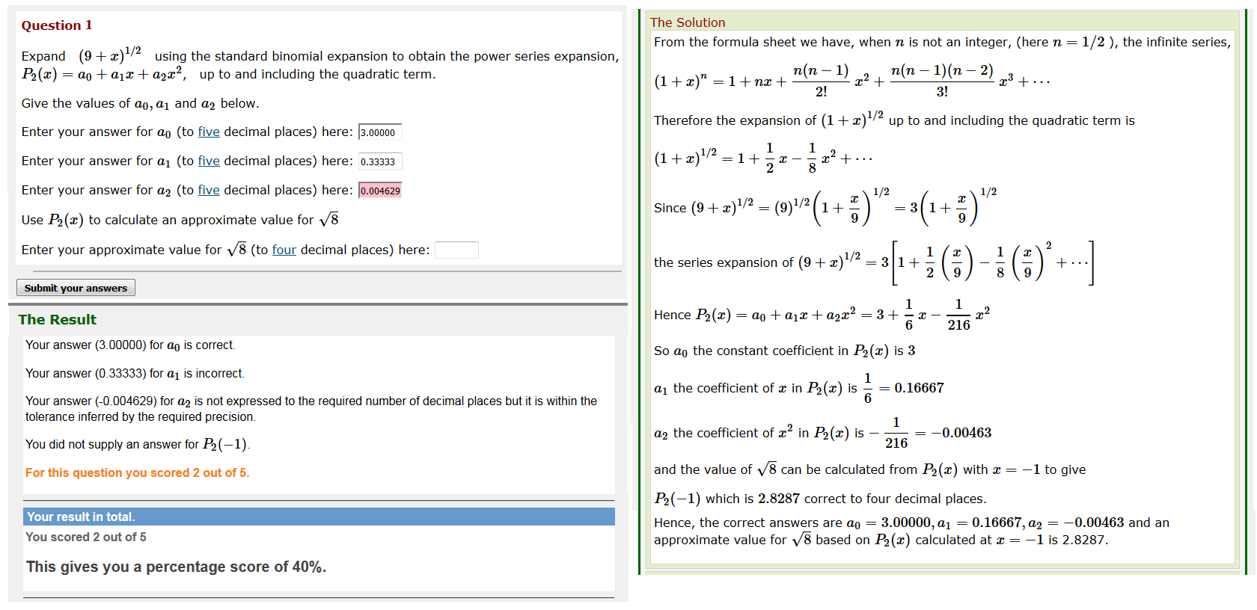
Dewis Questions – different types
Numeric, multiple choice, string/text
Dewis question example:

Slide 6
2014-15 On-line January Exam
All stakeholders met, discussed potential problems and solutions.
CETTS team - Patrick Hall
IT team - FET IT, Mary McDonnell, Matt Smith, Neil Porritt
DEWIS team – Rhys Gwynllyw, Karen Henderson
Module team - Alison Hooper, Karen Henderson
Two meetings October-December 2014 before January Exam
Worked out responsibilities of each team
Process for running exam
Two sittings 10.00-12.00 and 14.00-16.00

Slide 7
2014-15 On-line January Exam
IT team
Booked sufficient PC labs
Ensured PCs working on the day
Ensured PC displayed only relevant home page for DEWIS exam
Attended first 15 minutes of exam in each room to deal with technical problems should they arise
CETTS team
Allocated students to PC labs and exam time (morning or afternoon)
Allocated all RA students to one lab session
Each PC session had its own printed sheet of attendees, students had to sit exam in allocated room at allocated time
PC session run as normal exam – two invigilators, exam hard copy given to each student, hard copy answer script with docket collected

Slide 8
2014-15 On-line January Exam
DEWIS team
Students logged in using UWE username and password
In exam room, students given exam key (8 digit number) to access exam. Key would only work once – ensured only students in exam room could access exam.
On-line exam - green top horizontal bar giving time of exam and student id.
Green bar –turned to pink – once answers submitted.
Module team
Set DEWIS On-line Exam
Supplied academic for each PC session to support invigilators.
Supplied hard copy of exam plus normal exam front sheet with instructions. Front sheet available to students prior to exam.
Answer books provided for student workings. All answer books collected afterwards, but invigilators had to ensure answers were submitted on-line before allowing a student to leave.

Slide 9
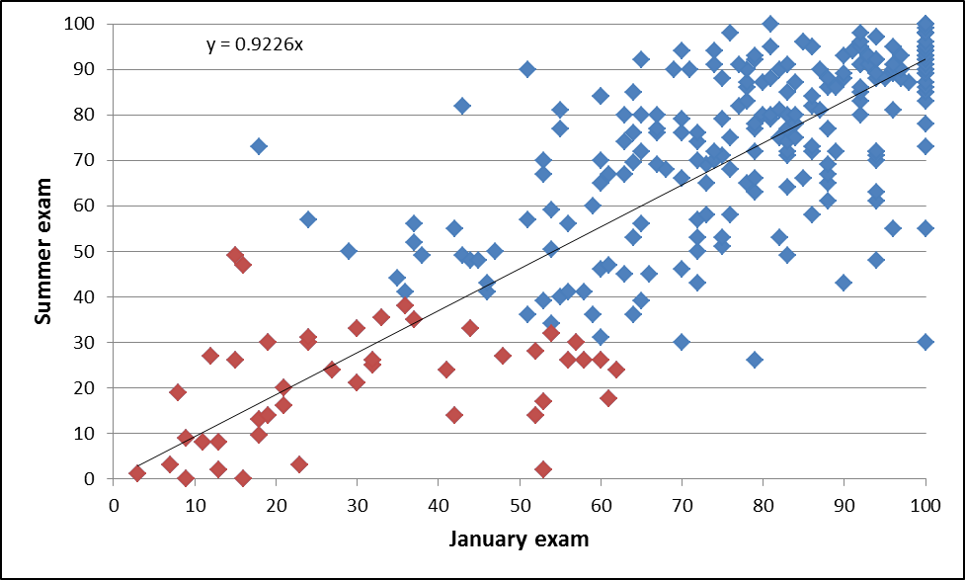
Examination Results 2014-15
Examination Results for the 2014/15 academic year showing the correlation between the written summer exam results and the on-line January exam results. The blue/red squares indicated students who passed/failed the module and the black line (y=0.9226x) is the line of best fit through the origin.

Slide 10
Examination Results 2014-15
Semester 1 e-Assessment Test Results versus Jan Examination results 2014-15.

Slide 11
Examination Results 2015-16
Weekly tests average score vs January exam 2015-16.
Entry level breakdown
.

Slide 12
Consequence of On-line January Exam
Students take note of feedback
January 2016: 313 attempts, 241 feedback views
Cohort problems indicated early
(i) BTEC students are given two hours tutorial per week as opposed to normal one hour.
(ii) Exam practice sessions offered

Slide 13
Consequence of On-line January Exam
A comparison between the mark that the paper-based exam booklet would have been awarded compared to the official on-line mark for a sample of students (blue squares).

