Slide 1
Assessment Feedback: Evaluating the use of screencasting
Mandy Lee, Sue Norman, Sarah Whitehouse, Dr Marcus Witt
Education, ACE
UWE Learning and Teaching Conference
21st June 2016

Slide 2
Background and literature

Slide 3
Introduction
We have been using video (Kaltura) to provide assessment feedback for written assignments in the BA(Hons) Early Childhood programme and the BA(Hons) Primary Education (ITE) for two years.
This has been positively received by students, but we were keen to evaluate the method and students’ responses more fully.

Slide 4
What are screencasts?
Some studies have looked at the use of video of the marker only – not with the student’s work on the screen too.
Others have captured the screen with the student’s work up too so you can talk through the script – this is what we have done.

Slide 5
How to feedback using screencasts
Read and annotate the submission and save the annotated version
Still on the same Student Submission page, select the mashup icon, then from the drop-down, select Kaltura Media.
On the top right of the screen click on Add media and then on Record your screen
If you want to record a video of yourself in the corner of the screen too then click on the camera icon on the bar at the bottom.
Make sure the assignment is on your screen and drag the dotted screen to encompass it.
Click on the red record button to start your recording. You can scroll up and down the assignment on your page. Click on done when you have finished.
Give the recording a title (student number).
Finally, click on upload. The upload can take some time – I go and get the next assignment and read through and annotate this whilst the previous video is uploading.

Slide 6
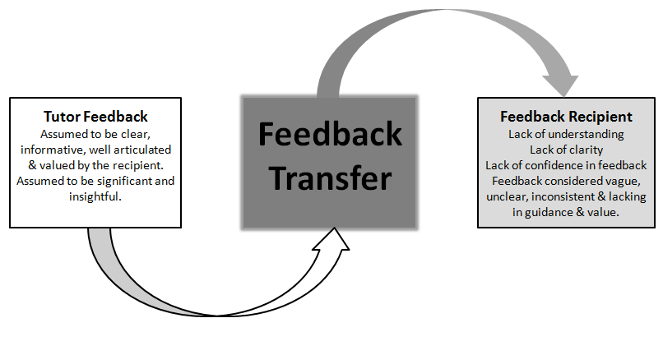
Focus - effective feedback
Initiatives (workshops and focus groups with staff and students) on improving assessment feedback in 2012 and again last year.
Feedback Transfer Between Tutors and Students (Turner & West 2013)

Slide 7
Summary from previous student focus groups on assessment and feedback generally:
Content/nature of feedback
Always give examples to illustrate points (this was the strongest and most consistent message from all of the students).
More detail is appreciated – brief feedback is less likely to be useful.
Video assessment feedback is very useful because it can facilitate many of the above points:
talking can be more accessible
it is possible to be very specific about examples for points made throughout
it can be very in-depth – the marker can say more than they would be able to easily write.

Slide 8
Potential Benefits
Value and depth of feedback - much more feedback can be provided in a 10 minute screencast than in 10 minutes of typing (Henderson and Phillips 2015, Turner & West 2013). All of the feedback is matched to the script – nothing vague about it.
Encourages more in-depth ideas and analysis-focused comments over micro-level feedback (Vincelette & Bostic 2013)
Student engagement with the feedback – they spent more time reviewing it – although possibility of the Hawthorne effect (Turner & West 2013).
More personal (Henderson & Phillips 2015, Parton 2010, Turner & West 2013, Vincelette & Bostic 2013).
Takes no more time than written feedback (Vincelette & Bostic 2013)

Slide 9
Reviewing our feedbacks: Content analysis

Slide 10
Content analysis version 1
After we had all engaged with the literature, we used the key principles outlined by Henderson and Philips (2014) to devise a recording sheet for content analysis of our feedbacks.
We then all went off to try this with some examples we had previously recorded- this was an eye opening experience!
The following was my recording sheet for a student who had produced a weak assignment….

Slide 11
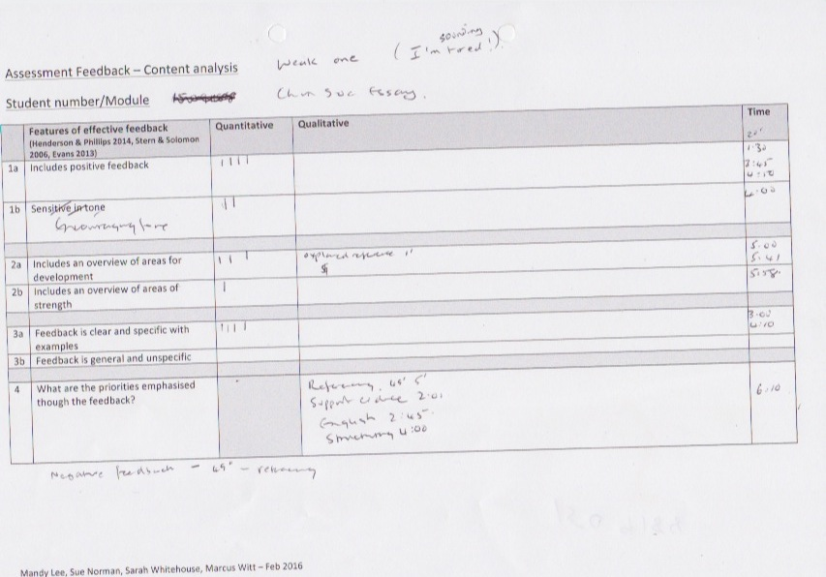
Sue…

Slide 12
Version 2…
We then met again to reflect upon the experience and the challenges we had encountered with regards to producing a meaningful content analysis
We also all watched each other’s examples of feedback to see what lessons could be learned- for example was there a ‘maximum’ length of time for feedback?
We needed to be able to record in more detail regarding the level of analysis of the feedback
We also wanted to record the tone of our feedback
Had we presented a clear summary of strengths as well as weaknesses?

Slide 13
Based on our discussions, our reading, and feedback from students we came up with a revised content analysis record form
Once again this is an example of a form I completed from a previous recording for a student who had produced a weak assignment

Slide 15
Initial conclusions drawn
Version 2 of the content form was much more suitable for our purposes. Thoughts leading from these:
A general feeling that 5 minutes was a good length for the feedback- stronger assignments might receive shorter feedback- and weaker ones perhaps up to 7 minutes.
A useful discussion about the level of analysis of the feedback – this style of feedback can lead to more feedback on higher order thinking rather than micro level (spelling, grammar etc.) (Vincelette & Bostic 2013)
Using the lessons learned from this, some members of the team have adapted their practice and just used screen casting once again for feedback for an assignment. We have asked the students for their opinions on this…

Slide 16
Student evaluations

Slide 17
Previous feedback from our EC students
‘the best feedback we have had’
It was really interesting to hear the feedback against the essay to see visually where the issues/strong points were.’
‘I understood it a lot as I could see where Mandy was talking about and really took in what I need to improve on.’
‘shows they take time to go through your work’
‘felt like a more personal feedback than a typed sheet’

Slide 18
Results of Student Survey

Slide 19
Headlines
Overall, what format(s) of assessment feedback would you most like to receive?
Opinions about video feedback were strong and polarised.
16 out of 30 said they would prefer video feedback
3 out of 30 said they would prefer written feedback
11 out of 30 said they would prefer ‘both’.
Catering for the variety of opinions is relatively easy by offering a choice. The students who would like both forms of feedback present more of a challenge.

Slide 20
What would you consider to be the optimum length of video feedback?
50% thought that 2-5 mins was optimal.
50% thought that 5-10 mins was optimal.
To what extent did the video feedback contain the features of good feedback you identified above?
76% - to a great extent
21% - somewhat
3% - not at all

Slide 21
What is helpful about video feedback compared to feedback given in other ways, for example written feedback?
Easier to understand
Felt more personalised
Exemplification was clearer
More motivating

Slide 22
What is helpful about video feedback compared to feedback given in other ways, for example written feedback?
‘Brought it to life. Gave sense of interactivity without actually having that. Helped to pinpoint specific areas discussed and helped identity where I was meeting criteria in a much more effective way. Took much less time to get the key ideas too. Also felt more personalised.’
‘The language used when talking is far easier to take on board than that in a short comment in Word markups.’
‘Written feedback is very unanimous and basic, video feedback is detailed and you hear the marker explain things.’
‘Comments seem more meaningful when given verbally.’
‘Could give a more detailed response that felt more personal and engaging.’
‘Written feedback can sound negative. With video feedback you feel as though you are being spoken to directly which is more personal. I took criticisms much better when being spoken to.’

Slide 23
However
Some students wanted to be able to go through their feedback at their own pace.
Performance against specific assessment domains is not explicitly conveyed through video feedback.
It is more difficult to make connections between the feedback and subsequent assignments.
Can feel more negative – the ‘personal’ element noted earlier can cut both ways.

Slide 24
Also …
For students on teacher education and Early Childhood courses who will be in the business of giving feedback to children, the questionnaire caused them to think about the ways that they might give that feedback.

Slide 25
Issues
All of the studies I looked at, and in the work I have done, most students prefer feedback in this format.
However the one key issue which has arisen is the lack of a written record to support the use of feedback with future assignments
Several students would prefer written feedback too!
A clear and persistent steer to download the video, and to note summary points might improve this.
A few technical issues but it has mostly been very straightforward.

Slide 26
Next steps

Slide 27
Being sure to offer the students a choice and making this explicit to them.
How do we cater for students who would like both forms of feedback?
Ways to make the key points more ‘portable’ to future assignments.
Taking care over tone of voice, body language etc
How do we ensure that video feedback relates specifically to the assessment domains?

Slide 28
Thoughts and questions?

Slide 29
References
Henderson, M. & Phillips, M. (2015) ‘Video-based feedback on student assessment: scarily personal’, in Australasian Journal of Educational Technology, 2015, 31(1).
Parton, B. S., Crain-Dorough, M., & Hancock, R. (2010). Using flip camcorders to create video feedback: Is it realistic for professors and beneficial to students? International Journal of Instructional Technology & Distance Learning, 7(1), 15-23.
Turner, W. & West, J. (2013) Assessment for “Digital First Language” Speakers: Online Video Assessment and Feedback in Higher Education. International Journal of Teaching and Learning in Higher Education 2013, Volume 25, Number 3, 288-296
Vincelette, E.J. & Bostic, T. (2013) Show and tell: Student and instructor perceptions of screencast assessment. Assessing Writing 18 (2013) 257-277.

