Slide 1
Presentation by
International partnership exploring specific learning difficulties (SpLD), inclusive practice, reasonable adjustments and specialist support
James McKenzie Kelly Goodfellow
7th June 2018

Slide 2
Aims of the session
To demonstrate a successful international partnership between UWE and Zayed University (United Arab Emirates)
To identify the key linguistic and cultural considerations when identifying international students with SpLD, particularly in relation to students from the Middle-east and Gulf regions
To explore how this might impact upon provision of support and inclusive practice at UWE

Slide 3
Session overview
Who was involved?
How did the partnership come about?
What took place during the consultancy visit?
What has UWE learnt from this partnership?
What next for the partnership?

Slide 4
1. Who was involved?

Slide 5
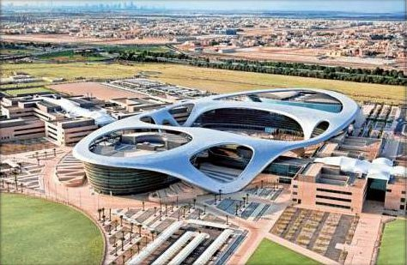
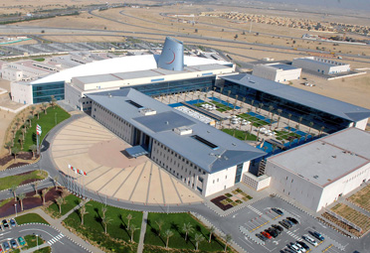
10,000 students
2 campuses
90% female students
Switch from Arabic to English at HE level
1% disability self-disclosure
Established Accessibility service for physical/sensory impairment 10 years ago
Limited provision for hidden disability

Slide 6
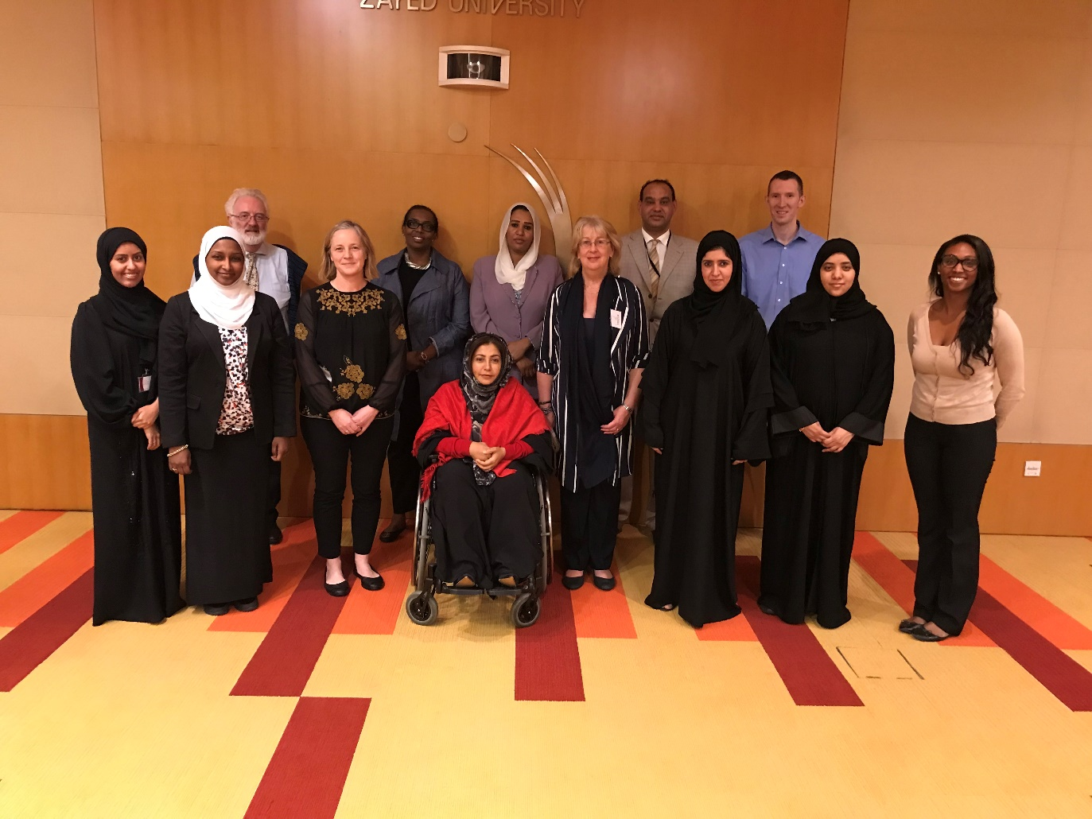

Slide 7
2. How did the partnership come about?
Project timeline
Project objectives
Project outcomes
Project challenges

Slide 8
Project timeline
Initiating
Apr 2015 – British Council arranged visit to UWE by HEIs from Gulf region
2015
Jan 2016 – Recce visit to ZU
Apr 2016 – Follow up visit to UWE
2016
Planning
Aug 2017 – Project relaunched
2017
Jan 2018 – Consultancy visit to ZU
Executing
2018

Slide 9
Project objectives
To provide specific training to ZU staff on SpLD and how to identify and support students
To provide advice, support and practical suggestions on how best to set up and promote new specialist services for students at ZU
To share experience in relation to inclusive practice and reasonable adjustments
To provide opportunity for observing ZU staff screening students for SpLD and provide feedback

Slide 10
Project outcomes
Successful consultancy visit
10 staff trained
Tools, resources and promotional materials shared
Implementation of new services for ZU students
…
In time, this should lead to increased disclosure, more students identified and supported, and raised awareness of SpLD across ZU

Slide 11
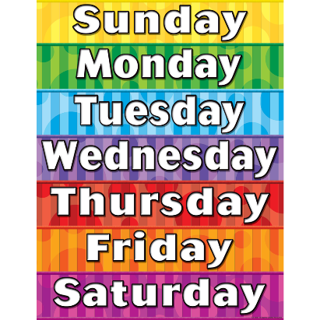
Project challenges
Bristol Dubai

Slide 12
3. What took place during the consultancy visit?
SpLD definitions and terminology
SpLD screening
SpLD diagnostic assessment
Specialist 1:1 study skills support
Institutional adjustments
Inclusive practice
Measuring value and impact / promotion

Slide 13
SpLD identification
Diagnostic Assessment
screening
Discussion
Are UWE staff confident in identifying whether a student’s study issues may stem from English being an additional language, a Specific Learning Difficulty or other factors?
Key factors in identification:
Features of native language
Screening tools and assessment tests available

Slide 14
Language considerations
Typical Student concerns:
Reading accuracy, comprehension and speed
Written accuracy, spelling and grammar
Understanding instruction
What is your experience in your own language?
How does this compare to your experiences learning English?
Complications!

Slide 15
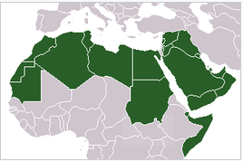
Arabic language
Arabic language - Top 5 most spoken language
Classic, MSA and spoken/ local dialect
English as instructional language post secondary
Transparency
Dyslexia and Multilingualism: Identifying and supporting bilingual learners who might be at risk of developing SpLD/dyslexia Mortimore et al (2012)

Slide 16
Culture and pedagogy
Learning difficulties need to be considered within the context of the individual’s cultural world (Martin 2009)
Educational experience
Maths
Assessment Materials and assessors background
Language used - Reasonable adjustments – to correct, to proofread, to rectify
UWE – student authorship, confidence and independence
ZU – ‘helping students to help themselves’
In the UAE - Less identification of SpLD? Awareness
Technology driven
Martin, D (2009) Language Disabilities in Cultural and Linguistic Diversity Clevedon: Multilingual Matters

Slide 17
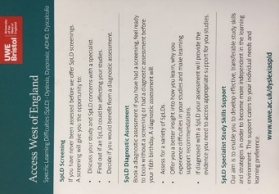
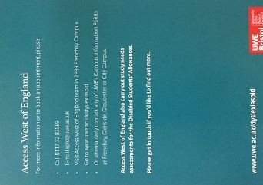
4. What has UWE learnt from this partnership?
More detailed investigation in early identification stages by UWE staff
Training of UWE staff who screen and support. To raise awareness of these cultural and linguistic differences
Include SpLD awareness and EAL discussion in our UWE wide staff training sessions – 3 times per year. Through the Learning and Development Centre

Slide 18
5. What next for the partnership?
Co-presenting workshop at the National Association of Disability Practitioners International conference at the end of June
Plan to follow up with ZU at the end of 2018 to evaluate changes made
Ongoing dialogue

Slide 19
Questions
Access West of England  www.uwe.ac.uk/awe  Frenchay 2P39  ext. 83589  spld@uwe.ac.uk

