Slide 1
Presentation by
Engineering and Society
Paired peer active service learning
Laura
Fogg-Rogers
Senior Research Fellow in Science Communication
@laurafoggrogers
Laura.foggrogers@uwe.ac.uk
Wendy
Fowles-Sweet
Director of Professional and Workforce Development
Wendy.Fowles-Sweet@uwe.ac.uk
24/11/17
Engineering Education Research Conference

Slide 2
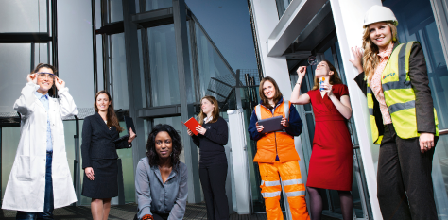
Engineering has an image problem
#11%
isnotenough
5%
of primary school teachers have a STEM higher qualification
Gender identity is formed between ages 5-7
Notes:
Does STEM have an image problem too?!

Slide 3
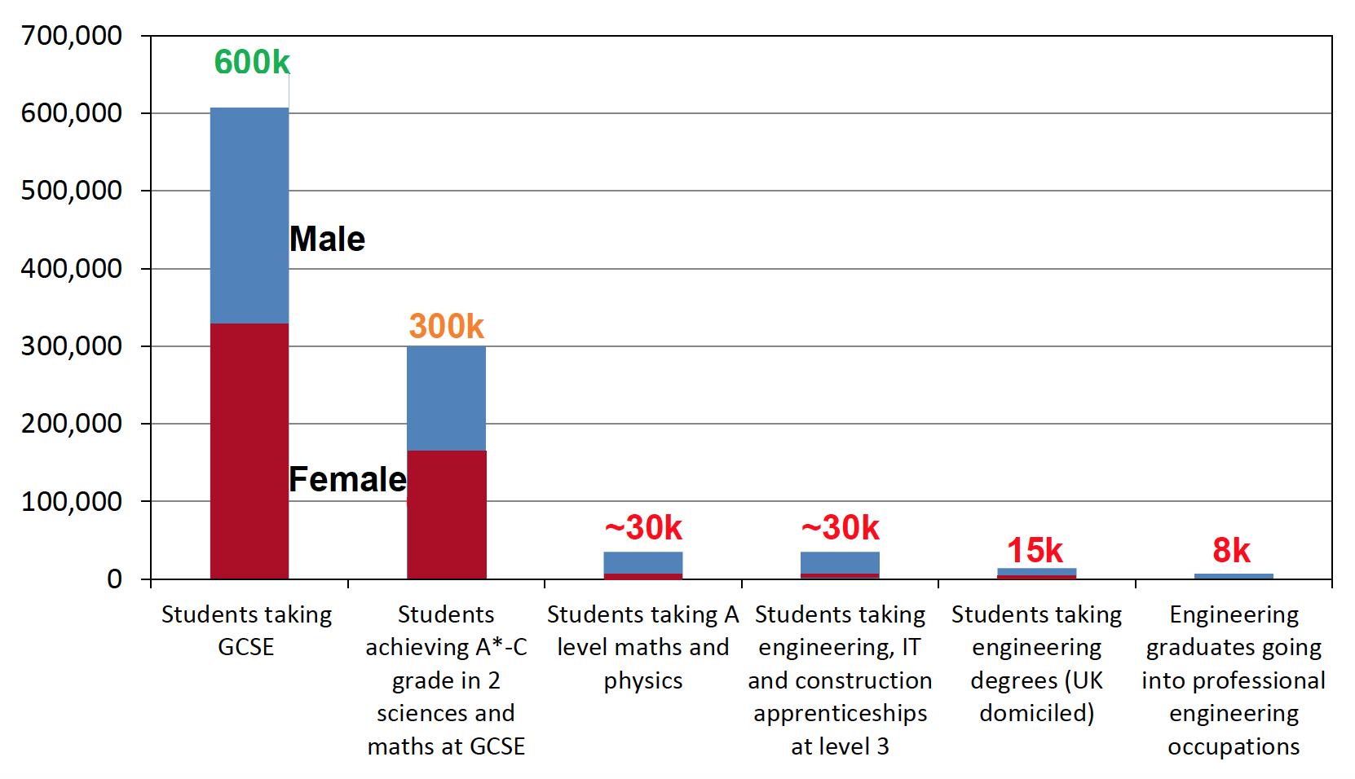
Overview- The engineering skills challenge
Royal Academy of Engineers

Slide 4
STEM engagement… with whom?
Engineers
Teachers
Key Stage 2 Primary School Children
Improving public engagement skills is a key aim for engineering professional bodies (EPC, 2014)
Recruitment into engineering is needed to meet the employment gap (Engineering UK, 2017).
50% of primary school teachers identify low confidence and subject knowledge in engineering (ENGINEER, 2014)
Children, particularly girls, decide on the appropriateness of science as a career before age 11 (Archer et al, 2013).
Girls like connecting STEM disciplines with relevant real-world problems (High Level Group on Science Education, 2007).
Initial Teacher Education is key opportunity to embed experience in curriculum.

Slide 5
Engineering and Society
New 15 credit module at UWE for third year engineering students
Importance of “Engineering Citizenship”:
Professional development
Lifelong learning
Competencies and social responsibilities of a professional engineer.
Understanding of and engagement with the effect of engineering upon society
Part of the professionalism demanded by the UK Engineering Council ‘s Specification for Engineers (UK-SPEC).
HEFCE Innovation Awards 2016
Notes:
Project Development
In the above example:
Teachers were 2nd year students, with their learning part of their degrees.
Engineering students were volunteers, whose learning was not rewarded within their curricula. However, the engineers felt the activity would fit well within their degree programmes.

Slide 6
Paired Peer Mentors
Year 3 Engineering Students BEng/MEng
Year 2 Initial Teaching Education students
Key Stage 2 Primary School Children
Public Engagement skills
Engineering knowledge
Inquiry-based science education

Slide 7
Engineer and teacher training
Engineer learning outcomes:
Communication skills
Pedagogical theories
Societal issues
Teacher learning outcomes:
Engineering Design Process
STEM subject knowledge and confidence

Slide 8
Paired peer learning
In groups, discuss:
Which courses could complement yours?
What skills could students learn from working with their peers?

Slide 9
Evaluation Design
Student Engineers
Open response questionnaires
Reflective diaries
Perceptions questionnaire
Engineering Outreach Self-Efficacy Scale
Pre-Service Teachers
Open response questionnaires
Reflective diaries
Perceptions questionnaire
Engineering and Science Subject Knowledge Confidence Scales
Teaching Engineering and Science Self-Efficacy Scales
Children
Open response questionnaires
Perceptions questionnaire
Post-it note feedback wall

Slide 10
Paired peer mentor model
Engineer 10: Working in a pair was very helpful. There were instances where my engineering knowledge was necessary to speak to the class and equal instances where my partner helped knowing how to speak to the children, control the class etc.
Teacher 10: It was useful having an engineering expert during certain aspects of the teaching lesson, as he was able to explain the scientific terms regarding forces - like lift, weight, mass and thrust.
Notes:
The paired peer model is where we think we had the most impact and so that is what we’re extending. They viewed each other as experts.

Slide 11
Pre-service teachers’ self-efficacy
P<0.00
Fogg-Rogers, L. A., Edmonds, J. and Lewis, F. (2017) Paired peer learning through engineering education outreach . European Journal of Engineering Education, 42 (1). pp. 75-90. ISSN 0304-3797 Available from: http://eprints.uwe.ac.uk/29111
Notes:
The mean Education Outreach Self-Efficacy scale (EOSS) value for the student engineers did not significantly change over the course of the intervention (observed test value is reported as Z throughout; here Z = -0.48, p= 0.64). Before the project the mean Fogg-Rogers et al 2016. Paired Peer Learning through Engineering Education Outreach. 13
PSE value was 7.9 out of 10 (SD = 1.2) and following the project the mean value was 8.0 (SD = 1.1).
The mean Teaching Engineering Self-Efficacy (TESS-R) value for the pre-service teachers significantly increased over the course of the intervention Z = -2.81, p= 0.005; before the project the mean PSE value was 4.1 out of 10 (SD = 0.9) and following the project this had increased to 7.8 (SD = 0.4).
The mean Engineering Subject Knowledge Confidence (ESKCS) value for the pre-service teachers significantly increased over the course of the intervention Z = -2.81, p= 0.005; before the project the mean value was 3.3 out of 10 (SD = 1.8) and following the project this had increased to 7.3 (SD = 0.9). All these results can be seen in Figure 3.

Slide 12
Professional Engineer
Personal commitment to professional standards, recognising obligations to society, the profession and the environment.
Demonstrate effective interpersonal skills.
General and specialist engineering knowledge and understanding to optimize the application of existing and emerging technology.
Professionalism: Chartered Engineer
Apply appropriate theoretical and practical methods to the analysis and solution of engineering problems.
Provide technical and commercial leadership.
Notes:
Pictorially – this module focuses on the red box

Slide 13
University social responsibility
The module acts as service learning for future engineering professionals.
Demonstrate an ability to design, plan, communicate and deliver STEM concepts to different audiences (e.g. teachers & school pupils).
Develop awareness of ethics and risk assessment in professional practice, including codes of practice, professional standards & workplace ethics.
Reflective practice about practitioner as methodologist – able to choose, use, evaluate methods, techniques, tools and technologies.
Instigator for equity within society. Appreciation of society’s issues. Professionalism in determining equitable solutions.
Notes:
Understand and critique science communication and public engagement strategies, considering contemporary societal contexts for engineering.
Understand and critique pedagogical theories and strategies for teaching Science, Technology, Engineering and Mathematics.
Demonstrate an ability to design, plan, communicate and deliver STEM concepts to different audiences (paired teachers & primary school pupils).
Develop awareness of ethics and risk assessment in professional practice, including codes of practice, professional standards & workplace ethics.
Critically reflect on the strategies used and the experiences undertaken.
Action plan for their future career and personal goals in employment.
Development transferable skills such as:
Teamwork
Partnership working
Professional relations
Relationships between academe and practice
Project and time management.

Slide 14
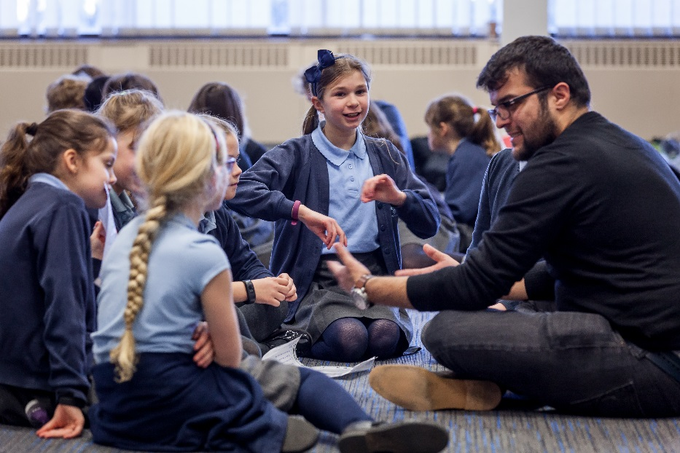
Service learning
In groups, discuss:
How do you, or could you, embed practice based learning?
How can university students learn with and for communities?
Strategy 2020
Outstanding learning
Ready and able graduates
Research with impact
Strategic partnerships, connections, and networks

Slide 15
Presentation by
Engineering and Society
Paired peer active service learning
Laura
Fogg-Rogers
Senior Research Fellow in Science Communication
@laurafoggrogers
Laura.foggrogers@uwe.ac.uk
Wendy
Fowles-Sweet
Director of Professional and Workforce Development
Wendy.Fowles-Sweet@uwe.ac.uk
24/11/17
Engineering Education Research Conference

