Slide 1
Presentation by
“Keep Taking The Tablets” (But Maybe Not In School) – How Are Students And Staff On Education Programmes Navigating Different Digital Policy Contexts? Jane Andrews & Mark Jones Department of Education & Childhood, UWE
Dr Jane Andrews
Mark Jones
Department of Education and Childhood
UWE
7th June 2018

Slide 2
Aspirations for mobile technologies and learning
UWE 2020 Strategy
UNESCO mobile learning week 2018
supporting our staff in providing a high quality, relevant and engaging practice-oriented learning experience, both on and off campus, for all our learners, using the latest technology and global information sources

Slide 4
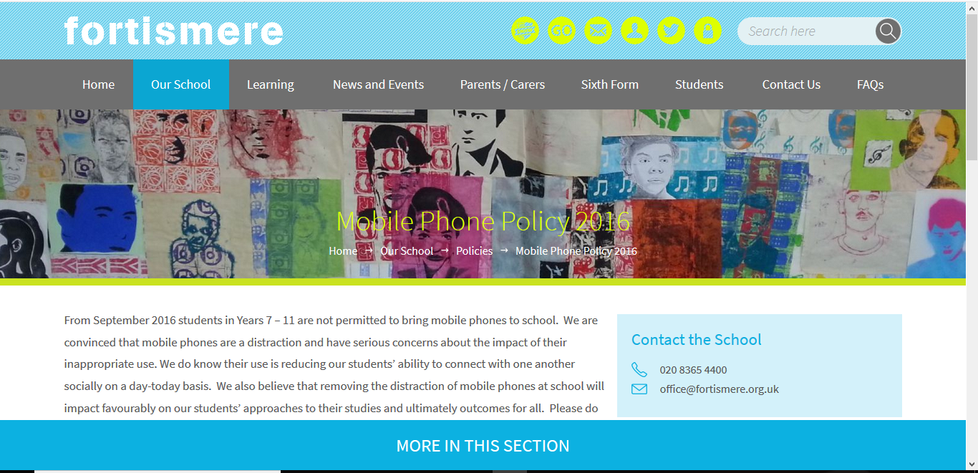

Slide 5
Outline
Focus for our research – To explore the variables that cause differences in initial teacher education students’ perceptions about using mobile phones in university taught sessions and on school placements.
From the literature - Mobile devices and our lives; mobile devices and learning
Our study
Issues arising
Discussion questions – over to you

Slide 6
Mobile technologies and our lives
Katz, J. (Ed.) (2003) Machines that become us – The social context of personal communication technology New Brunswick and London: Transaction Publishers
Integration and separation of devices into our professional and personal lives
Devices as reflections of the self (e.g. wallpaper choices)
Katz, J. (2006) Magic in the air – Mobile communication and the transformation of social life London: Routledge
Transformation of public space

Slide 7
Mobile technologies and learning
Some starting points from literature :
“There is already an agreement that m‐learning brings new opportunities and can improve the learning process (Kalinic et al, 2011)” cited in Şad and Göktaş (2013).
(if so when and how, but also when not and why?)
“The use of mobile technologies increases immediacy and connection between students and teachers”
(Kaliisa, Palmer and Miller, 2017, p.2)
(what do we mean by connection? partial, strong, weak.. ?)
“Our experiences lead us to suggest that educators should be focusing less on whether mobile learning should be implemented and more on developing mobile learning in curricula that is comprehensive, sustainable, meaningful and compulsory, in order to prepare students for accessing and using such resources in their working lives.”
(Fuller and Joynes, 2014)
(sites of learning; 'School cultures’, student as professional ‘trainee teacher’

Slide 8
Our study
2014-2015
Online survey of students (range of UG and PG education-related programmes) and staff on a range of questions about perceptions of and uses of mobiles in learning and teaching
Focus group interviews with groups of students and with groups of staff
2017-2018
Online survey of initial teacher education students (UG and PG) (focus for today’s presentation)

Slide 9
Findings from 2014-15 study
Some teacher trainees aware of differing staff perceptions of technological devices and learning – strategies developed to cope
Some subject-specific beliefs – as English specialists or as design specialists we do / don’t need technology – identity issues
Staff views polarised – for and against using devices in taught sessions
Students in schools on placements negotiating differing school policies and practices – strategies developed to cope (e.g. locking mobile in car so policy not violated)

Slide 10
Findings from 2017-18 study​
Question 5 and 5a
In your opinion what have you found the attitude of university academics (e.g. lecturers/tutors) is to ITE students
using mobile phones in university taught sessions e.g. lectures, seminars/small group sessions? (only select one
statement)
“differing personalities”
“some lecturers think is a distraction rather than adding value”
“phones can be useful as a search tool but also serve as a distraction”.
“Distraction”
“It is often viewed that if you are on a phone your are not paying attention or listening purely because you aren’t looking”
“It can be difficult for a lecturer to know if students are using their work to consolidate learning or for socialising. Granted it's usually a mix of both.”
“it's our choice to listen and engage in the session whether to lose out on teaching, they won't go over it again for us”
“Some people dislike phones and think your using them for social media, others understand you may have outside things going on or need it for children/jobs/home life etc, or for recording lectures.”
CHOICE DISTRACTION TRUST RELEVANCE BALANCING RESPECT
Mobile technologies = distraction, added value or both?

Slide 11
Findings from 2017-18 study​
Students should be allowed to use their mobile phones at all times and for what ever purpose is required ( e.g. searches related to the lecture/ seminar, checking incoming personal texts and social media updates, sending messages etc..)
Students should be allowed to use their mobile phones at all times for educational related tasks and activities but with limited non related activities (e.g. checking personal texts, social media and emails)
Students should be allowed to use their mobile phones at particular points in a session as agreed in advance with fellow students and the lecturer/speaker
for both related and non-related activity)
Students should be allowed to use their mobile phones at particular points in a session as agreed in advance with fellow students and the lecturer/speaker (for activities related to the lecture/seminar e.g. searching terminology, checking articles, sharing links)
Students should be allowed to use their mobile phones at all times but only for educational related tasks
Students should be allowed to use their mobile phones at particular points in a session as agreed in advance with fellow students and the lecturer/speaker
(for non-related activity)
Uni
Students should not be allowed to use their mobile phones at all in seminars
Uni
Social
Uni
Uni
Uni
Social
Social
Uni
Uni
Social
Social
Uni
Use at all times
Use at particular points
No use allowed

Slide 12
Findings from 2017-18 study​
Question 6a
“If phones were limited to only related use then they should be allowed to be used at any time. Agreed times/breaks would allow for free use of them as monitoring use for strictly related use is almost impossible, some individuals will take advantage of free use.”
“I don’t think people should be sat texting in a lecture/seminar as itis rude. However the odd point to act as a 'brain-break’ if it is a long session can be helpful. It may also be a useful learning tool within the session to research on a related-activity.”
“when a student has a question that does not necessarily need to be addressed by an academic, the answer can be found immediately.”
“ I believe that students should always be allowed to use their mobile phones for educational reason - as it is a fantastic resource that the university don’t have to supply. I believe that none related tasks as well can be used occasionally, as students will just do it anyway and could be more distracted by the vibrations in their pocket but not being able to see what it is.”
“Even though I admit have used a phone in lectures for both university work related and social life related instances. The majority of people around me use them only to socialise which is distracting. It would be impossible for lecturers to police some kind of half measure, so I think the approach should be black or white.”
“As long as it’s not obvious we are texting someone then there shouldn’t be a problem. I have to text work quite a lot at uni and if phones were banned I probably wouldn’t be able to arrange my shifts!.“
Work-university Immediacy Responsibility Invasive/ non-invasive

Slide 13
Findings from 2017-18 study
Question 6a
“As we are paying and choosing to be on the course itis our right to check our phones - especially as it could be important. Also, we know the appropriate time to look on our phones …..”
“It's not school, students are adults so should not be 'told' when to use their device, but most people understand that it is rude to use it overtly or unnecessarily. I don’t like being given work to look up on my phone in class, because I think it is lazy teaching and some people do not have smart phones.”
“ It frustrates me to see students constantly using phones during lectures/seminars to check social media, text friends etc..”
“As long as it doesn’t disrupt the lecture (e.g. loud beeps!) then it should be down to the student to decide how best to pay attention and absorb the content. If they (foolishly) decide to just sit there and play games or goof-off on social media, that's their choice. It's a university not a crèche.”

Slide 14
Findings from 2017-18 study
6d During the ITE course, some ITE students may be more active in encouraging other ITE students to set up and use social media to support group connectivity, information sharing and collaboration. How would you describe your own attitude/ experiences to the use of social media and groups during your course ?

Slide 15
Findings from 2017-18 study
7. How often do you use your personal mobile phone when in your placement school/educational setting?
Arriving at school
Before the school day starts -
During the morning e.g. children arriving, tutorial time
During the morning lessons/activities
During my morning break
During lessons/ activities before lunch
During lunchtime
During afternoon registration/
tutorial

Slide 16
Findings from 2017-18 study
How would you describe your personal attitude to how you think teachers and ITE students should be able to use their personal mobile phones while in a school or other educational setting?

Slide 17
Issues arising …
Learners’ agency – own choices, impact on others’ choices
Perceptions of “good” teaching and learning and mobile devices
Modelling of tutors, university processes
Integration – mobile devices as a great resource
Separation – perceptions of appropriate use of mobile devices
Student lives – paid work “integrated” into student life

Slide 18
Discussion Questions on Tables

Slide 19
Thank you!
Jane.AndrewsEDU@uwe.ac.uk
Mark7.Jones@uwe.ac.uk

