Slide 1
Learning 2020
June 7th 2018
Jane Harrington
Deputy Vice Chancellor and Provost

Slide 2
TEF 3 – UWE GOLD!

Slide 3
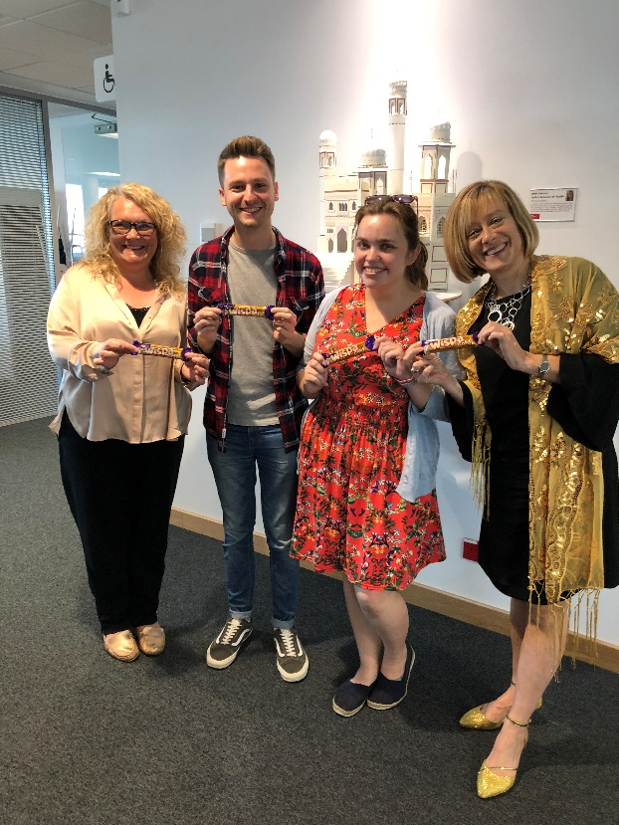
TEF GOLD 2018
Students from all backgrounds achieve consistently outstanding outcomes
Level for full-time student satisfaction with academic support, and the rate of progression to highly skilled employment or further study, are above the provider’s benchmarks.
Levels of student satisfaction with teaching and assessment, and rates for continuation and progression to employment or further study, are consistent with the provider’s benchmark.

Slide 4
TEF GOLD 2018
Evidence of:
A comprehensive system of student representation at all levels of the institution
The thorough and systematic embedding of an institutional culture for the recognition and reward of teaching excellence
Outstanding learning resources at institutional and subject-specific levels with extensive facilities for lecture capture
Successful approaches to personalised learning, with effective support arrangements for specific student groups, that secure the highest levels of student engagement with learning
The systematic embedding of enterprise and entrepreneurship throughout the curricula
Outstanding performance with regard to sustained employment and graduate earnings

Slide 5
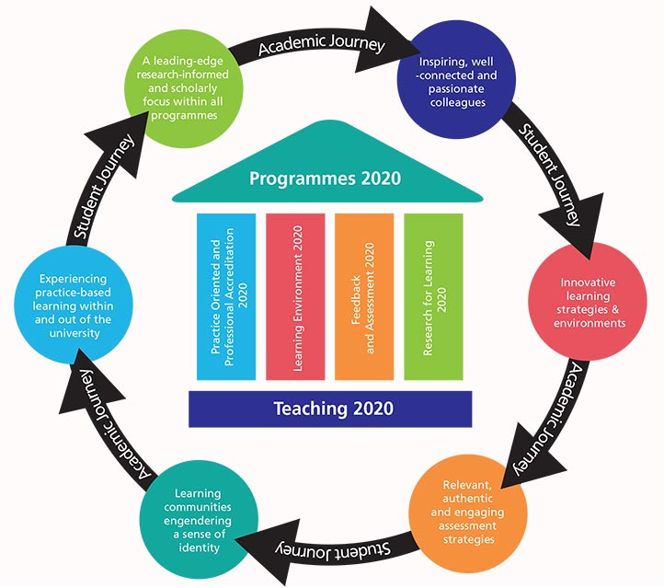
Learning 2020
Our ambition is to integrate academic and student facing outcomes to enable Strategy 2020 Ready & Able Graduates and Outstanding Learning – through 6 key objectives.
and students
belonging
Notes:
We have integrated the best practice outcomes for Programme Design, Practice Oriented, Feedback & Assessment and Research for Learning – through the Enhancement Framework.

Slide 6
Ready & Able Graduates
Outstanding Learning
Enabled by
Strategic
Teaching 2020
Inclusivity 2020
Enhancement Framework
Student Journey
Student Life 2020
Learning Environments 2020
Enterprise & Employability
Enterprise 2020
Enhanced Year
P2020
C2020
Operational
NSS Taskforce
DLHE Taskforce

Slide 7
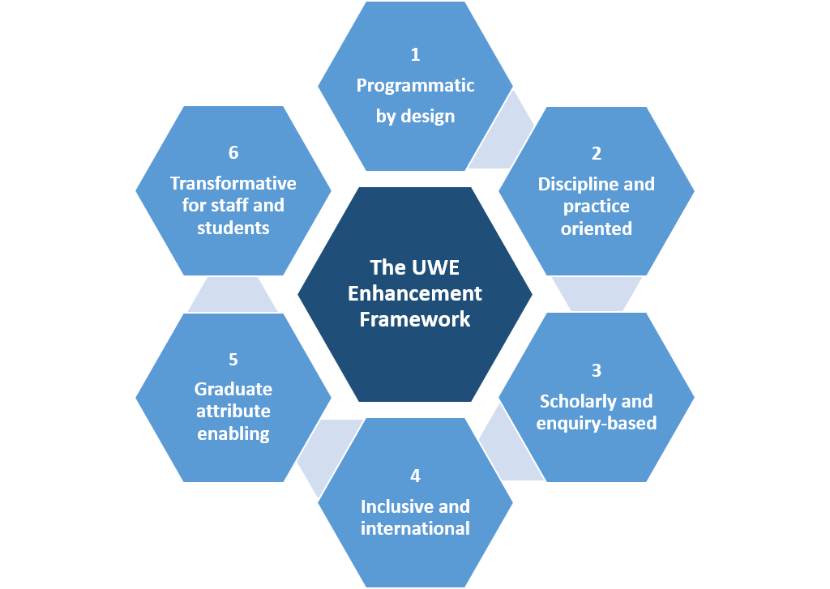
Enhancement Framework
Our ambition is to design and enhance our UG/PG programmes through discipline specialism and be practice-oriented with the best curriculum design including pedagogic practice.
Currently Available
Continuous Improvement tool to support programme review including the APR.
New Programme Design Process to ensure programmes are validated against the University priorities.
Programme Evaluation Review is currently in pilot phase.
Coming next
Curriculum Management tool for new programmes Jan 19.

Slide 8
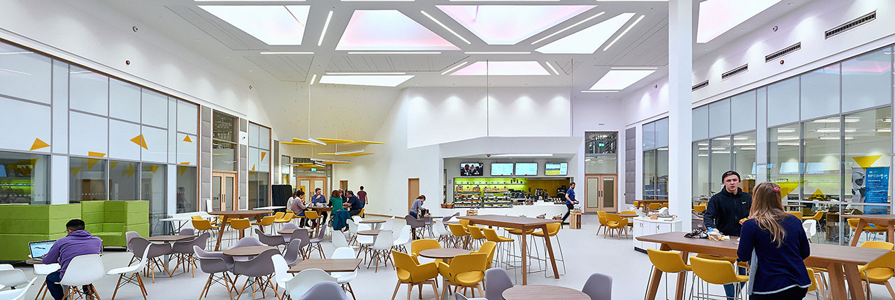
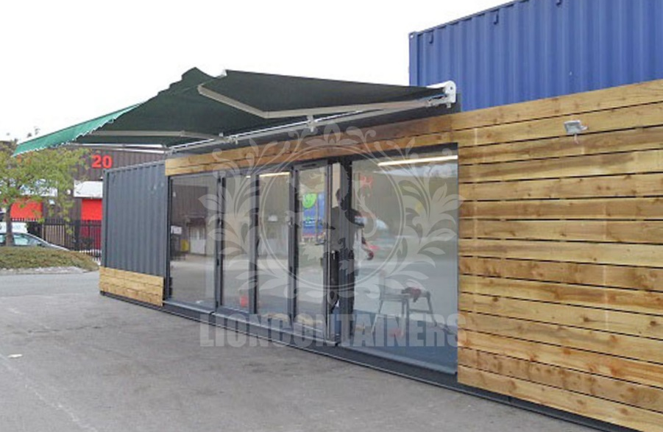
Enterprise
Our ambition is to design and enhance our UG/PG programmes designing in contextually meaningful innovation and enterprise, and enabling the space and resources to support them.
Currently Available
Incubator spaces across all campuses and externally for UG enterprise students.
All programmes have in-built enterprise/innovation attributes for UG students.
An enterprise rich schedule of events for students over the year.
Coming next
Incubator/space and support for students wishing to start up their enterprise whilst UG (2018/19)

Slide 9
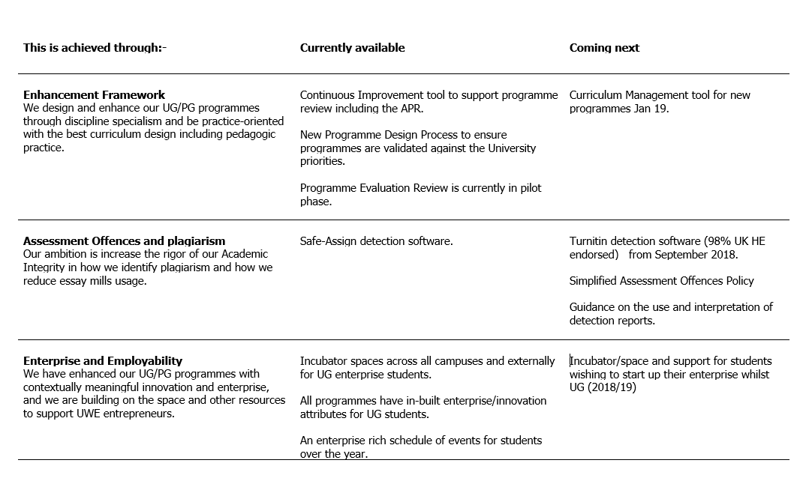
Learning 2020 - what has been delivered so far and what to expect next (1 of 2).

Slide 10
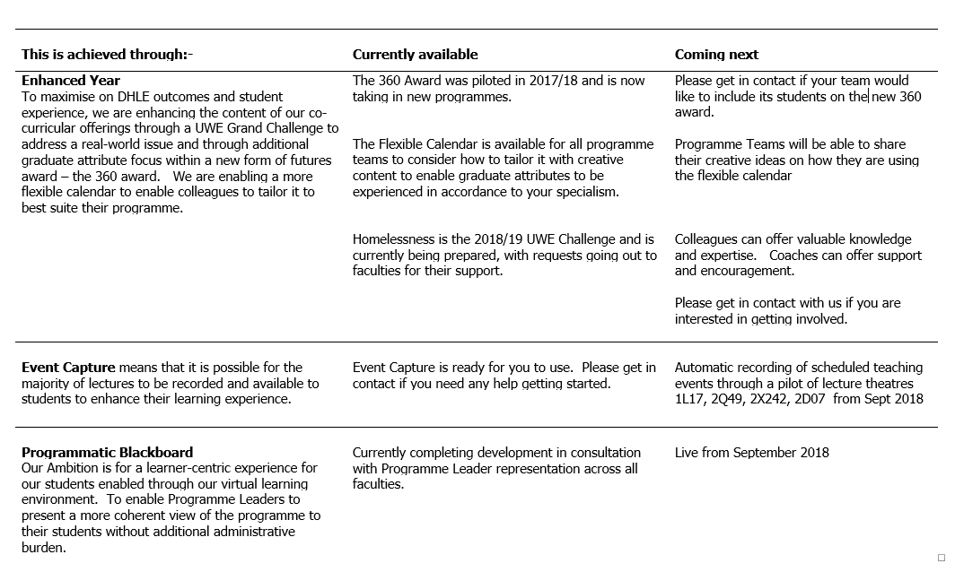
Learning 2020 - what has been delivered so far and what to expect next (2 of 2).

Slide 11
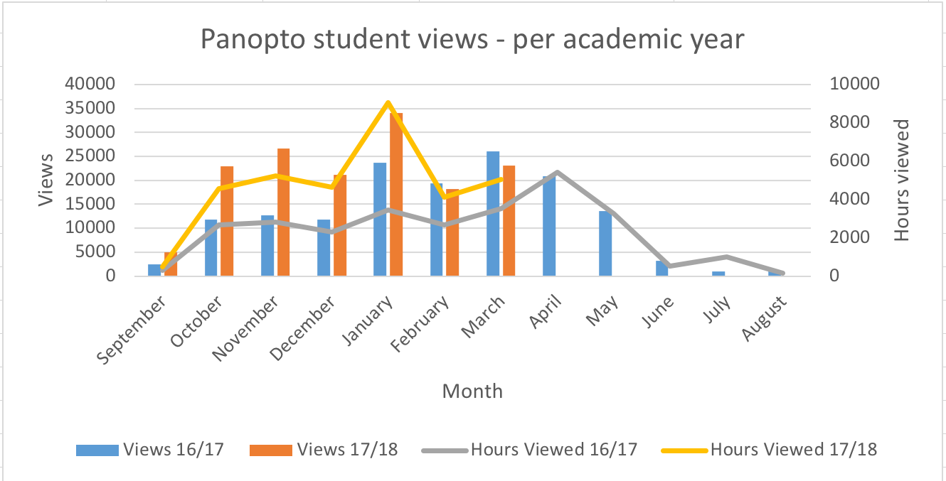
Event Capture
Our ambition is for all lectures recorded and available to students to enhance their learning experience.
and students
Currently Available
Event Capture is ready for you to use. Please get in contact if you need any help getting started.
Coming next
Automatic recording of scheduled teaching events through a pilot of lecture theatres 1L17, 2Q49, 2X242, 2D07 from Sept 2018
General Upward Trend in Student viewing of Lectures

Slide 12
Programmatic Blackboard
Our Ambition is for a learner-centric experience for our students enabled through our virtual learning environment. To enable Programme Leaders to present a more coherent view of the programme to their students without additional administrative burden.
Coming Next
Available from September 2018

Slide 13
What next?
Top 20 University
Enhancement Framework
Programme level Support, alongside teaching and learning
Subject level TEF
Employability and Enterprise
Continuation and Personalised Learning
Academic Development for Programme Leaders and Module Leaders, Apprenticeship
New Regulations
Multi-disciplinary Curriculum
Students as co-delivers, partners, research contributors
Role of digital learning
Reward and recognition for teaching and learning
UWE Pedagogy?
Never forgetting the basics!

Slide 14
Learning 2020
June 7th 2018
Jane Harrington
Deputy Vice Chancellor and Provost

