Slide 1
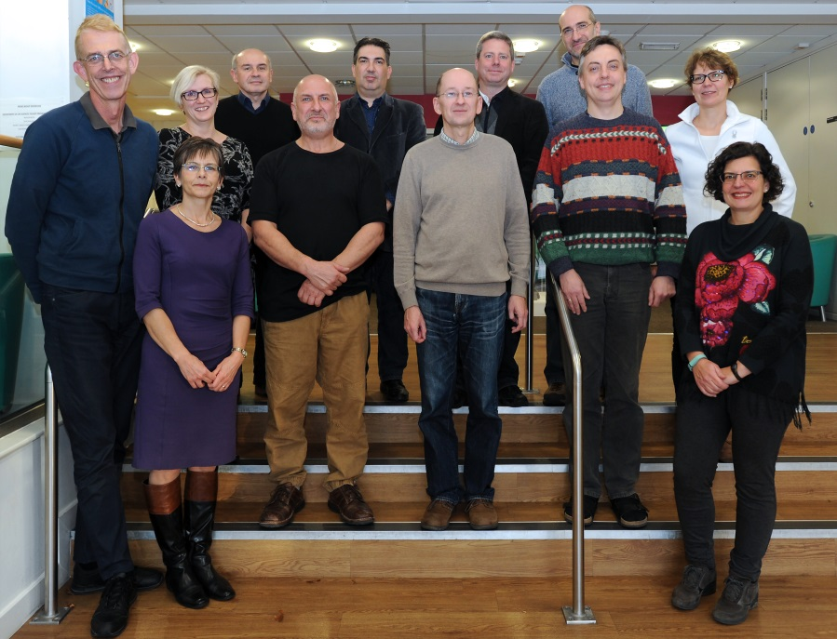
Integrated Programme Assessment (IPA): Reduced Assessment and Better Graduates
CATE WINNERS 2016
David Tree
Director of Teaching and Learning
Department of Life Sciences
Notes:
Thank you for the invitation to talk to you about an innovative assessment approach we have been using at Brunel, for which we received a Collaborative Award for Teaching Excellence, sponsored by the HEA (UK).
Whilst Amanda Harvey and myself collected the award last January, this was on behalf of all the Biosciences staff, some of which you see here.
IPA is used in about half of the subject areas at Brunel, but Biosciences remains the flagship.
What is it?
Why we developed it?
What are the outcomes?
How did we do it?

Slide 2
HE sector context
Learning Outcomes – transparency of how students demonstrate achievement
UK/international interest in IPA driven by:
- concerns about over-assessment
- need for authentic assessments
- “we test what is easy to test…..”
- standards based assessment
- sustainable assessment
Notes:
David Boud (Australia)
Standard based assessment – where students meet or don’t meet the requirements; clear transparency of how LOs are met;
Sustainable assessment - meets needs of the present w/o compromising students ability to meet their own future learning need – fosters long-term learning

Slide 3
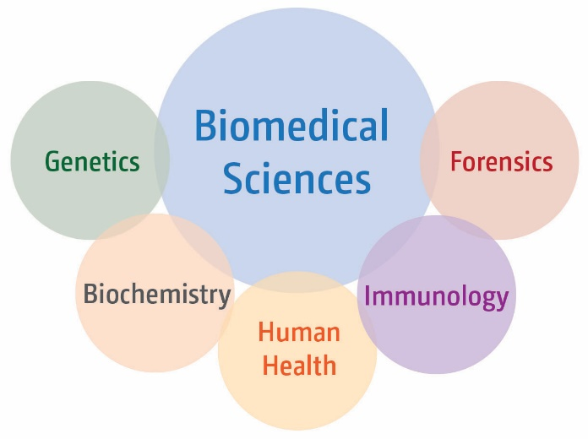
Drivers for change (2010)
Heavy assessment burden
Increased student numbers
Many low-credit pieces of assessment
Improve graduate attributes
Application of knowledge
Develop range of skills
In silo learning
Senate Regulations (2009)
-
uncoupled
teaching and assessment
Notes:
At Brunel we deliver a core Biomedical Sciences programme, with a number of specialist pathways that so that students can tailor their degree according to their interests.
In 2010, this was a typical science programme with many assessments, often for small credits, and student numbers had doubled without a corresponding change in assessment practice – so a heavy assessment burden both for students and staff.
We were also increasingly aware of the need to improve graduate attributes, i.e. the skills they can demonstrate on graduation, in particular the application of knowledge, as well as developing a greater range of skills, and to try to tackle the compartamentalised learning that is often so evident in students in a modular system.
At the same time, changes to our Academic regulations had facilitated uncoupling teaching and assessment

Slide 4
Integrated Programme Assessment (IPA): Teaching and Assessment uncoupled
Module
T
T
T
T
T
A
A
A
A
A
T
T
T
T
T
A
A
A
Separating study and assessment reflects real life – we integrate information from many sources to solve a problem
Notes:
Explain module
….. allows us to move away from a structure where teaching and assessment is contained within single modules, to one where assessment is separated from the teaching. Tried to illustrate how assessment can then require integration of information from a teaching activities that may be delivered across a range of modules..
This is reflective of real life ….

Slide 5
What we achieved
Reduced summative assessment burden by 2/3
Designed meaningful assessments that develop:
critical and analytical thinking
application of knowledge
independent and reflective learning
Give all students the same learning/development opportunities
Improved student experience and outcomes
Notes:
But before telling you about how we made the changes, I want to give you the outcomes and perhaps pique your interest!
In 2010, staff in Biosciences were marking ~10,000 pieces of work each year. This reduced to about 3000 pieces after IPA.
We moved away from assessment that tested knowledge to ones that developed …..
We made sure that all students had the same opportunities to develop skills irrespective of optional modules studied, and we have seen improved outcomes:

Slide 6
Student Awards Data
Pre-IPA
Post-IPA
Degree outcomes have improved using the synoptic approach compared to the modular programme.
Notes:
Increase in good degrees.
Introduced for new starters in September 2011, so first graduates would come through in summer 2014; however we have placements and so this cohort was a mix of those subject to new and old assessment regime. Summer 2015 was the first year where all graduates had followed IPA.
This year’s data has not been finalised yet as we are awaiting outcomes from reassessment, but it looks to be in line. Whilst I don’t want to put too much emphasis on this data as the assessment tasks were changed, we believe that with fewer pieces of assessments they become more high stakes for students, who take them more seriously. Crucially students have the time to work on them. To support fewer assessments, there are formative feedback provided on various tasks, and so students are also better supported.

Slide 7
Closing the Attainment Gap
2012-2013 | 2015-2016
12.5% | 7.5%
-5%
Pre-IPA
Post-IPA
Attainment gap reduced using the integrated assessment approach compared to the modular programme.
Notes:
We have just started to look at different groups of students, and the overall picture is that improved outcome is observed for all groups, and whilst the attainment gap still persists, it is reduced.

Slide 8
Graduate Level Outcomes
Pre-IPA
Post-IPA
Positive graduate level outcomes increased; negative outcomes decreased
Notes:
Perhaps a more interesting measure is the DLHE graduate level outcomes data, which shows that an increased proportion (10%) of Biomed graduates had positive outcomes after experiencing IPA programme, compared to the modular programme. There is a reduction in unemployment and non-graduate work.

Slide 9
Students feel better prepared for employment
Pre-IPA
Post-IPA
Biomedical Sciences graduates feel better prepared for employment than Department of Life Sciences graduates
Notes:
And the students report via additional questions in the DLHE survey that they are better prepared for employment, compared to the dept as a whole.

Slide 10
NSS – Assessment and Feedback
 | 2013 | 2015
Biosciences | 73% | 79%
Brunel | 72% | 71%
Sector | 74% | 76%
+6%
-1%
+2%
Pre-IPA
Post-IPA
National subject ranking increased from 28th to 8th
Notes:
And NSS also improved pre- and post-IPA. Held steady in 2016, but this year students boycotted and so no reliable data.
Outcomes good – what did we do?

Slide 11
Senate Regulation changes
From:
… must normally undertake modules to a value of at least 120 credits at each level…
To:
…A normal period of study will be approved for each programme…Each year of full-time study shall normally be equivalent to 120 credits of assessment…
Notes:
The regulatory changes are actually very simple – we changed from – to:
Note that this description does not preclude modules.
We adhere to the UK credit framework and so each student will do 120 credits worth of study per year, and 120 credits worth of assessment.
This then allows us to weight the assessment independently of the study hours.

Slide 12
IPA in five easy steps
What is the purpose of the programme – who is it for? Aim
What do we want graduates to know; be able to do; skills/competencies? Learning Outcomes
What assessments are needed/appropriate to demonstrate learning outcomes are met? Assessment Strategy
How are students best supported to be successful in assessments? Teaching Strategy
What content needs to be covered, in what sequence, by whom, etc. Delivery
Notes:
IPA can be described in 5 easy steps, using what has been termed backwards design (Wiggins and McTighe, 1998)
1 Defining what the the purpose of the programme is. This gives you the aim.
2 Determine what the programme-wide attributes are and define explicit outcomes – we defined Learning Outcomes for each level, but could be done for the programme overall to reduce summative assessment even further.
3 Once the LOs have been determined you need to think about how students are going to demonstrate that they have achieved them.
This will form the assessment strategy, and for us an important factor was that they had to integrate information
4 How students are supported to through lectures, seminars, practical classes, formative tasks to be successful in assessments forms the teaching strategy.
5 And finally, the delivery schedule is decided.
I don’t know about you, but traditionally at Brunel this is often the starting point, and we have worked very hard to convince our staff that starting with what you already do is unlikely to give the innovative curriculum and exciting programmes that we should be delivering.

Slide 13
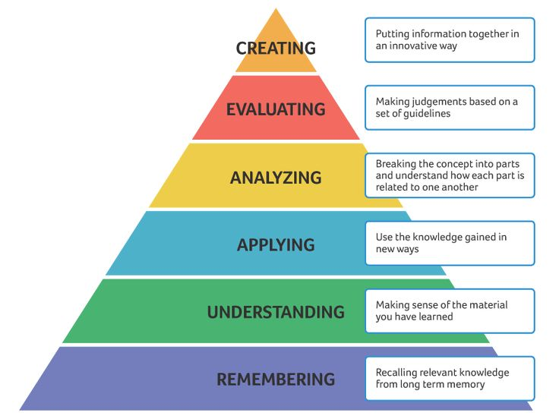
Graduate Attributes
Informed by:
Benchmark Statements
PSRB requirements
Notes:
Guided by subject benchmark statement we settled on 4 broad skills areas:
These did not change, but were developed to an increasing complexity from level 4 to level 6.
And in describing the LOs we had due regard to Bloom’s taxonomy.

Slide 14
Assessment follows Bloom’s taxonomy
Level
6
Level
5
Level
4
Notes:
And in describing the LOs we had due regard to Bloom’s taxonomy.

Slide 15
Assessment focussed on skills
Skills
Subject Knowledge, Understanding Integration
Communication
Analysis/ Evaluation
Professional development
Notes:
Guided by subject benchmark statement we settled on 4 broad skills areas:
These did not change, but were developed to an increasing complexity from level 4 to level 6.
And in describing the LOs we had due regard to Bloom’s taxonomy.

Slide 16
Assessment focussed on skills
Skills
Subject Knowledge, Understanding Integration
Communication
Analysis/ Evaluation
Professional development
Assessment
Subject specific and synoptic exams
Presentations Scientific reports and papers
Literature Data Problem Solving
Portfolios
Final Year Project
L | Communication
4 | The ability to communicate basic scientific topics Report
5 | The ability to communicate scientific data and literature Journal manuscript
6 | Effectively communicate complex scientific information Dissertation
Notes:
Guided by QAA subject benchmark statement we settled on 4 broad skills areas:
These did not change, but were developed to an increasing complexity from level 4 to level 6.
In order to ensure that assessment was fit-for-purpose (Sally Brown 2004) we developed a clear rationale for what and how we wanted students to demonstrate they met the LOs, and this gives you an idea of the type of assessments we are using:
And you can see we have tried to give a sense of progression in the requirements from Level 4-6, example is for written communication.

Slide 17
Coherence within and between levels
Coherence
Level 6
Level 5
Level 4
Agder University 16 October 2017
Notes:
We developed each level, and then did a vertical check to ensure there was coherence and progression, avoiding unnecessary repetition.
Iterative process.

Slide 18
IPA - Level 4
Study
Critical Thinking
(5)
Research skills
(15)
Practical skills
(20)
Biology of the cell
(40)
Biochemistry
(20)
Anatomy & Physiology (20)

Slide 19
IPA - Level 4
Assessment
Synoptic Exam 1
(20)
Biomedical Sciences Exam 1
(20)
Practical Skills: Molecular Analysis
(20)
Practical Skills: Biochemical Analysis
(20)
Practical skills: Microscopy (20)
Research Skills & Communic-ation
(20)
Study
Critical Thinking
(5)
Research skills
(15)
Practical skills
(20)
Biology of the cell
(40)
Biochemistry
(20)
Anatomy & Physiology (20)

Slide 20
IPA - Level 4
Assessment
Synoptic Exam 1
(20)
Biomedical Sciences Exam 1
(20)
Practical Skills: Molecular Analysis
(20)
Practical Skills: Biochemical Analysis
(20)
Practical skills: Microscopy (20)
Research Skills & Communic-ation
(20)
Study
Critical Thinking
(5)
Research skills
(15)
Practical skills
(20)
Biology of the cell
(40)
Biochemistry
(20)
Anatomy & Physiology (20)

Slide 21
IPA - Level 4
Assessment
Synoptic Exam 1
(20)
Biomedical Sciences Exam 1
(20)
Practical Skills: Molecular Analysis
(20)
Practical Skills: Biochemical Analysis
(20)
Practical skills: Microscopy (20)
Research Skills & Communic-ation
(20)
Study
Critical Thinking
(5)
Research skills
(15)
Practical skills
(20)
Biology of the cell
(40)
Biochemistry
(20)
Anatomy & Physiology (20)

Slide 22
IPA - Level 4
Assessment
Synoptic Exam 1
(20)
Biomedical Sciences Exam 1
(20)
Practical Skills: Molecular Analysis
(20)
Practical Skills: Biochemical Analysis
(20)
Practical skills: Microscopy (20)
Research Skills & Communic-ation
(20)
Study
Critical Thinking
(5)
Research skills
(15)
Practical skills
(20)
Biology of the cell
(40)
Biochemistry
(20)
Anatomy & Physiology (20)

Slide 23
IPA - Level 4
Assessment
Synoptic Exam 1
(20)
Biomedical Sciences Exam 1
(20)
Practical Skills: Molecular Analysis
(20)
Practical Skills: Biochemical Analysis
(20)
Practical skills: Microscopy (20)
Research Skills & Communic-ation
(20)
Critical Thinking
(5)
Research skills
(15)
Practical skills
(20)
Biology of the cell
(40)
Biochemistry
(20)
Anatomy & Physiology (20)

Slide 24
Practical Skills: Microscopy
From Study Blocks:
Anatomy and Physiology: Function and histology of the human digestive tract
Biology of the Cell: Differentiation of different and potentially pathogenic bacteria
Practical Skills: Enumeration of cells with a counting chamber and a microscope
Research Skills:
Using a microscope safely and correctly

Slide 25
Practical Skills: Microscopy
The students are faced with the clinical scenario of a patient suffering from abdominal pain.

Slide 26
Practical Skills: Microscopy
The students are faced with the clinical scenario of a patient suffering from abdominal pain.
Abdominal pain could be caused by

Slide 27
Practical Skills: Microscopy
The students are faced with the clinical scenario of a patient suffering from abdominal pain.
Abdominal pain could be caused by
A) histological (structural) changes

Slide 28
Practical Skills: Microscopy
The students are faced with the clinical scenario of a patient suffering from abdominal pain.
Abdominal pain could be caused by
A) histological (structural) changes B) an unusually high number of bacteria normally present in the gut, or

Slide 29
Practical Skills: Microscopy
The students are faced with the clinical scenario of a patient suffering from abdominal pain.
Abdominal pain could be caused by
A) histological (structural) changes B) an unusually high number of bacteria normally present in the gut, or C) by a bacterial or fungal species not normally present in the gut.

Slide 30
Practical Skills: Microscopy
The students are faced with the clinical scenario of a patient suffering from abdominal pain.
Abdominal pain could be caused by
A) histological (structural) changes B) an unusually high number of bacteria normally present in the gut, or C) by a bacterial or fungal species not normally present in the gut.
Students have to assess histology images of the digestive tract as well as routine microbiology procedures such as Gram staining and microbiological enumeration techniques in order to establish what might be the cause of problems for a patient

Slide 31
IPA - Level 5
Assessment
Synoptic Exam 2
(20)
Biomedical Sciences Exam 2
(20)
Professional Skills
(20)
Primary Literature Interrogation and Synthesis (20)
Data Evaluation and Reporting
(20)
Data Analysis, Interpretation and Presentation
(20)
Study
Critical Thinking
(5)
Career
skills
(15)
Molecular and Cellular Biology
(20)
Genetic Engineering and Immunobiology
(20)
Principles of Human Disease
(20)
Analytical Biochemistry(20)
Medical Biochemistry (20)
Metabolic Regulation (20)
Genetics & Development (20)

Slide 32
IPA - Level 5
Assessment
Synoptic Exam 2
(20)
Biomedical Sciences Exam 2
(20)
Professional Skills
(20)
Primary Literature Interrogation and Synthesis (20)
Data Evaluation and Reporting
(20)
Data Analysis, Interpretation and Presentation
(20)
Study
Critical Thinking
(5)
Career
skills
(15)
Molecular and Cellular Biology
(20)
Genetic Engineering and Immunobiology
(20)
Principles of Human Disease
(20)
Analytical Biochemistry(20)
Medical Biochemistry (20)
Metabolic Regulation (20)
Genetics & Development (20)

Slide 33
IPA - Level 5
Assessment
Synoptic Exam 2
(20)
Biomedical Sciences Exam 2
(20)
Professional Skills
(20)
Primary Literature Interrogation and Synthesis (20)
Data Evaluation and Reporting
(20)
Data Analysis, Interpretation and Presentation
(20)
Study
Critical Thinking
(5)
Career
skills
(15)
Molecular and Cellular Biology
(20)
Genetic Engineering and Immunobiology
(20)
Principles of Human Disease
(20)
Analytical Biochemistry(20)
Medical Biochemistry (20)
Metabolic Regulation (20)
Genetics & Development (20)

Slide 34
Data Analysis, Interpretation and Presentation
Poster presentation based on case study
Students are given raw data (similar to that generated in laboratory practical experiments):
- Histology Sections (exfoliative smears, liver biopsy)
ELISA data
CD4 T cell counts
Liver enzyme assays
Data is analysed and formatted for presentation
Concludes with likely prognosis and possible treatments
Presented at the Brunel Symposium on Opportunistic Infections in Diseases of the Immune System

Slide 35
IPA - Level 6
Assessment
Scientific
Communication
(20)
Problem Solving and Data Analysis (20)
Biomedical Sciences Exam 3
(20)
Synoptic Exam 3
(20)
Final Year Project
(40)
Study
Forensic Investigation (20)
Term 2
Option 1
(20)
Term 2
Option 2
(20)
Term 2
Option 3
(20)
Genomic Technologies (20)
Medical Biochemistry (20)
Microbial Pathogenesis (20)

Slide 36
IPA - Level 6
Assessment
Scientific
Communication
(20)
Problem Solving and Data Analysis (20)
Biomedical Sciences Exam 3
(20)
Synoptic Exam 3
(20)
Final Year Project
(40)
Study
Forensic Investigation (20)
Term 2
Option 1
(20)
Term 2
Option 2
(20)
Term 2
Option 3
(20)
Genomic Technologies (20)
Medical Biochemistry (20)
Microbial Pathogenesis (20)

Slide 37
IPA - Level 6
Assessment
Scientific
Communication
(20)
Problem Solving and Data Analysis (20)
Biomedical Sciences Exam 3
(20)
Synoptic Exam 3
(20)
Final Year Project
(40)
Study
Forensic Investigation (20)
Term 2
Option 1
(20)
Term 2
Option 2
(20)
Term 2
Option 3
(20)
Genomic Technologies (20)
Medical Biochemistry (20)
Microbial Pathogenesis (20)

Slide 38
Problem Solving and Data Analysis Coursework
Portfolio of work from three options
Different options do different work BUT they all involve solving problems by analysing data
Fulfil the same learning outcomes
Biology, Genetics and Treatment of Cancer
Cellular Pathology
Endocrine Disorders
Genomic Medicine
Medical Immunology
Molecular Pharmacology and Toxicology

Slide 39
Synoptic Exam
A seen exam - question released 7 days in advance
At every level, increasing in difficulty and complexity
Expectation that students will:
integrate knowledge and information from across the degree and wider subject area
show engagement with, and critical understanding of, the primary academic literature
demonstrate understanding of relevant ethical issues

Slide 40
Main Challenge = Main Strength Collegial and team-based approach
Notes:
Overcoming “You’re messing with MY module”
Staff need to know more about what (and how) colleagues teach
Multiple markers for each assessment requires thorough moderation
Need to be creative with synoptic assessment
Weaker areas are exposed (exam only assessment units)

Slide 41
Building a successful team
Who is needed?
Students
Staff
Experts in Programme Design
Taught Programmes Office

Slide 42
Main Challenge - Collegial and team-based approach
Overcoming “You’re messing with MY module”
Staff need to know more about what (and how) colleagues teach
Multiple markers for each assessment requires thorough moderation
Need to be creative with synoptic assessment
Weaker areas are exposed (exam only blocks)

Slide 43
Benefits
Staff
Assessment burden is reduced
Marking is shared
Teaching has become a ‘community property’
Students
Fewer more interesting assessments
Formative activities supports learning
Recognise graduate attributes
Better students outcomes
Better preparation for employment
Increased student satisfaction
Highlighted as good practice by professional bodies

Slide 44
Stakeholder Perspectives: Student Feedback
“I have to deliver presentations, communicate with clients at face to face meetings, deliver training - all of which require good oral presentation skills and some degree of confidence.
Posters and presentations are great practice for that, in addition to being good practice at presenting information visually in an easy to read and attractive manner.
Talks and the 'conference style' poster presentations were also really good for developing networking skills, something that's come in really handy being in a client-facing position”
- (2015 Graduate)
Notes:
Students more aware of their skills and graduate attributes and therefore more likely to be able to demonstrate how they fit the role. May explain why we see better employment outcomes.
I made a big claim in the title of my talk – Better Graduates – I hope this demonstrates why.

Slide 45
Stakeholder Perspectives: PSRB and Design Panel Comments
At Accreditation events PSRBs have identified the use of study and assessment blocks as an example of good practice.
- Royal Society of Biology Accreditation Dec 2014
At re-approval events, this structure has been commended for its flexibility:
“the Panel commended a very well thought out and re-designed programme with clear documentation which made excellent use of the new freedom of the programme”.
- Re-approval BSc OT January 2012

Slide 46
Stakeholder Perspectives: External Examiners
External Examiners confirm:
“the methodology of separating assessment blocks from teaching blocks, should increase the abilities of students to synthesise material and develop critical thinking and should be commended”.
“[the synoptic approach allows] students scope to bring together material in such a way that must enhance their overall understanding”.
Notes:
All students, irrespective of chosen options, have the same opportunities for skills development.

Slide 47
Stakeholder Perspectives: Staff Comments
“My initial reservation with the programme-level learning and assessment strategy for The Division of Biosciences centred on the introduction of non-assessed exercises within the curriculum. For example a number of laboratory assessment were not directly assessed with a formal “linked” assessment.
However, having seen the strategy operate for a few academic cycles, I am convinced that a programme (rather than modular) level assessment strategy is advantageous because it prevents a silo approach to learning and encourages students to take a wider view in their learning strategies. It also permits a wider use of synoptic assessments which allows a more effective assessment of student knowledge and skills and allows constructive alignment of learning and assessment”
- Former Staff Member

Slide 48
Requirements for IPA
Regulations that accommodate separation of teaching/study and assessment
Collegial and team/based approach
Vision of what is to be achieved
Plan everything (coordinators/marking/moderation)
HEA Annual Conference 6 July 2017

Slide 49
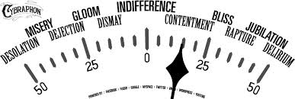
Happy-o-meter of IPA approach
Why wouldn’t it work for you?
http://www.brunel.ac.uk/about/education-innovation

Slide 50
Integrated Programme Assessment (IPA): Reduced Assessment and Better Graduates
CATE WINNERS 2016
David Tree
Director of Teaching and Learning
Department of Life Sciences
Notes:
Thank you for the invitation to talk to you about an innovative assessment approach we have been using at Brunel, for which we received a Collaborative Award for Teaching Excellence, sponsored by the HEA (UK).
Whilst Amanda Harvey and myself collected the award last January, this was on behalf of all the Biosciences staff, some of which you see here.
IPA is used in about half of the subject areas at Brunel, but Biosciences remains the flagship.
What is it?
Why we developed it?
What are the outcomes?
How did we do it?

