Slide 1

Presentation by
Classroom Based Enquiry (CBE)
Information for Senior Mentors, Subject Mentors and PGCE core/School Direct trainee teachers.
Mark Jones
Module Leader
15/10/18
Notes:
.

Slide 2
The Classroom Based Enquiry (CBE) Assignment
Classroom Based Enquiry
Why is there an emphasis on teachers researching their classroom practice?
Key information for the CBE for 2018-19
The difference between research methodology and methods
Planning a small scale classroom-based enquiry using case study methodology
What is expected at the proposal stage when school-based mentors and trainees discuss the proposed research between Monday 12th November and Wednesday 21st November 2018 ?
What is expected at the University Call Back Day on Friday 23rd November, 2018 ?
Writing up the completed research – an introduction.

Slide 3
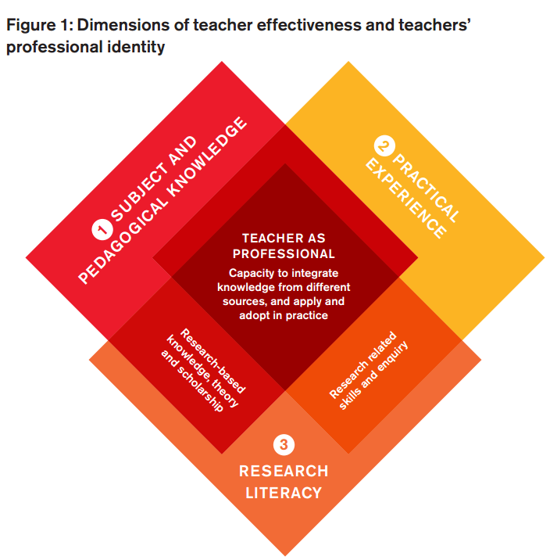

The Classroom Based Enquiry (CBE) Assignment
1. Why is there an emphasis on teachers researching their classroom practice ?
BERA-RSA (2014) Research and the Teaching Profession; building the capacity for a self-improving education system. Final report of the BERA-RSA Inquiry into the role of research in teacher education. London: BERA. Available from:
https://www.bera.ac.uk/wp-content/uploads/2013/12/BERA-RSA-Research-Teaching-Profession-FULL-REPORT-for-web.pdf [Accessed 16 February 2017]

Slide 4
The Classroom Based Enquiry (CBE) Assignment
1. Why is there an emphasis on teachers researching their classroom practice ?
First, the content of teacher education programmes may be informed by research-based knowledge and scholarship, emanating from a range of academic disciplines and epistemological traditions.
Second, research can be used to inform the design and structure of teacher education programmes.
Third, teachers and teacher educators can be equipped to engage with and be discerning consumers of research.
Fourth, teachers and teacher educators may be equipped to conduct their own research, individually and collectively, to investigate the impact of particular interventions or to explore the positive and negative effects of educational practice.
(BERA-RSA, 2014, pp. 10-11)

Slide 5
The Classroom Based Enquiry (CBE) Assignment
1. Why is there an emphasis on teachers researching their classroom practice ?
Professional Practice (PP)
Teaching File
Weekly Logs
Review Point Reports
RP1, RP2 (Placement A)
RP3, RP4 (Placement B)
Subject Knowledge for Teaching (SKfT) assignment
Professional Development (PD) assignment
Classroom Based Enquiry (CBE) assignment
BERA-RSA (2014) Research and the Teaching Profession; building the capacity for a self-improving education system. Final report of the BERA-RSA Inquiry into the role of research in teacher education. London: BERA. Available from:
https://www.bera.ac.uk/wp-content/uploads/2013/12/BERA-RSA-Research-Teaching-Profession-FULL-REPORT-for-web.pdf [Accessed 16 February 2017]

Slide 6
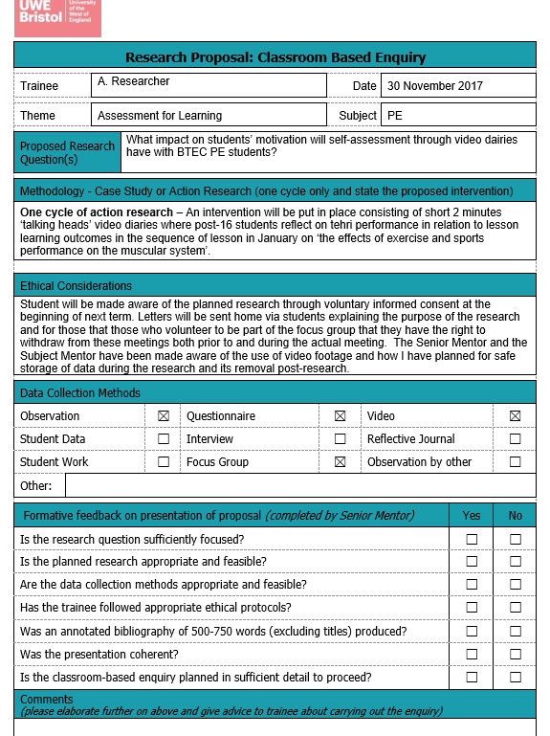
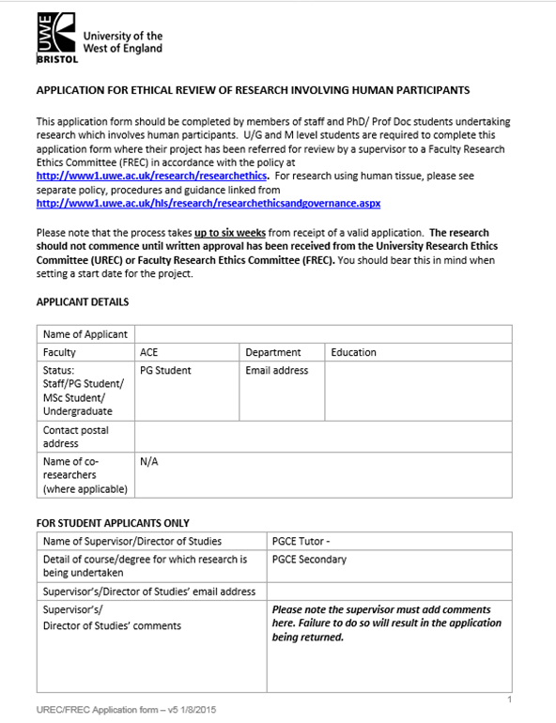
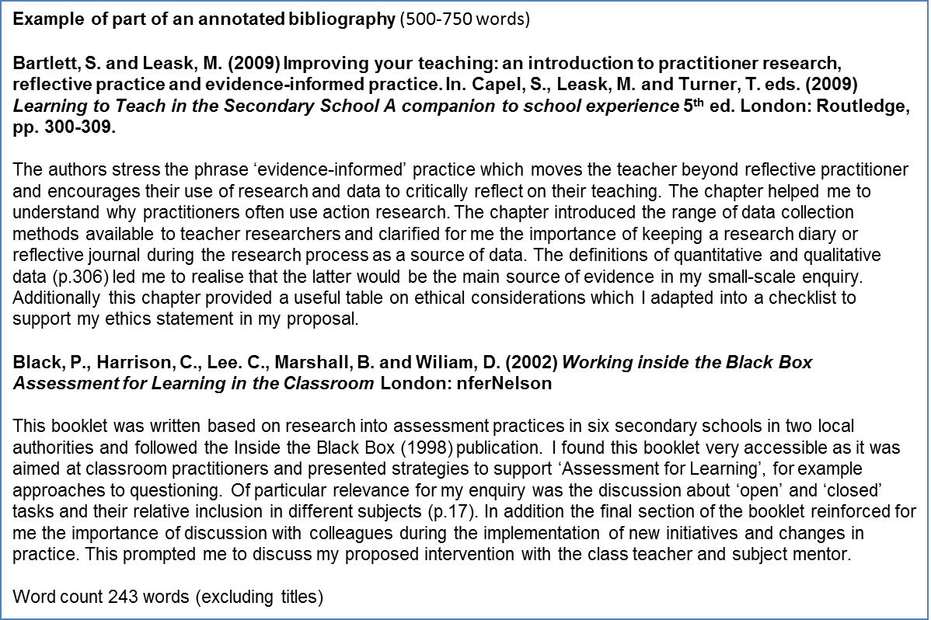
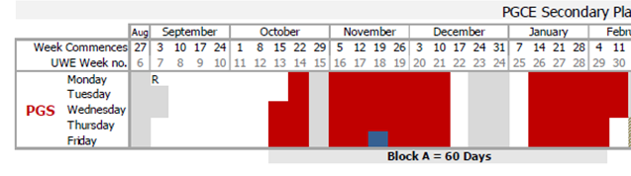
The Classroom Based Enquiry (CBE) Assignment
2. Key information for the CBE in 2018-19
Trainees will be using a methodology of Case Study
4. Period of 3 weeks when trainees able to start data collection for research
(case study)
5. Wednesday 9 January 2019 Trainees submits 3,750 wc written assignment (CBE).
1. Trainees have weekly lectures introducing then to concept of becoming ‘research literate’ – ‘engage with’ and ‘engage in’ research
2. Between Monday 12th November and Wednesday 21st November 2018 trainees present research proposal and annotated bibliography to Senior Mentor for formative feedback.
3. UWE Call Back Day Friday 23 November 2018 Trainees present their formative feedback and annotated bibliography and undergoes university’s ethical approval stage in order to collect data on return to placement.

Slide 7
The Classroom Based Enquiry (CBE) Assignment
3. The difference between research methodology and methods
Methodology
Methods
Document scrutiny
Case Study
Observation
Questionnaire
Interview
Focus Group
In much practitioner research methodology is used synonymously with approach.
Wilson (2013) suggests the methodological approaches of case study and action research as most appropriate to school-based research.
Whatever the purpose of the research, essentially there are three main approaches utilised within methods:
- analysis of documents, (including visuals and artefacts)
- observing
- questioning.

Slide 8
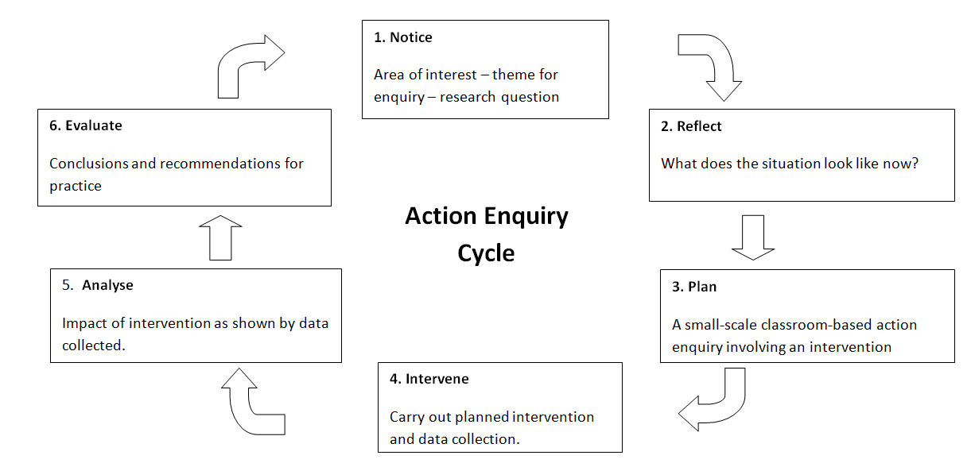
The Classroom Based Enquiry (CBE) Assignment
4. Planning a small scale classroom-based enquiry using Case Study
Case Study
5. Analyse - what has the data collection revealed about the situation being investigated ?
3. Plan for methods of data collection to investigate the selected theme.
4. Carry out data collection
e.g. interviews, observations, document scrutiny, work scrutiny.

Slide 9
The Classroom Based Enquiry (CBE) Assignment
4. Planning a small scale classroom-based enquiry using Case Study
Student is interested in pupils’ perceptions of citizenship education in the school (case study)
1. Identify a theme or area of interest.

Slide 10
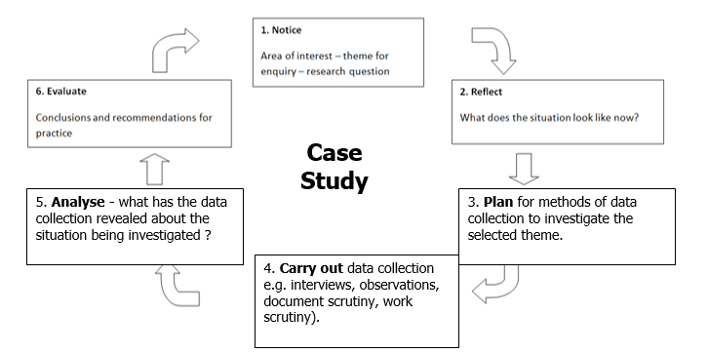
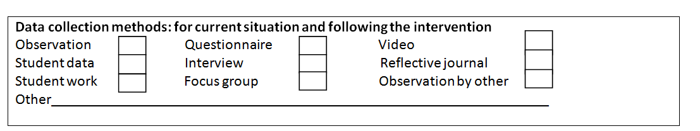
The Classroom Based Enquiry (CBE) Assignment
4. Planning a small scale classroom-based enquiry using Case Study
Student is interested in pupils’ perceptions of citizenship education in the school (case study)
Reflect – What does the situation look like now?
Read literature on theme and research methodology/methods/ethics
Plan for how data will be collected during the case study research

Slide 11


Russian Doll principle
Russian Doll Principle – refining the research question
Goldilocks Test

Slide 12
The Classroom Based Enquiry (CBE) Assignment
4. Planning a small scale classroom-based enquiry using Case Study
1. A small scale investigation into year 7 pupils’ perceptions of the vertical tutoring approach in their new school. This case study focused on four year 7 pupils who were part of a vertical tutor group of 22 pupils (Year 7 to Year11). The main methods used were observation, questionnaire and interviews.
2. A case study of Year 11 students’ attitudes to the content and teaching approaches use in Year 11 PSHE lessons. This case study explored how three different students experienced the PSHE curriculum in their school.
3. A case study of 9C’s perceptions of migration in the UK. This case study used data collection methods of a questionnaire (24 pupils) followed by semi-structured interviews (3) with photo-elicitation.

Slide 13
5. What is expected at the proposal stage?
Example of part of an annotated bibliography (500-750 words)
Bartlett, S. and Leask, M. (2009) Improving your teaching: an introduction to practitioner research, reflective practice and evidence-informed practice. In. Capel, S., Leask, M. and Turner, T. eds. (2009) Learning to Teach in the Secondary School A companion to school experience 5th ed. London: Routledge, pp. 300-309.
The authors stress the phrase ‘evidence-informed’ practice which moves the teacher beyond reflective practitioner and encourages their use of research and data to critically reflect on their teaching. The chapter helped me to understand why practitioners often use action research. The chapter introduced the range of data collection methods available to teacher researchers and clarified for me the importance of keeping a research diary or reflective journal during the research process as a source of data. The definitions of quantitative and qualitative data (p.306) led me to realise that the latter would be the main source of evidence in my small-scale enquiry. Additionally this chapter provided a useful table on ethical considerations which I adapted into a checklist to support my ethics statement in my proposal.
Black, P., Harrison, C., Lee. C., Marshall, B. and Wiliam, D. (2002) Working inside the Black Box Assessment for Learning in the Classroom London: nferNelson
This booklet was written based on research into assessment practices in six secondary schools in two local authorities and followed the Inside the Black Box (1998) publication. I found this booklet very accessible as it was aimed at classroom practitioners and presented strategies to support ‘Assessment for Learning’, for example approaches to questioning. Of particular relevance for my enquiry was the discussion about ‘open’ and ‘closed’ tasks and their relative inclusion in different subjects (p.17). In addition the final section of the booklet reinforced for me the importance of discussion with colleagues during the implementation of new initiatives and changes in practice. This prompted me to discuss my proposed intervention with the class teacher and subject mentor.
Word count 243 words (excluding titles)

Slide 14

5. What is expected at the proposal stage ?
  All work must be undertaken within an explicit code of ethics, as specified in BERA (2018) guidelines
  In undertaking action research, the primacy of your professional responsibilities as a teacher must always be respected
  It is helpful to share elements of your project and process with pupils and colleagues to promote shared ownership of the improvement of learning
  “It is normally expected that participants’ voluntary informed consent to be involved in a study will be obtained at the start of the study…”(BERA, 2018, p.9)
  Any participant has the right to withdraw from providing additional time or information to your enquiry, beyond what is part of their normal relationship to you as a teacher, and they need to be informed of this at the outset
  You must endeavour to protect participants from educational, physical and psychological harm at all points in the research
  You are required to ensure confidentiality/anonymity of participant identity and data, beyond that already in the public domain
NB One of the inclusions in the annotated bibliography should be BERA (2018)

Slide 15
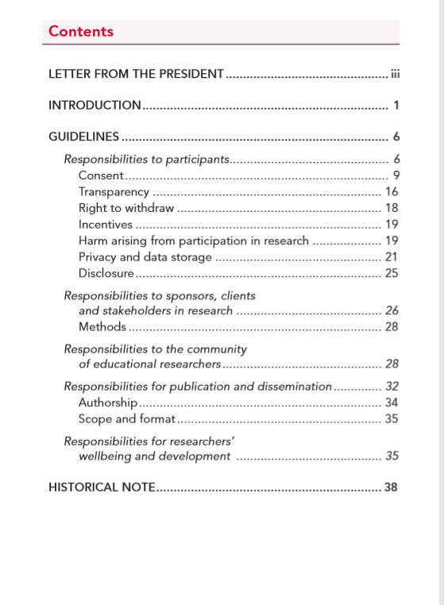
5. What is expected at the proposal stage ?
NB One of the inclusions in the annotated bibliography should be BERA (2018)

Slide 16
5. What is expected at the proposal stage ?
‘The Association recognises that the community of educational researchers is multidisciplinary and diverse in its application of research approaches and philosophical positions. Concepts such as ‘data’, ‘reliability’, ‘validity’, ‘credibility’, ‘trustworthiness’, ‘subjectivity’ and ‘objectivity’ may therefore be understood and legitimately applied in different ways. Ethical review processes thus need to be conducted in an open-minded and inclusive manner.’
(BERA, 2018, p.3)
NB One of the inclusions in the annotated bibliography should be BERA (2018)

Slide 17
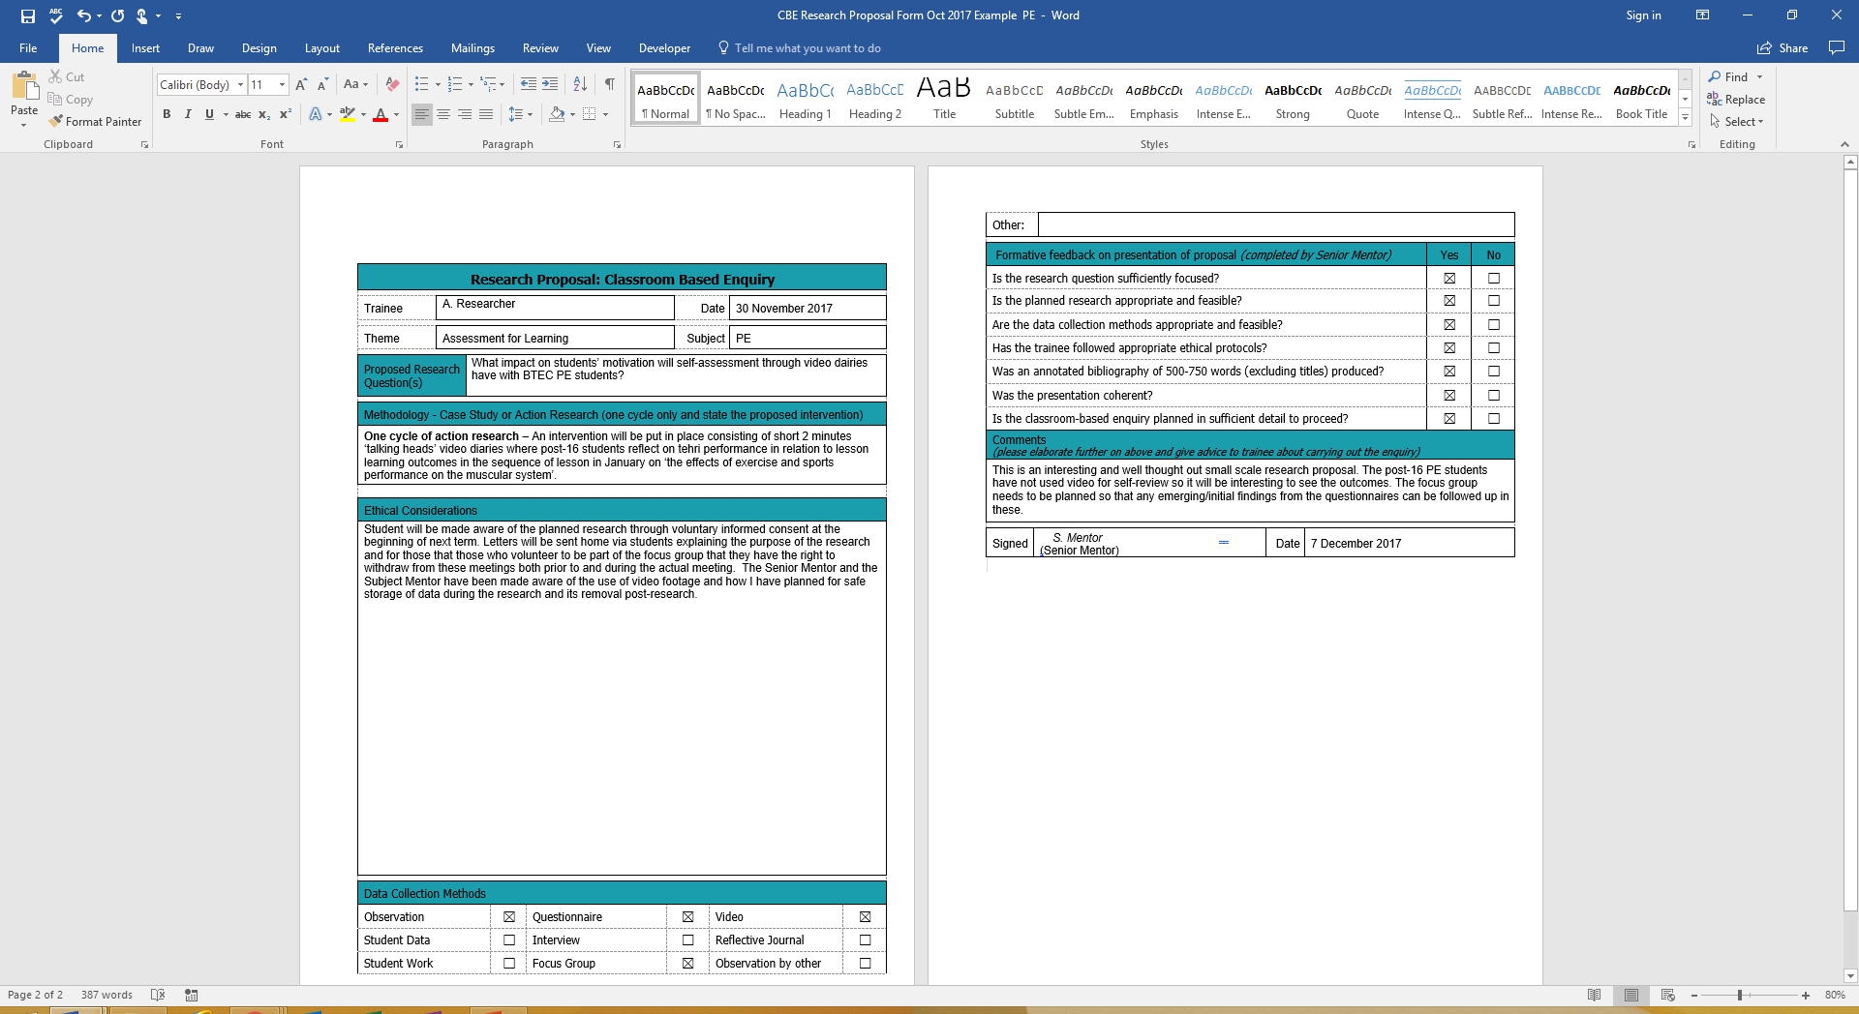
5. What is expected at the proposal stage ?
Example of part of an annotated bibliography (500-750 words)
Bartlett, S. and Leask, M. (2009) Improving your teaching: an introduction to practitioner research, reflective practice and evidence-informed practice. In. Capel, S., Leask, M. and Turner, T. eds. (2009) Learning to Teach in the Secondary School A companion to school experience 5th ed. London: Routledge, pp. 300-309.
The authors stress the phrase ‘evidence-informed’ practice which moves the teacher beyond reflective practitioner and encourages their use of research and data to critically reflect on their teaching. The chapter helped me to understand why practitioners often use action research. The chapter introduced the range of data collection methods available to teacher researchers and clarified for me the importance of keeping a research diary or reflective journal during the research process as a source of data. The definitions of quantitative and qualitative data (p.306) led me to realise that the latter would be the main source of evidence in my small-scale enquiry. Additionally this chapter provided a useful table on ethical considerations which I adapted into a checklist to support my ethics statement in my proposal.
Black, P., Harrison, C., Lee. C., Marshall, B. and Wiliam, D. (2002) Working inside the Black Box Assessment for Learning in the Classroom London: nferNelson
This booklet was written based on research into assessment practices in six secondary schools in two local authorities and followed the Inside the Black Box (1998) publication. I found this booklet very accessible as it was aimed at classroom practitioners and presented strategies to support ‘Assessment for Learning’, for example approaches to questioning. Of particular relevance for my enquiry was the discussion about ‘open’ and ‘closed’ tasks and their relative inclusion in different subjects (p.17). In addition the final section of the booklet reinforced for me the importance of discussion with colleagues during the implementation of new initiatives and changes in practice. This prompted me to discuss my proposed intervention with the class teacher and subject mentor.
Word count 243 words (excluding titles)
Between Monday 12th and Wednesday 21st November 2018

Slide 18
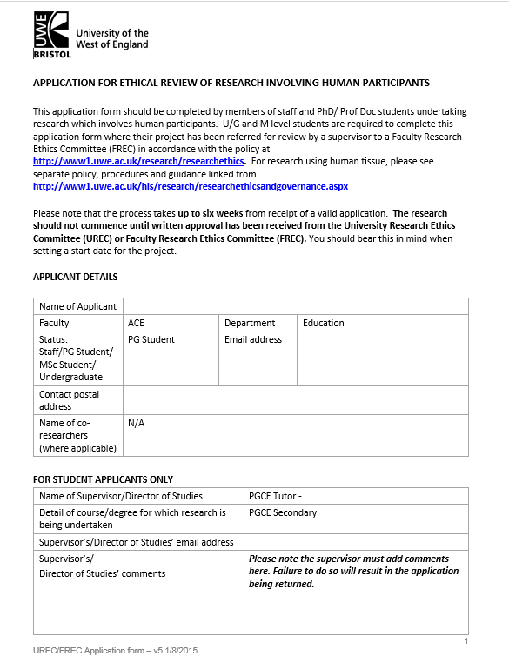
6. What is expected at the UWE Call Back Day on 23 November 2018?
Example of part of an annotated bibliography (500-750 words)
Bartlett, S. and Leask, M. (2009) Improving your teaching: an introduction to practitioner research, reflective practice and evidence-informed practice. In. Capel, S., Leask, M. and Turner, T. eds. (2009) Learning to Teach in the Secondary School A companion to school experience 5th ed. London: Routledge, pp. 300-309.
The authors stress the phrase ‘evidence-informed’ practice which moves the teacher beyond reflective practitioner and encourages their use of research and data to critically reflect on their teaching. The chapter helped me to understand why practitioners often use action research. The chapter introduced the range of data collection methods available to teacher researchers and clarified for me the importance of keeping a research diary or reflective journal during the research process as a source of data. The definitions of quantitative and qualitative data (p.306) led me to realise that the latter would be the main source of evidence in my small-scale enquiry. Additionally this chapter provided a useful table on ethical considerations which I adapted into a checklist to support my ethics statement in my proposal.
Black, P., Harrison, C., Lee. C., Marshall, B. and Wiliam, D. (2002) Working inside the Black Box Assessment for Learning in the Classroom London: nferNelson
This booklet was written based on research into assessment practices in six secondary schools in two local authorities and followed the Inside the Black Box (1998) publication. I found this booklet very accessible as it was aimed at classroom practitioners and presented strategies to support ‘Assessment for Learning’, for example approaches to questioning. Of particular relevance for my enquiry was the discussion about ‘open’ and ‘closed’ tasks and their relative inclusion in different subjects (p.17). In addition the final section of the booklet reinforced for me the importance of discussion with colleagues during the implementation of new initiatives and changes in practice. This prompted me to discuss my proposed intervention with the class teacher and subject mentor.
Word count 243 words (excluding titles)
PGCE and School Direct trainees will present their formative feedback and carry out further ethical approval at UWE Call Back Day on Friday 23 November 2018.

Slide 19
The Classroom Based Enquiry (CBE) Assignment
Key information for the CBE in 2018-19
4. Period of 3 weeks when trainees able to start data collection for research
(case study)
5. Wednesday 9 January 2019 Trainees submits 3,750 wc written assignment (CBE).
3. UWE Call Back Day Friday 23 November 2018 Trainees present their formative feedback and annotated bibliography and undergoes university’s ethical approval stage in order to collect data on return to placement.

Slide 20
7. Writing up the completed research – an introduction.
1. Introduction
2. Context
3. Literature Review
4. Methodology and Methods
5. Analysis
6. Evaluation
Appendices
Reference list
NB: Literature should be utilised throughout the assignment.

Slide 21
7. Writing up the completed research – an introduction.
Assessment Criteria: M Level
This assignment will be assessed against the following criteria:
ALM: Conceptual Domain (Core)
The assignment demonstrates that the student can use and organise coherently relevant ideas, perspectives or theories to interpret and/or explore issues under study. In addition, the student can critically analyse and/or evaluate those ideas, perspectives or theories showing the ability to synthesise and/or transform ideas in the process of developing an argument.
CLM: Contextual Domain
The assignment demonstrates that the student has an awareness of the significance of relevant contextual factors (e.g. personal, class, school, national and policy) influencing the area of study and is able to critically engage with the contextual significance.
DLM: Research Domain
The assignment demonstrates that the student can plan for and execute a small scale enquiry in a systematic and reflexive manner, identifying and explaining the research process and critically analysing and evaluating research outcomes.
You are required to meet all the criteria.

Slide 22
7. Writing up the completed research – an introduction.
1. Introduction- Clearly and succinctly explain the theme for your classroom-based enquiry and why you chose to investigate this area of your practice. Identify your precise research question.
2. Context – Explain how the research theme and research question are relevant and significant to the context of your professional development; this could include:
your personal professional development needs and your values (an autobiographical element);
the situational context within which you are placed (e.g. LA/ academy/ MAT/ subject/ class/ students);
the policy context, current initiatives that impact on this area of practice (National or within the school).
3. Literature Review – make sure that relevant literature relating to the theme of the research is drawn upon and critically engaged with to show you have an understanding of previous research in this area.

Slide 23
7. Writing up the completed research – an introduction.
4. Methodology and Methods
- Use of case study - Discuss the use of case study as appropriate to the situation or phenomenon being researched; acknowledge any challenges to/ or ambiguities around using case study).
- Methods of data collection - Discuss the methods used to collect data. What methods did you use to collect data during the research and why? How were ethical issues considered and addressed? Why did you choose these methods with reference to research literature?
5. Analysis - Provide an analysis of the data collected as part of this small-scale research. What does this data reveal about the theme being studied?

Slide 24
7. Writing up the completed research – an introduction.
6. Evaluation- Draw together the main findings from going through this classroom base enquiry process clearly identifying the impact for your professional practice. Evaluate the extent to which you have addressed your enquiry question. Critically review the strengths and limitations of the methods you used.
What implications will this small-scale research have for the students, school and/or on your practice). What recommendations might you make for other practitioners and/or what might you go on to try next?

Slide 25
The Classroom Based Enquiry (CBE) Assignment
Key information for the CBE in 2018-19
Trainees will be using a methodology of Case Study
Period of 3 weeks when trainees able to start data collection for research
(case study)
Completed CBE
3,750 wc
Wednesday 9 January 2019 Trainees submits 3,750 wc written assignment (CBE).
Between Monday 12th November and Wednesday 21st November 2018 trainees present research proposal and annotated bibliography to Senior Mentor for formative feedback.
UWE Call Back Day Friday 23 November 2018 Trainees present their formative feedback and annotated bibliography and undergoes university’s ethical approval stage in order to collect data on return to placement.

